Slide 1
PME Modernization
Update
COL Kevin E. McHugh, Commandant
Mr. Benjamin S. Valentine, Director of Education and Training
4 September 2024

Slide 2
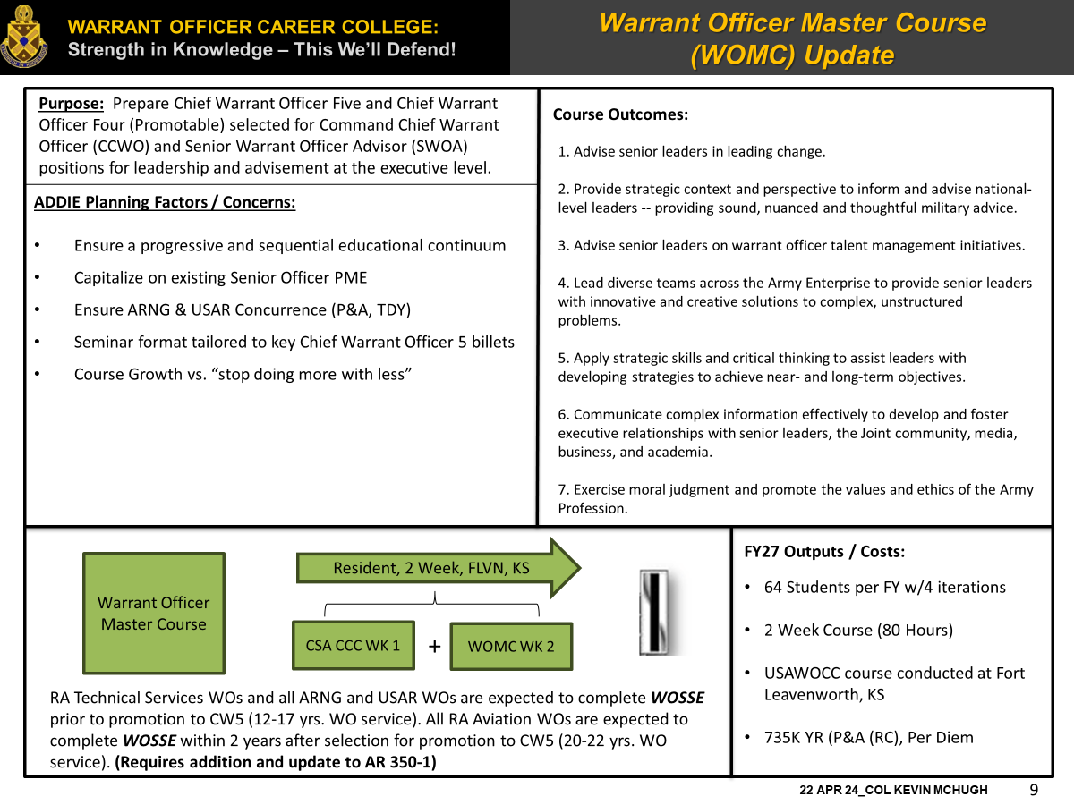
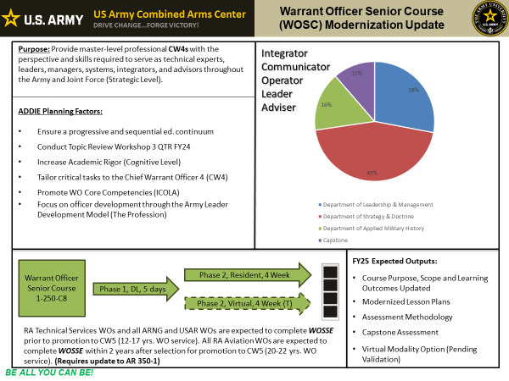
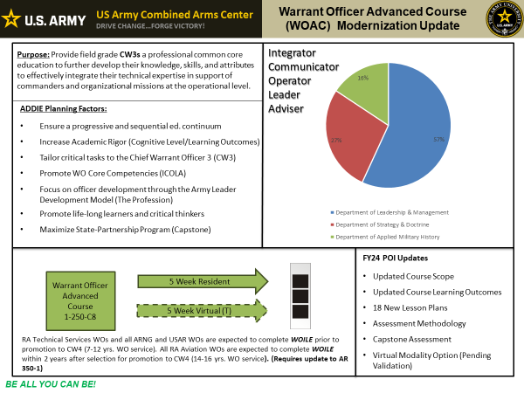
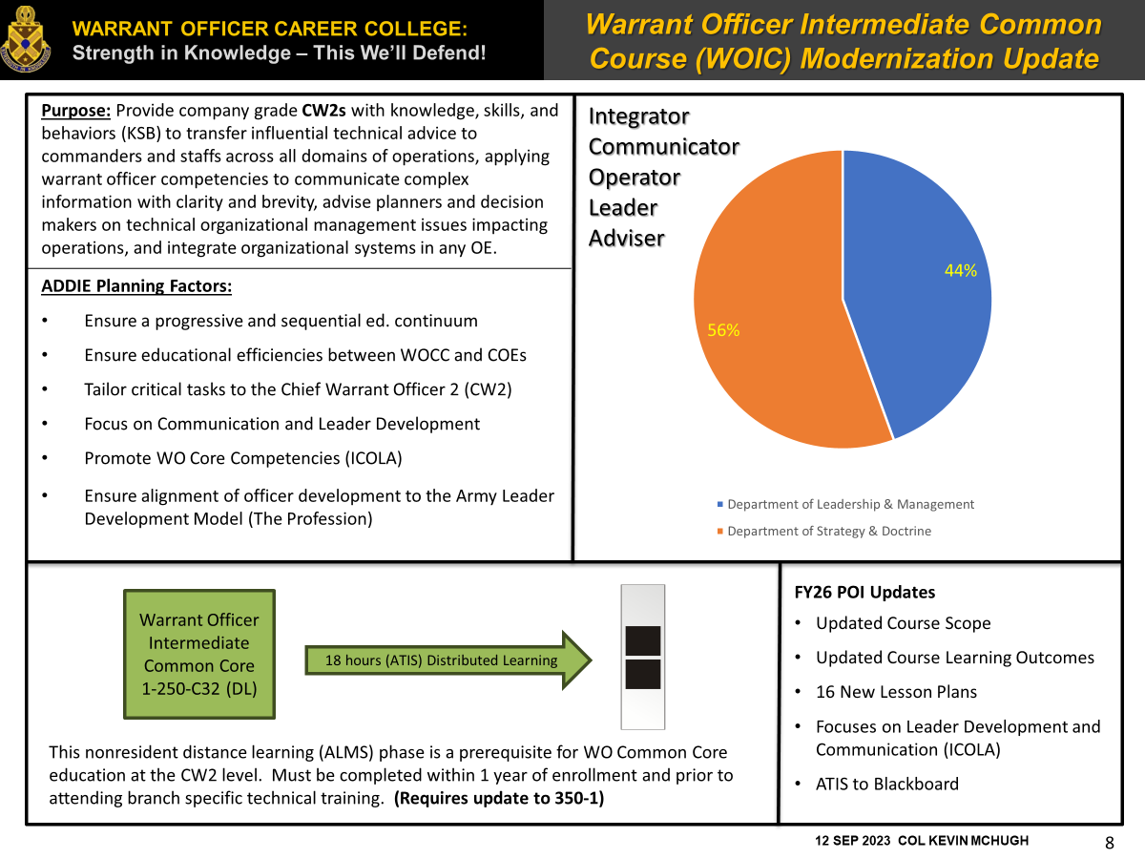
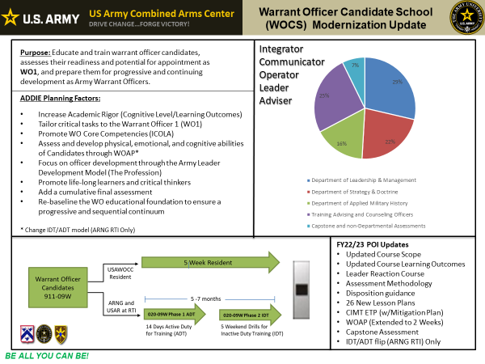

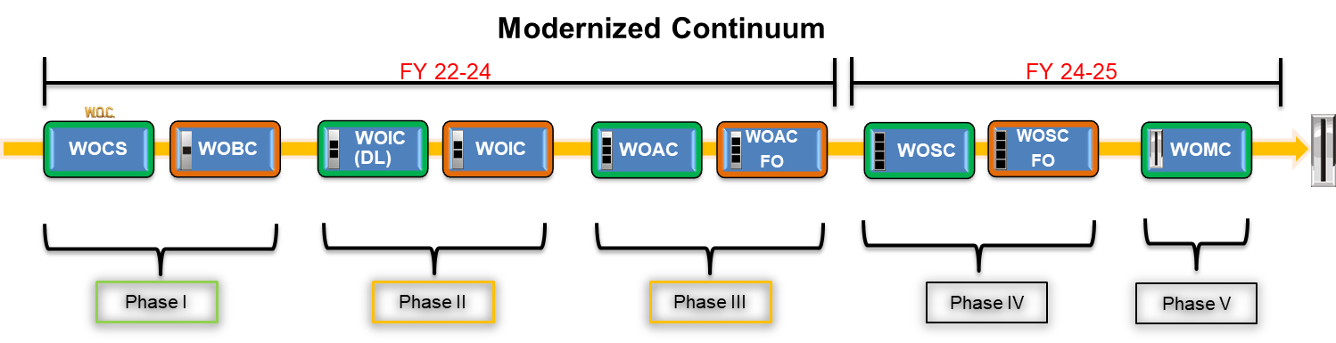
USAWOCC Modernization Update
Purpose: Create a modernized educational experience that develops critical common core knowledge, skills, and behaviors necessary for Army Warrant Officers to succeed as system Integrators, effective Communicators, doctrinally-based Operators, Leaders and Advisors thereby ensuring the success of the Army and Joint Force in any future operating environment.
ALA/GLOs
PHASE 3
PROGRESSIVE AND SEQUENTIAL EDUCATION

Slide 3





Warrant Officer Common Core Modernization Update (USAWOCC)
Modernized Continuum
FY 22-24
FY 24-25
WOCS
WOBC
WOIC (DL)
WOIC
WOAC
WOAC
FO
WOSC
WOSC
FO
WOMC
Phase I
Phase II
Phase III
Phase IV
Phase V
Technical Training – CAC / Centers of Excellence / Branches and Schools
Warrant Officer Common Core - USAWOCC
WOCS (WO1)
POI Approved 14 Sep
1 OCT, FY24 Implementation
Updated Purpose, Scope and Learning Outcomes (V.20)
All Compo concurrence
Tailored educational experience for the WO1
IDT/ADT Flip (ARNG RTI)
20.1 in progress, FY25
WOIC (CW2)
Course #: 1-250-C34
POI submission 1 JUL 25
FY26 implementation, 1 OCT 2025
ICTL Approved
Updated Purpose, Scope and Learning Outcomes (V.1.0)
ATIS Contract renewal for LP development
ATIS to Blackboard transition in review
WOAC (CW3)
Course #: 1-250-C35
POI submission 1 JUL 24
FY25 Implementation, 1 OCT 2024
ICTL Pending Approval
Updated Purpose, Scope and Learning Outcomes (V.1.0)
ADDIE Process Ongoing, Design 3rd QTR, FY24
WOSC (CW4)
Course #: 1-250-C36
POI submission 1 JUL 25
FY26 Implementation, 1 OCT 2025
Updated Purpose, Scope and Learning Outcomes (V.1.0)
ICTL Pending Approval
PILOT in FY25
WOMC (CW5)
ALCC approval ongoing
FY27 Implementation
Updated Purpose, Scope and Learning Outcomes (V.1.0)
ADDIE Process Ongoing
Tailored education for CCWO and SWOA “nominative” positions
PILOT in FY26

Slide 4
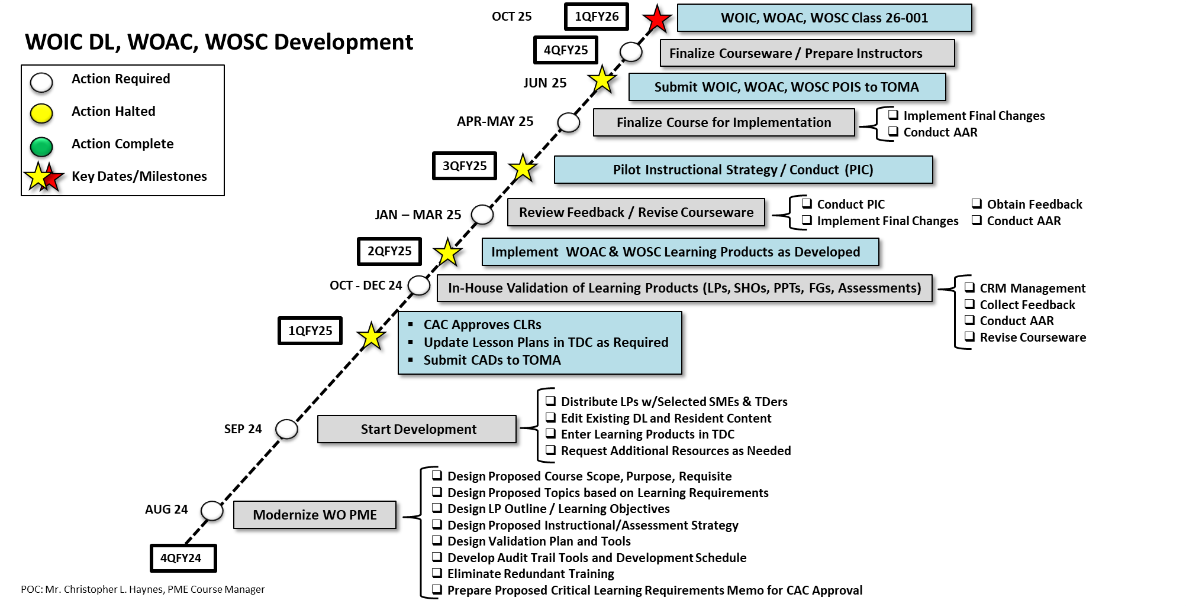
PME Modernization POAM

Slide 5
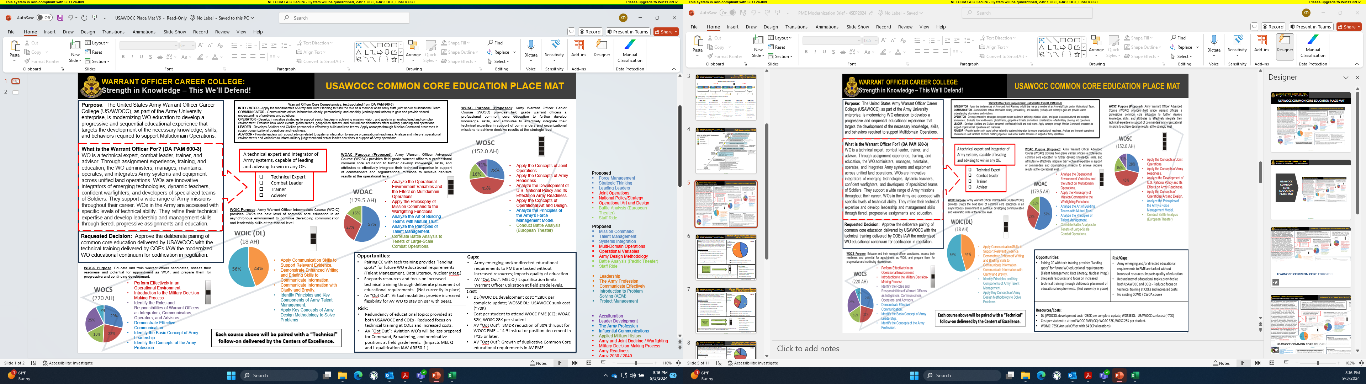
USAWOCC COMMON CORE EDUCATION PLACE MAT

Slide 6

Warrant Officer Intermediate Course (WOIC) DL Modernization
Purpose: Provides company grade warrant officers the advanced level common core education. WOIC prepares officers with the knowledge, skills, and behaviors required for assignment to CW3 positions at the tactical level as advisors to commanders and staffs to enhance warfighting lethality, deliver ready combat formations, continuously transform the organization, and steward the Army profession.
Integrator
Communicator
Operator
Leader
Adviser
FY 26
ADDIE Planning Factors:
Ensure a progressive and sequential ed. continuum
Ensure educational efficiencies between WOCC and COEs
Tailor critical tasks to the Chief Warrant Officer 2 (CW2)
Focus on Communication and Leader Development
Promote WO Core Competencies (ICOLA)
Ensure alignment of officer development to the Army Leader Development Model (The Profession)
Warrant Officer Intermediate Common Core
1-250-C34 (DL)
FY26 POI Updates
Updated Course Scope
Updated Course Learning Outcomes
16 New Lesson Plans
Focuses on Leader Development and Communication (ICOLA)
ATIS to Blackboard Transition
18 hours Distributed Learning
This nonresident distance learning (Blackboard) phase is a prerequisite for WO Common Core education at the CW2 level. Must be completed within 1 year of enrollment and prior to attending branch specific technical training. (Requires update to AR 350-1)
6
22 APR 24 col kevin mchugh

Slide 7

Warrant Officer Advanced Course (WOAC) Modernization Update
Purpose: Prepares officers with the KSBs required for assignment to CW4 positions at the operational level as advisors to commanders and staffs to enhance warfighting lethality, deliver ready combat formations, continuously transform the organization, and steward the Army profession. at the operational level.
Integrator
Communicator
Operator
Leader
Adviser
FY 26
ADDIE Planning Factors:
Ensure a progressive and sequential ed. continuum
Increase Academic Rigor (Cognitive Level)
Tailor critical tasks to the Chief Warrant Officer 3 (CW3)
Promote WO Core Competencies (ICOLA)
Focus on officer development through the Army Leader Development Model (The Profession)
Promote life-long learners and critical thinkers
Maximize State-Partnership Program (Capstone)
FY24 POI Updates
Updated Course Scope
Updated Course Learning Outcomes
18 New Lesson Plans
Assessment Methodology
Capstone Assessment
Virtual Modality Option
6/2 Adult Learning Model
Warrant Officer Advanced Course
1-250-C35
5 Week Resident
5 Week Virtual
WOs are expected to complete course prior to promotion to CW4 (7-12 yrs. WO service). Up to four courses offered in a virtual format. (Requires update to AR 350-1)
7
22 APR 24 col kevin mchugh

Slide 8

Warrant Officer Senior Course
(WOSC) Modernization Update
Purpose: Prepares officers with the knowledge, skills, and behaviors required for assignment to CW5 positions at the strategic levels as advisors to commanders and staffs to enhance warfighting lethality, deliver ready combat formations, continuously transform the organization, and steward the Army profession.
Integrator
Communicator
Operator
Leader
Adviser
FY 26
ADDIE Planning Factors:
Ensure a progressive and sequential ed. continuum
Conduct Topic Review Workshop 3 QTR FY24
Increase Academic Rigor (Cognitive Level)
Tailor critical tasks to the Chief Warrant Officer 4 (CW4)
Promote WO Core Competencies (ICOLA)
Focus on officer development through the Army Leader Development Model (The Profession)
Warrant Officer Senior Course
1-250-C36
FY25 Expected Outputs:
Course Purpose, Scope and Learning Outcomes Updated
Modernized Lesson Plans
Assessment Methodology
Capstone Assessment
5/3 Adult Learning Model
Phase 1, DL, 5 days
Phase 2, Resident, 4 Week
WOs are expected to complete course prior to promotion to CW5 (12-17 yrs. WO service). (Requires update to AR 350-1)
8
22 APR 24 col kevin mchugh

Slide 9

Warrant Officer Master Course
(WOMC) Update
Purpose: Prepares Chief Warrant Officer Five and Chief Warrant Officer Four (Promotable) selected for Command Chief Warrant Officer (CCWO) and Senior Warrant Officer Advisor (SWOA) positions for leadership and advisement at the executive level.
Course Outcomes:
FY 27
1. Advise senior leaders in leading change.
2. Provide strategic context and perspective to inform and advise national-level leaders -- providing sound, nuanced and thoughtful military advice.
3. Advise senior leaders on warrant officer talent management initiatives.
4. Lead diverse teams across the Army Enterprise to provide senior leaders with innovative and creative solutions to complex, unstructured problems.
5. Apply strategic skills and critical thinking to assist leaders with developing strategies to achieve near- and long-term objectives.
6. Communicate complex information effectively to develop and foster executive relationships with senior leaders, the Joint community, media, business, and academia.
7. Exercise moral judgment and promote the values and ethics of the Army Profession.
ADDIE Planning Factors / Concerns:
Ensure a progressive and sequential educational continuum
Capitalize on existing Senior Officer PME
Ensure ARNG & USAR Concurrence (P&A, TDY)
Seminar format / Style Education
Tailor education for 208 Nominative CCWO / SWOA positions
Course Growth vs. “stop doing more with less”
Identify feasible bill-paying options (internal and external)
Outputs / Costs:
64 Students per FY w/4 iterations (209.8 Hours/yr; 36 ICH, 10 IAH= Instr. +0.1)
2 Week Course (80 Hours) conducted @ FTLV, KS (USAWOCC Course)
P&A and Per Diem = $735K Annually
Cost offset is 64/150 “unused” seat allocations for CSA CCC to USAWOCC WOMC
Requires Classroom / ECP utilization
Warrant Officer Master Course
Resident, 2 Week, FTLV, KS
CSA CCC WK 1
+
WOMC WK 2
CCWO / SWOA
CW5s and CW4(P)s selected to serve in nominative positions explore the interpersonal aspects of leadership and how these skills change at the executive level, solving complex problems in ambiguous environments with creativity, innovation, and self-knowledge, understanding how warrant officers at executive levels operate and negotiate as an advisor and leader in a variety of contexts. (Requires addition to AR 350-1)
9
22 APR 24 col kevin mchugh

Slide 10
Endstate
Endstate
Technically and tactically competent Warrant Officers are critical to system integration and operational success. To develop the best integrators and leaders, USAWOCC must develop and deliver meaningful and effective learning experiences across multiple modalities that advance strategic learning goals.

Slide 11
Questions
Questions

