Slide 1

Hawaiʻi State Hazard Mitigation Forum
3nd Quarterly Meeting of 2022
08/23/2022

Slide 2
Call to Order
VOTING MEMBERS
Danielle Bass
  State Planning Office, Sustainability Coordinator
Jim Buika
  Costal Resource Planner, Maui County
Jonathan Chin
  Resilience and Energy Assurance, Maui County Planning
Pao-Shin Chu
  State Climatologist, University of Hawaii
Jimmie Collins
  Senior Planner, Hawaii Office of Homeland Security
Pam Eaton
  Administrator, Maui County Long Range Planning Division
Diana Felton
  State Toxicologist, State Department of Health
Eduardo Manglallan
  Deputy Director, Harbors Division, State Dept. of Transportation
Michael Moule
  Chief of Engineering, County of Kauai, Department of Public Works
Bethany Morrison
Long Range Planning Division, County of Hawaii, Planning Department
Raelynn Nakabayashi
  Honolulu Board of Water Supply, Executive Support Office
Tara Owens
  University of Hawaii, Sea Grant College Program
Barry Periatt
  Hawaii County, Civil Defense Agency
Genevieve Sullivan
  State Department of Transportation, Highways Division
April Suprenant
  Acting Deputy Director, Planning Department, County of Hawaii, Administration Division
17. Jan TenBruggencate
  Consultant, Island Strategy LLC
Michael Walker
  State Protection Forester, Division of Forestry & Wildfire
Lisa Webster
  Project Analyst, Coastal Zone Management Program
Hawaiʻi Emergency Management Agency

Slide 3
Agenda - Morning
  Opening remarks
  Introductions
  Strength, Weaknesses, Opportunities, and Threat (SWOT) Results
  Present new mitigation action: Resilience Hubs
  Building Resilient Infrastructure and Communities (BRIC) update
  Hazard Mitigation Grant Program (HMGP) update
  Flood Mitigation Assistance (FMA) update
  Working Lunch
Hawaiʻi Emergency Management Agency

Slide 4
Opening Remarks & Introductions
Administrator’s remarks, Luke Meyers
Forum Chair’s remarks, David Kennard
Introduce HI-EMA Disaster Recovery Specialist, Amber Ternus
Introduce HI-EMA Acting State Hazard Mitigation Officer, Kelsey Yamanaka
Hawaiʻi Emergency Management Agency

Slide 5
Vice Chair Nominations
Collect nominations
Majority vote needed for confirmation
Hawaiʻi Emergency Management Agency

Slide 6
Strength, Weaknesses, Opportunities & Threat (SWOT) Results
What areas does the Forum excel in?
What areas does the Forum need improvement in to meet its mission and enhance its services?
What external factors create a growing need for the Forum’s mission and services?
What external factors could harm/hinter the Forum’s mission and services?
SWOT Memo
Hawaiʻi Emergency Management Agency

Slide 7
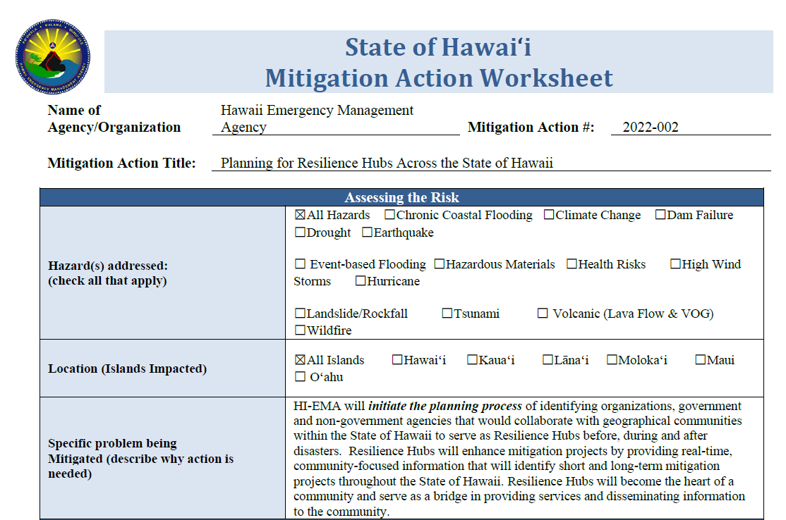
New Mitigation Actions
Resilience Hubs presentation, Francis Kau
Mitigation Action Worksheet
Hawaiʻi Emergency Management Agency

Slide 8
BRIC FY20 & FY21 Update
FY20 Awarded Projects
  Honolulu Board of Water Supply: Emergency Power Master Plan - $75K
  KCC/DOE: Microgrid at Kaimuki Middle School and Capacity Building - $375K
  City & County of Honolulu, OCCSR: Project Scoping Options for SLR - $150K
FY21 “Identified for Further Review – Round 1”
  Dept. of Transportation, Airports: Microgrids and Transportation Resilience Hubs - $475K
  City & County of Honolulu, DPP: Kapalama Canal Flood Control - $300K
  City & County of Honolulu, OCCSR: LHMP Update - $200K
FEMA’s BRIC FY21 Subapplication and Selection Status website
Hawaiʻi Emergency Management Agency
Notes:
FEMA’s FY21 BRIC Subapplication Status website: https://www.fema.gov/grants/mitigation/building-resilient-infrastructure-communities/after-apply/fy-2021-subapplication-status

Slide 9
BRIC FY 2022 NOFO
State Set-Aside: Capability & Capacity Building (C&CB) Activities
  $2 million cap
  Building Codes
  Mitigation Planning – up to 50% of set-aside allocation ($1 Million)
  Project Scoping
  Partnerships
Management Costs
  Up to 5% of total project costs can be used for grant management
Application opens 9/30/22
Application closes 1/27/23 at 9AM HST
National Competition: Mitigation Projects
  Up to $50 million per project
  Construction and hardening of critical infrastructure
  Phased projects (P1 A&E, P2 Construction)
NOFO
NOFO Fact Sheet
Hawaiʻi Emergency Management Agency

Slide 10
BRIC FY 2022
Current challenges: BCEGS, building codes
  Qualitative and Technical Criteria
  Coco Palms FY21 Qualitative Review Memo
HI-EMA’s priorities for FY22 set aside: BCEGS, building codes, and nature-based solutions
  Resource: FEMA’s Building Code Adoption Playbook
Hawaiʻi Emergency Management Agency
Notes:
HI-EMA has asked FEMA R9 for clarification on how the figures in the FY21 BRIC Qualitative Review Memo were calculated. Clarify that if projects didn’t make it past the qualitative review, it wasn’t sent to the technical review panel.

Slide 11





BRIC Annual Cycle
August
Notice of Funding Opportunity (NOFO) released August 12.
Notice of Intent (NOI) due to HI-EMA by 9/30/22 with project description, budget and work schedule.
Sept - Dec
Subapplication development for eligible projects.
Subapplication package submission to HI-EMA by 12/15/22.
September
January
July
HI-EMA submits application package to FEMA by January 27, 2023 at PM EST
Awarded applications announced and project Period of Performance (36 months) begins.
BRIC Notice of Intent Form
Applications & Supporting Documentation
BRIC Mitigation Action Portfolio
Hawaiʻi Emergency Management Agency

Slide 12
HMGP DR-4510
DR-4510 project status
90/10 cost share adjustment – FEMA released information sheet
Important deadlines
  Round 1 final subapplications due to HI-EMA – October 5, 2022
  Application period closes – February 1, 2023
Hawaiʻi Emergency Management Agency

Slide 13
FMA FY 2022 NOFO
Application opens 9/30/22
Application closes 1/27/23 at 9AM HST
Up to $800 million available
Three FEMA funding priorities:
  Capacity and Capability-Building
  Localized Flood Risk Reduction Projects
  Individual Flood Mitigation Projects
Hawaiʻi Emergency Management Agency
Notes:
C&CB – state and local mit plans, tech assistance, project scoping to help develop local and individual flood mitigation projects,
Localized (previously called community flood mit proj) and individual flood mit projects
Usual 75% fed, 25% non-fed, unless benefitting community scores a low enough on the CDC’s SVI
- Individual flood mit projects, 90% for RL and 100% for SRL

Slide 14
FMA FY 2022
HI-EMA’s goal: develop competitive projects for FMA national competition
  Strategy: identify SRL/RL communities and support project development in those areas
    Objective 1: collaborate with State DLNR and County Floodplain Managers
    Objective 2: set up regular meetings between SHMO, NFIP Coordinator, and County Floodplain Managers
Hawaiʻi Emergency Management Agency
Notes:
Collaborate with DLNR and county floodplain managers to identify communities most at risk
Set up quarterly meetings with DLNR county floodplain managers HM

Slide 15
Working Lunch
12:00pm – 12:45pm

Slide 16
Agenda - Afternoon
  Working Lunch
  2023 State Hazard Mitigation Plan (SHMP) calendar coordination
  Review SHMP update timeline
  BATool and Story Map overview
  Verify subject matter expert (SME) list
  Closing comments
  Adjournment
Hawaiʻi Emergency Management Agency

Slide 17
2023 SHMP Calendar Coordination
Future Forum meeting schedule (9am – 2:30pm)
  October 12, 2022 (extra meeting dedicated to SHMP update)
  November 30, 2022
  March 1, 2023
  June 7, 2023
  August 30, 2023
  November 29, 2023
Public outreach meetings
  Tentatively week of December 12, 2022
Virtual Baseline Assessment Tool (BATool) training
  Tuesday, August 30 from 10am – 11am
Hawaiʻi Emergency Management Agency

Slide 18
Review SHMP Update Timeline
Tetra Tech roles and deliverables
Capability assessment
Goals and strategies
Tetra Tech schedule
Hawaiʻi Emergency Management Agency

Slide 19
BATool & Storymap Overview
BATool: mitigation action progress reporting platform
Kauai County Story Map example
OPSD CZM example
Hawaiʻi Emergency Management Agency

Slide 20
Verify Subject Matter Experts
Roles and responsibilities
Contact Information
Secondary SME’s
SME survey results
Hawaiʻi Emergency Management Agency

Slide 21
Closing Comments
Forum Chair’s closing comments, David Kennard
Administrator’s closing comments, Luke Meyers
Hawaiʻi Emergency Management Agency
Notes:
If you want to add an item on the next quarterly meeting agenda, submit your request to DK by November 15, 2022.

Slide 22
Mahalo nui loa

