Slide 1
ECOMP For National Guard Technician Employees

Slide 2
ECOMP
This training will provide employees with the steps necessary to submit OSHA-301 forms and CA-1/CA-2 forms using the Department of Labor application ECOMP.

Slide 3
ECOMP
ECOMP is a Department of Labor application that will allow DOD to file OSHA-301, CA-1, CA-2, and CA-7 forms electronically.
ECOMP will be replacing the current EDI method DOD uses to file claims electronically.
This switch will affect employees, supervisors, injury comp specialists, and safety personnel.

Slide 4
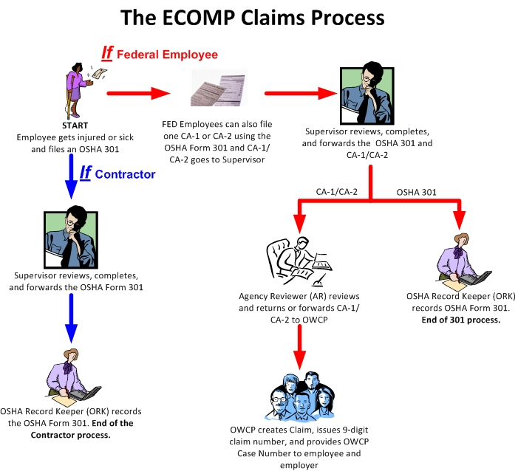
ECOMP’s Workflow
National Guard has elected to use the option to file OSHA-301 forms using ECOMP as a notice of workplace injury or illness.

Slide 5
Benefits of using ECOMP
Employee can file a claim from home and submit to their supervisor. They do not have to use a computer at work or sit with their supervisor in order to file a claim.
Documents supporting the claim can be uploaded at the time the claim is entered by the employee. This means that crucial information will be seen by the Claims Examiner when the claim is submitted, speeding up adjudication of the claim.
Employees can log into ECOMP and view and print copies of claim forms when necessary.

Slide 6
Benefits of using ECOMP
Employees can check status of claim submission and will receive claim numbers when assigned by DOL.
Claim numbers are received more quickly from DOL allowing medical providers to bill OWCP and thus reduce any problems when providers want to initially submit bills after treatment.

Slide 7
Alternate methods of filing
If a claim cannot be filed by the employee using ECOMP, there are alternate methods of filing the claim with DOL.
  The agency can elect to have agency personnel (Injury Compensation Specialist) file a claim on behalf of an employee. This will be an agency decision and will most likely be done on a case by case basis that is dependent upon specific circumstances.
  Hard copy claim form can be processed through the agency and sent to DOL.

Slide 8
Employee Registration
Employees must first register and create an account in ECOMP in order to file a claim. During registration, the employee will select their Department/Agency/Duty Station & enter Supervisor E-mail address.
Employee uses the Internet at any computer to access the ECOMP URL www.ecomp.dol.gov
They can then use this account whenever they file subsequent claims using a User ID and Password established when they register.

Slide 9
Employee Registration
The application guides the employee through the process for ease of use.
Passwords can be reset using security questions set up during registration so employees do not have to worry about forgotten passwords.
Employees can use their home computer, if they so desire, to file the required forms.

Slide 10

The employee will click on the Sign in/Register button to start the registration process

Slide 11
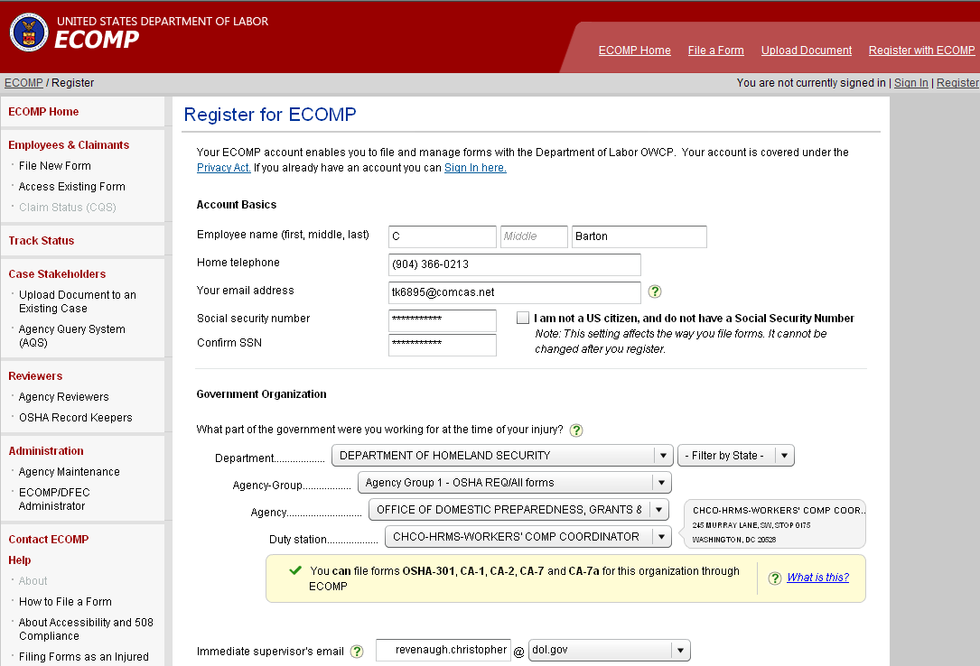
Employee Registration
The employee will then enter information to create their account. This information will include their name, phone, SSN, and email address where they want any claim notifications to be sent. They will also select their duty station from a series of dropdowns and enter their immediate supervisors email address. This email address will determine where any claims submitted by the employee will be sent for supervisory review.
Joe
Employee
(123) 456-7890
(123) 456-7890
Joe.Employee@gmail.com
Supervisor

Slide 12
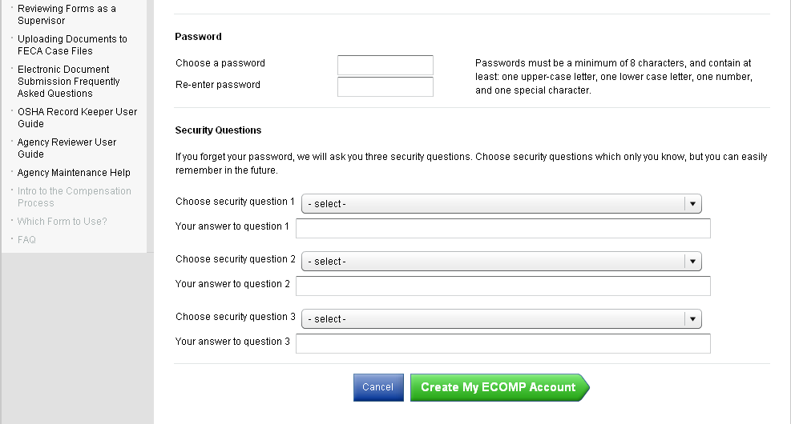
Employee Registration
The employee then creates a password that will be used to access ECOMP and a series of three security questions which will be used to allow the employee to reset their password should the need arise.

Slide 13
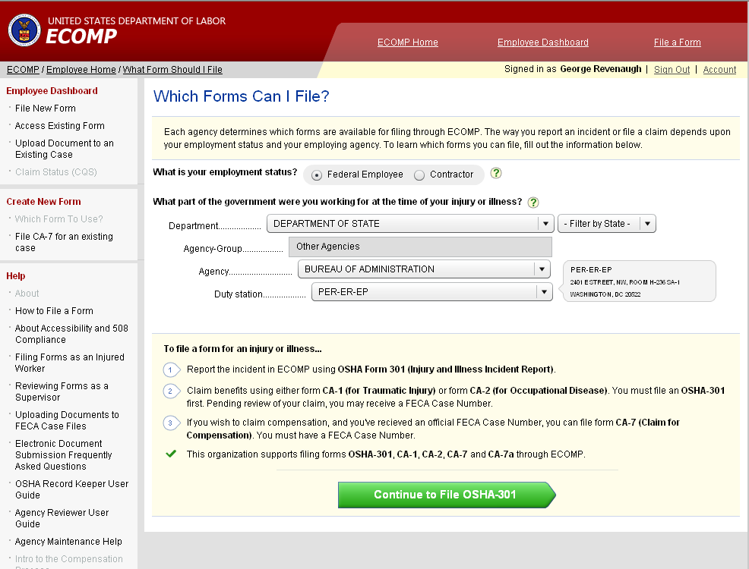
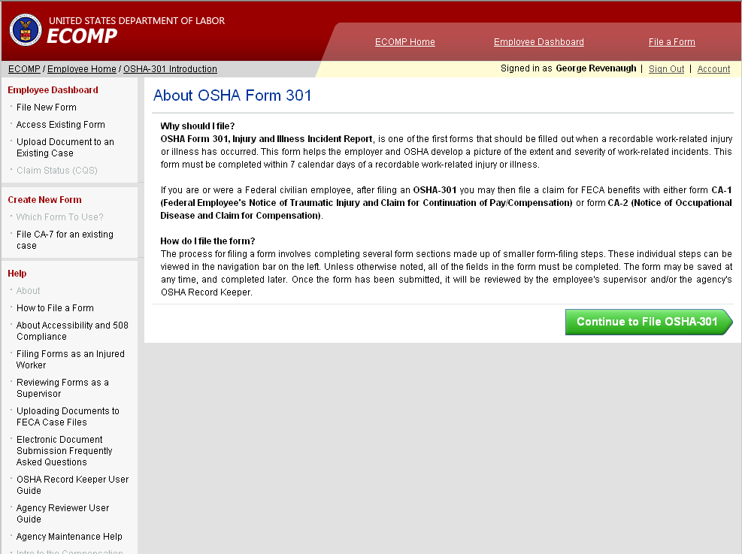
Filing an OSHA 301: Employee Portion
Once the employee sets up their account they can then file a claim. ECOMP will notify the employee which claims can be filed. All DOD employees will be allowed to file CA-1, CA-2, CA-7, and CA-7a forms. If the OSHA-301 will be filed through ECOMP it will appear on the list of enabled forms in the bottom part of the screen
Joe Employee

Slide 14
Filing an OSHA 301: Employee Portion
Joe Employee
For National Guard Technician employees the OSHA-301 will need to filled out by the employee and submitted before they will be allowed to file a CA-1 or CA-2 form.
Once the OSHA-301 is filed it will have no further effect on the CA-1/CA-2 filing. A delay in processing the OSHA form will not delay submission of the CA-1 or CA-2

Slide 15
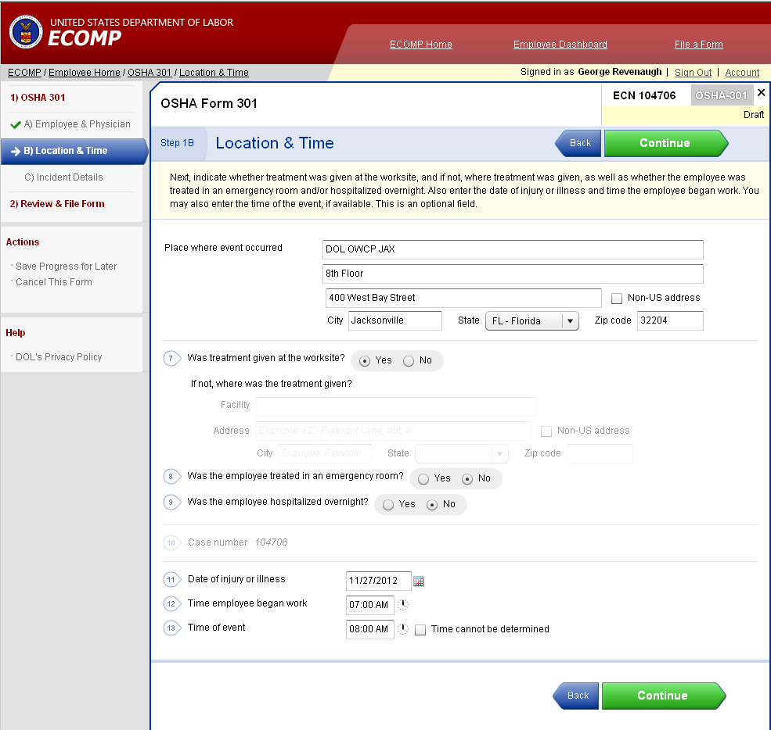
Filing an OSHA 301: Employee Portion
Joe Employee
The employee will be guided through the filing process.

Slide 16
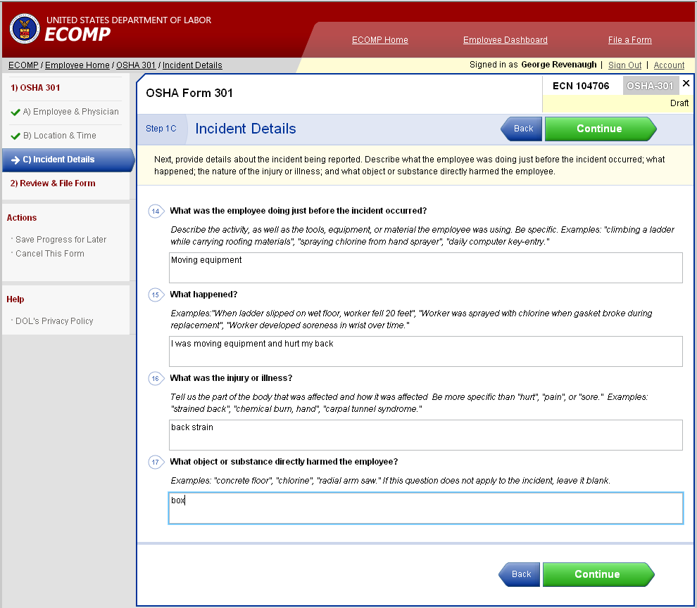
Filing an OSHA 301 : Employee Portion
Joe Employee

Slide 17
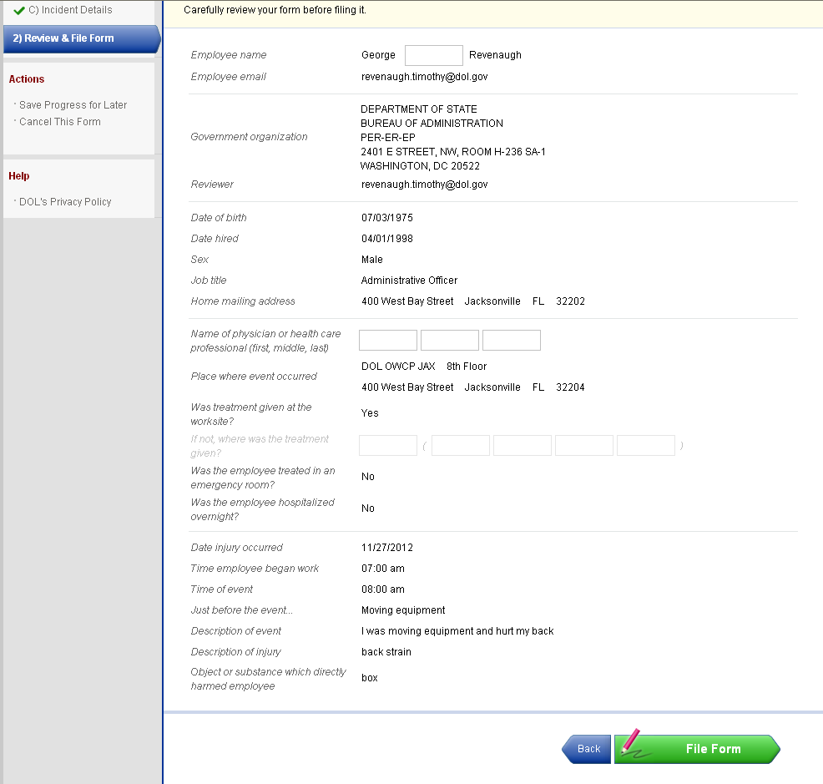
Filing an OSHA 301 : Employee Portion
Joe
Employee
Before the OSHA-301 form is submitted the employee will be given a chance to review the information on the form. If the employee is satisfied with the information then it can be forwarded by clicking on the File Form button at the bottom of the screen. If changes need to be made then the employee can move back through the form to make the necessary changes.
Joe.Employee@gmail.com
Supervisor

Slide 18
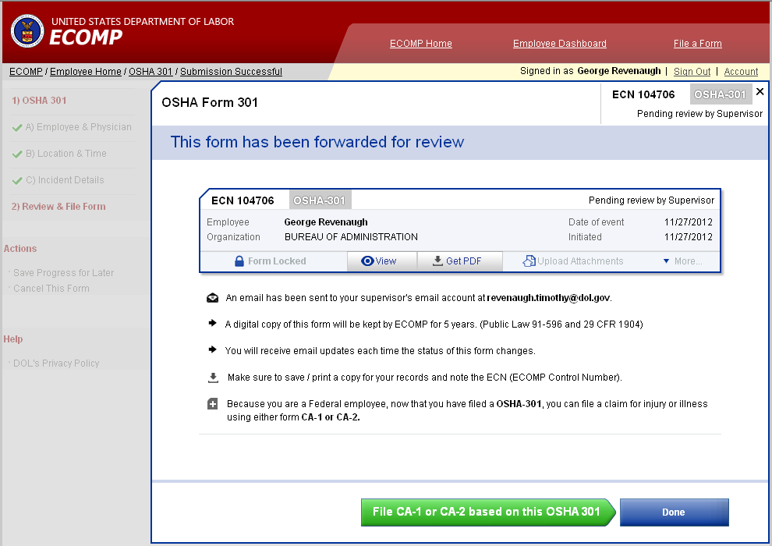
Filing an OSHA 301 : Employee Portion
Joe Employee
Once the OSHA-301 has been forwarded, the employee will see it on their dashboard. They will then be given the opportunity to continue to file a CA-1 or CA-2 injury or illness claim based upon the incident documented on the OSHA-301 or exit ECOMP.
Joe Employee
Supervisor

Slide 19
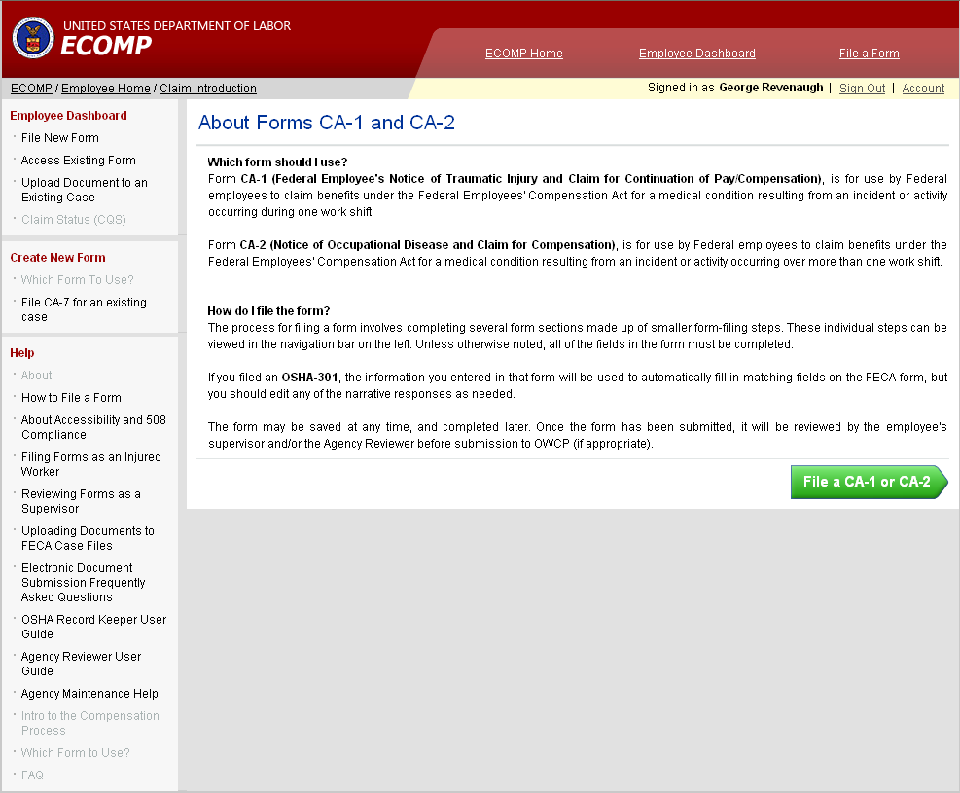
Filing a CA-1 or CA-2: Employee Portion
Joe Employee
A screen will display providing information on when to file a CA-1 or CA-2 to allow the employee to file the correct form. Clicking File a CA-1 or CA-2 will start the process.

Slide 20
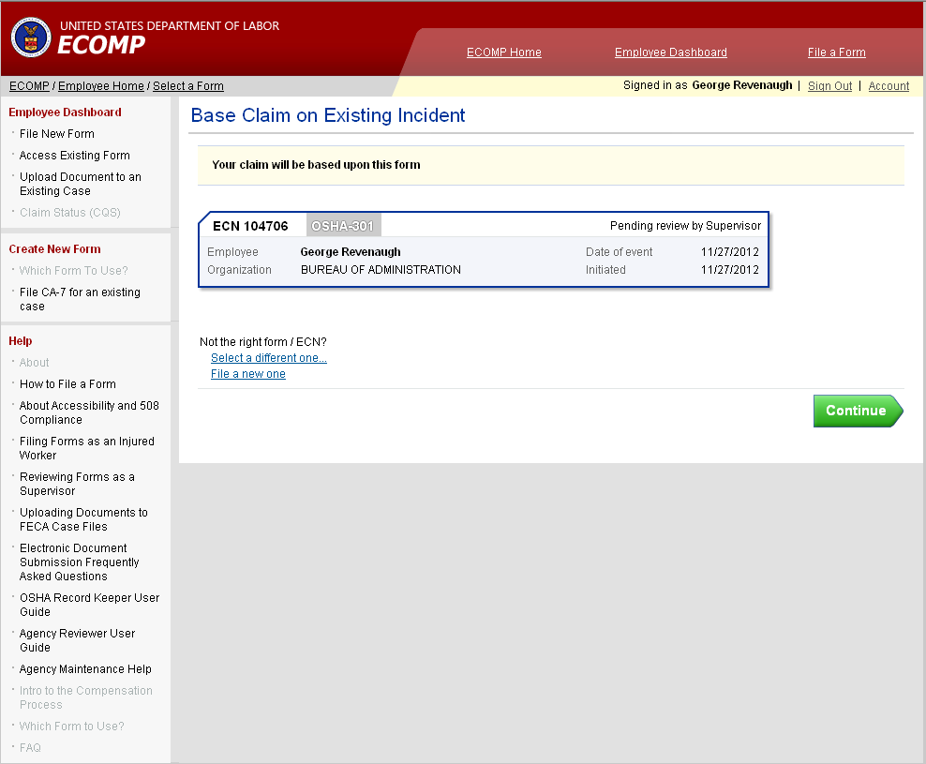
Filing a CA-1 or CA-2: Employee Portion
Joe Employee
Joe Employee
If this is the only OSHA-301 on the employee dashboard then the employee clicks Continue. If there is more than one OSHA-301 form on the dashboard, the employee can select which OSHA-301 will be used as the basis for the FECA claim.

Slide 21
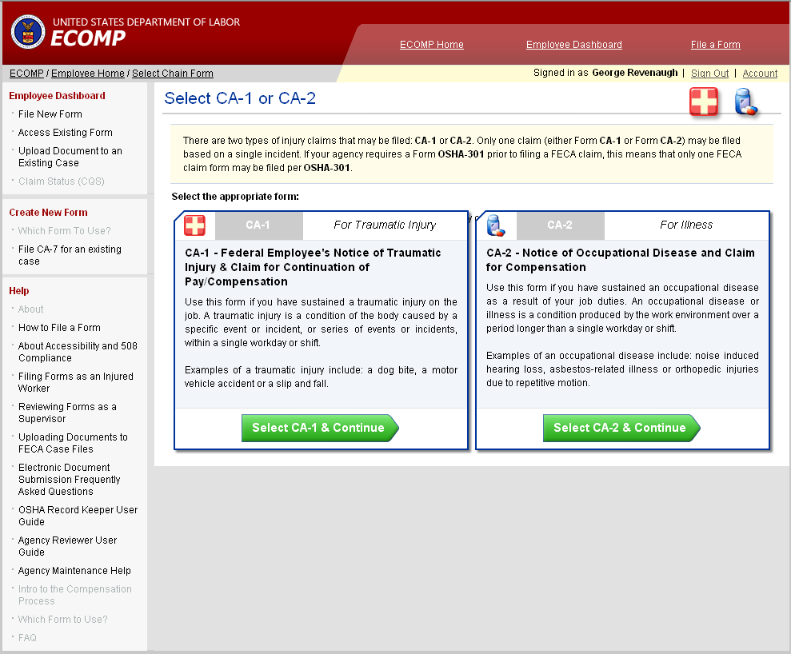
Filing a CA-1 or CA-2: Employee Portion
Joe Employee
OR
The employee then selects the type of form to be filed.

Slide 22
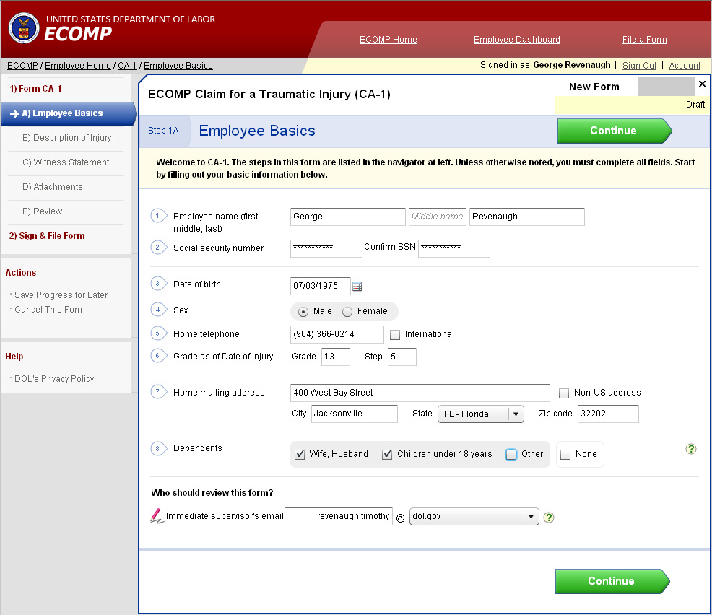
Filing a CA-1 or CA-2: Employee Portion
Joe Employee
The employee will then be guided through the filing process. Information entered into the OSHA-301 that can be used on the CA form will automatically flow to the CA form thus eliminating the need to enter duplicate information

Slide 23
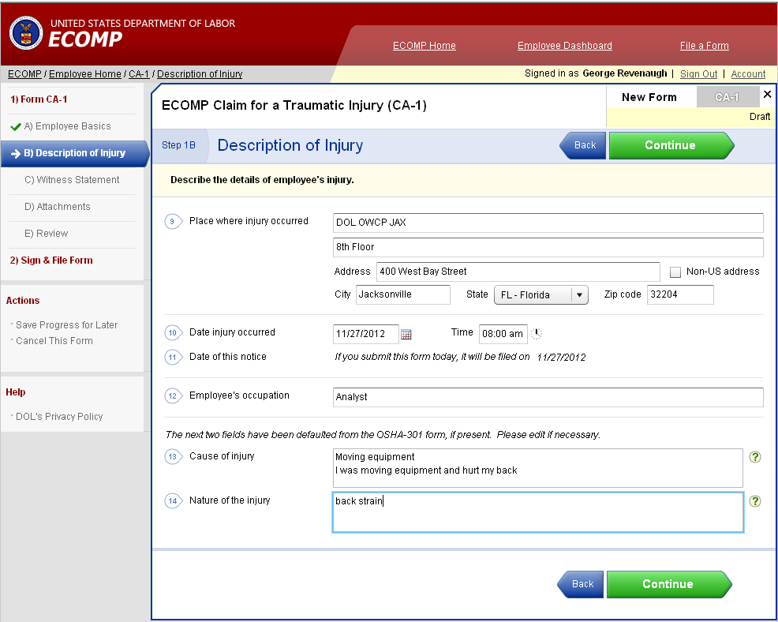
Filing a CA-1 or CA-2: Employee Portion
Joe Employee
Clicking Continue will move the employee through the form

Slide 24
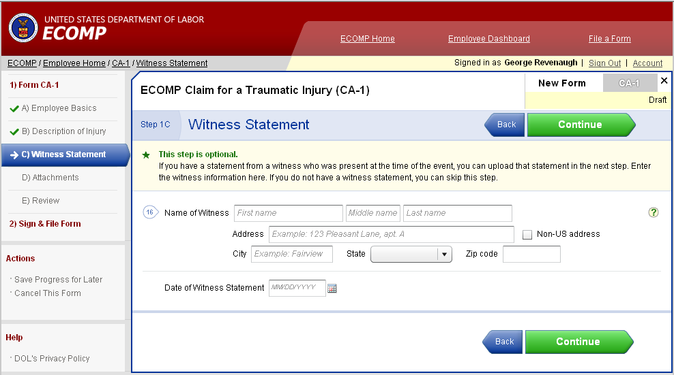
Filing a CA-1 or CA-2: Employee Portion
Joe Employee
A witness statement is not required. If a witness statement was made, the witness information can be entered here and the actual statement uploaded into the system to be included with the claim submission.

Slide 25
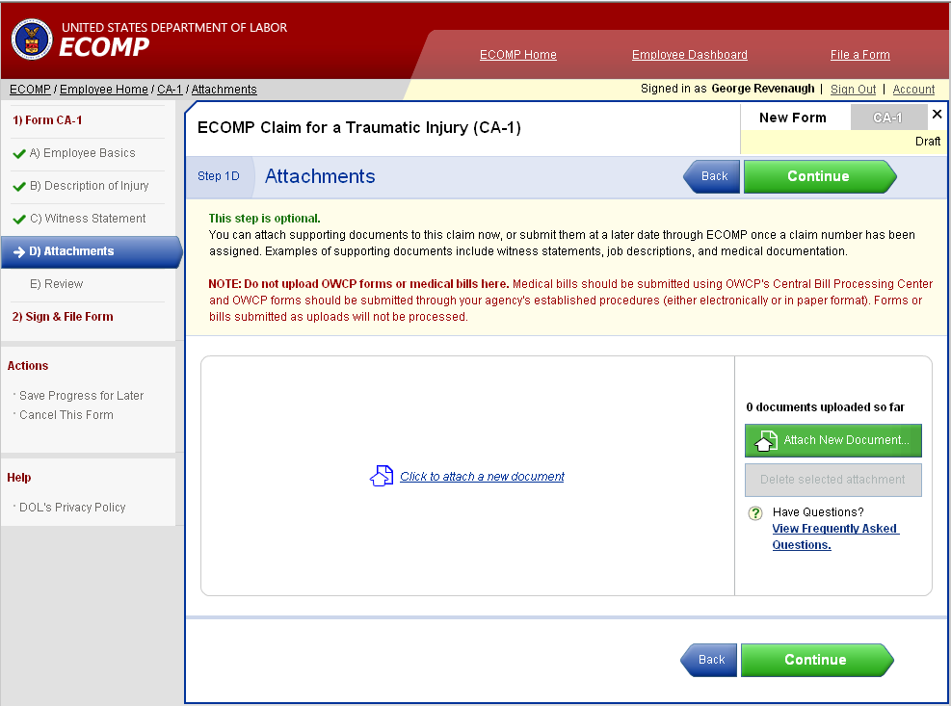
Filing a CA-1 or CA-2: Employee Portion
Joe Employee
All documents that the employee wishes to include with their initial claim submission can be uploaded here. This is not the only time that the employee can submit documents to OWCP. It is, however, the only opportunity to initially submit documents with the claim filed through ECOMP.

Slide 26
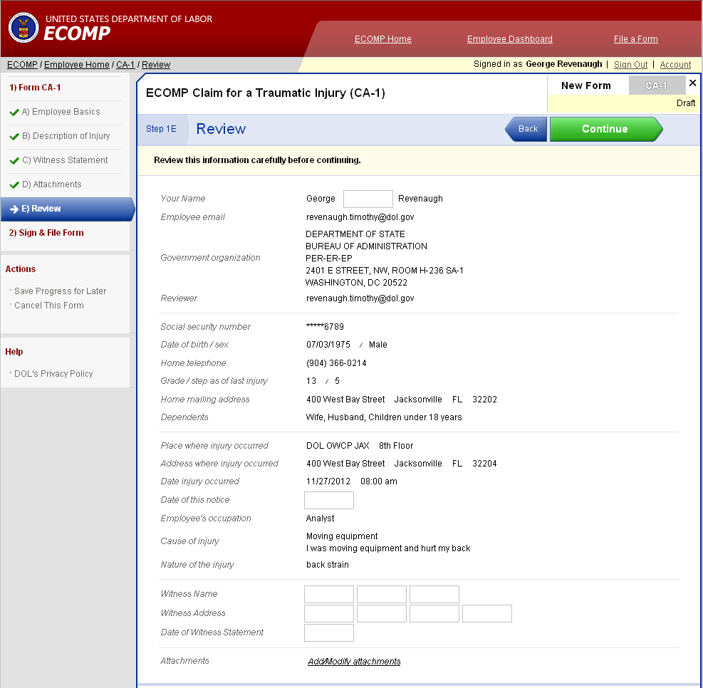
Filing a CA-1 or CA-2: Employee Portion
Joe Employee
When the employee has completed filling in the required information they will be allowed the opportunity to review the information entered. If information needs to be changed the employee can go back and change it.
If a required field is missing, a notification will appear on the screen.

Slide 27
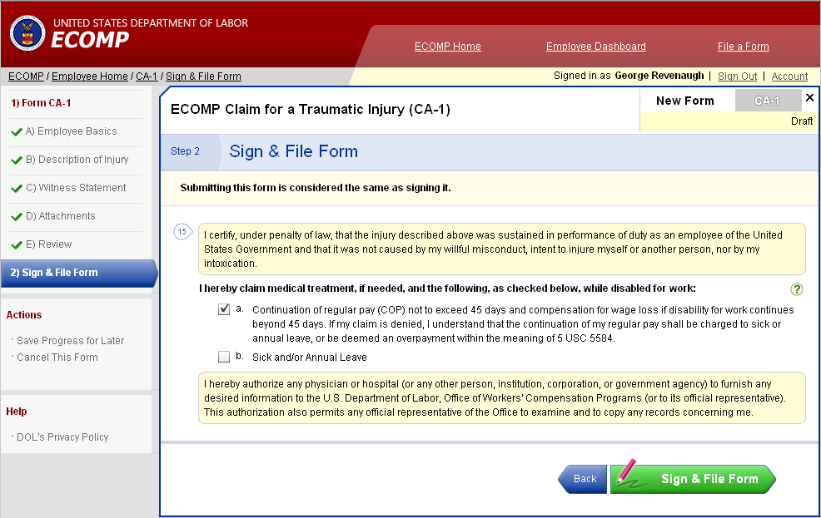
Filing a CA-1 or CA-2: Employee Portion
Joe Employee
The last step in the process is to sign the form and file. A hard copy form with the employee’s and supervisor’s signature is required to be maintained by the agency. Obtaining the signatures on the hard copy form will not delay the electronic filing of the claim form.

Slide 28
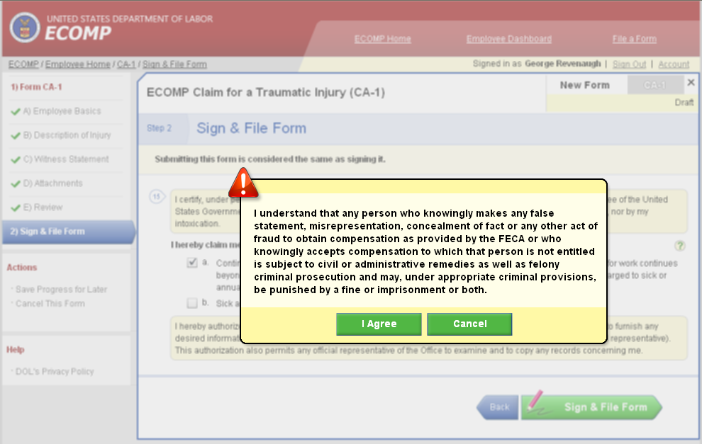
Filing a CA-1 or CA-2: Employee Portion
Joe Employee
The employee will then click I Agree

Slide 29
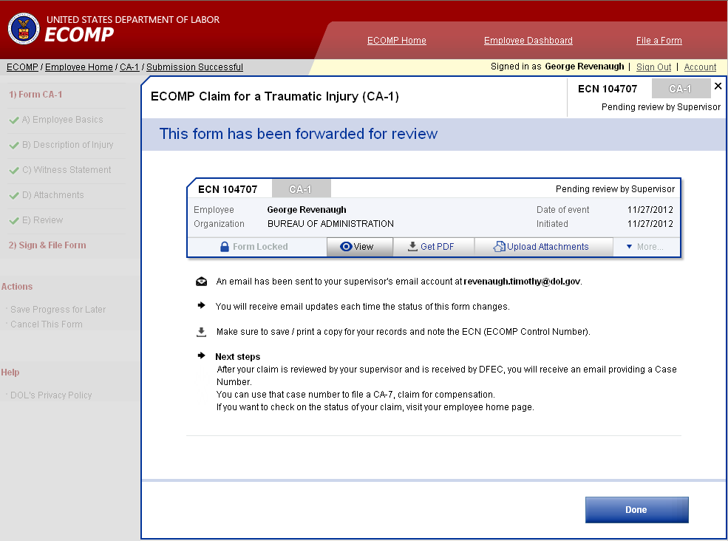
Filing a CA-1 or CA-2: Employee Portion
Joe Employee
Joe Employee
The employee then can see the status of the claim. Clicking Done completes the process

Slide 30
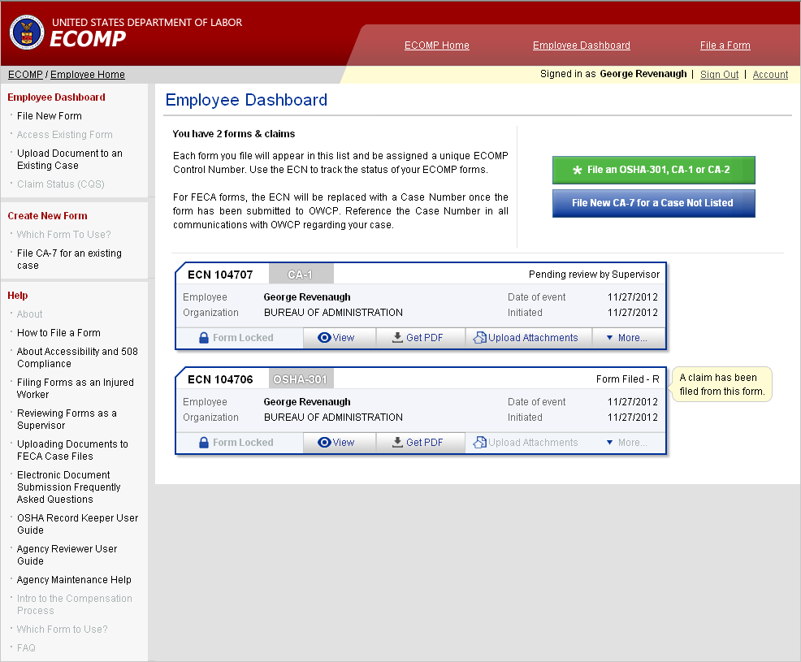
Updated Employee Dashboard
Joe Employee
Joe Employee
Joe Employee
The dashboard will now reflect all the forms filed by the employee.

Slide 31
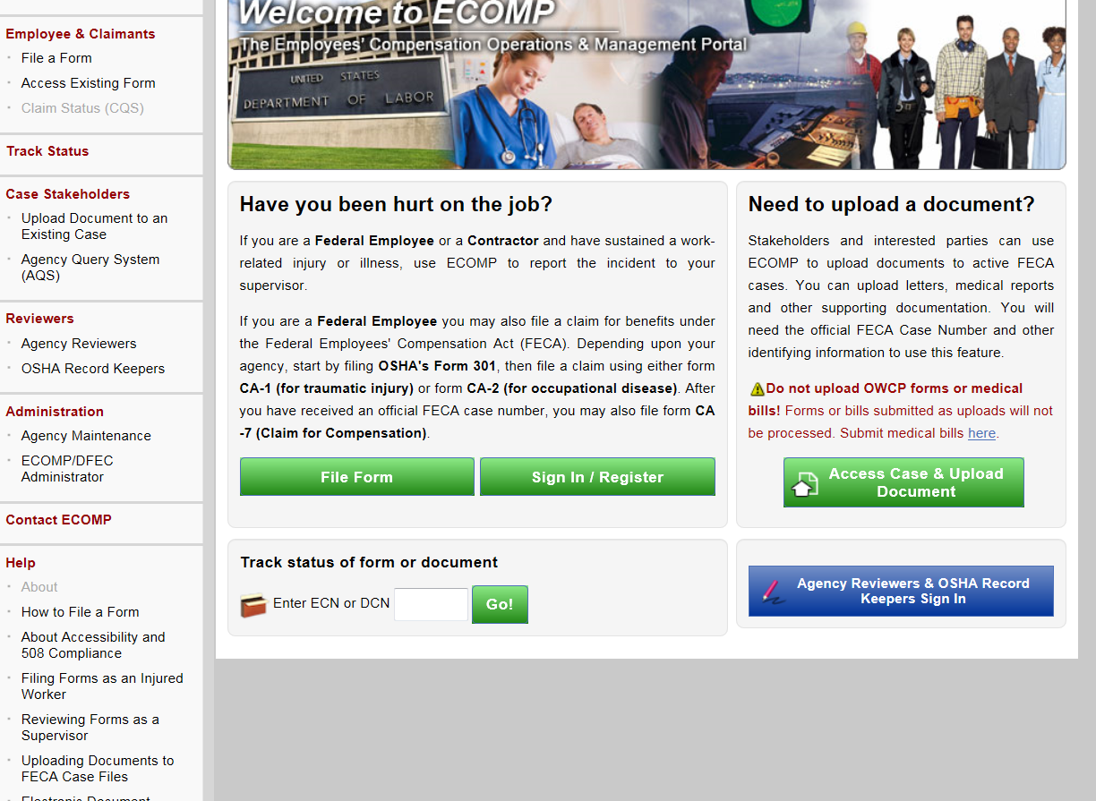
Additional Training
Additional training is available for employees. To view this training click on the Filing Forms as an Injured Worker link on the ECOMP page under the Help section.

Slide 32
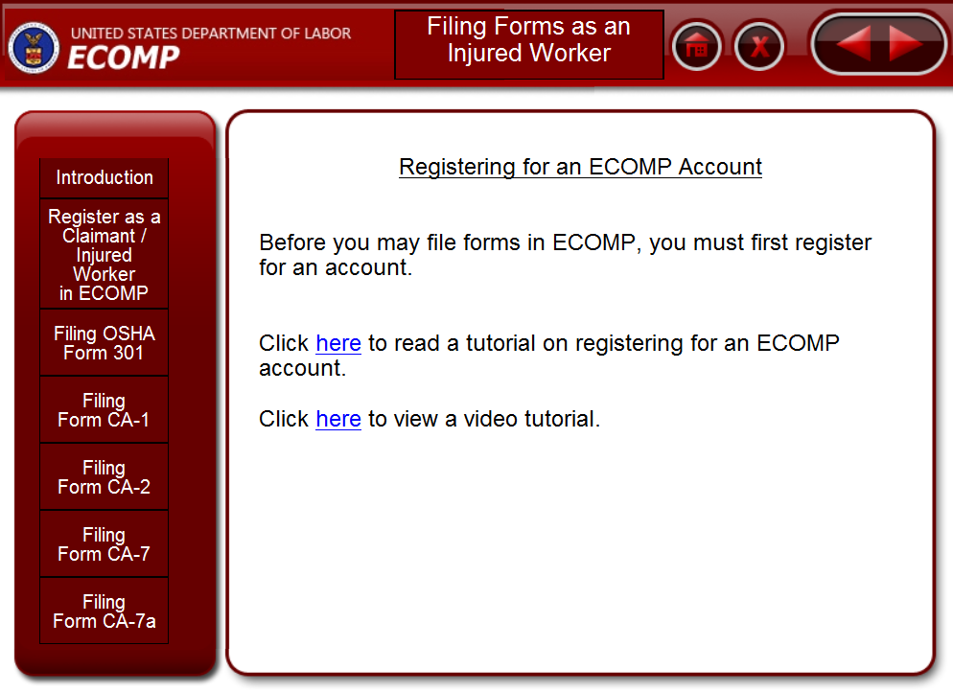
Additional Training
The employee can then see video tutorials by clicking on the topic listed on the left side of the screen. The tutorials will show the employee the steps necessary to perform the action and can be paused or replayed as necessary.

