Slide 1
ECOMP For Supervisors

Slide 2
ECOMP
This training will provide supervisors with the steps necessary to review OSHA-301 forms and CA-1/CA-2 forms using the Department of Labor application ECOMP.

Slide 3
ECOMP
ECOMP is a Department of Labor application that will allow DOD to file OSHA-301, CA-1, CA-2, and CA-7 forms electronically.
ECOMP will be replacing the current EDI method DOD uses to file claims electronically.
This switch will affect employees, supervisors, injury comp specialists, and safety personnel.

Slide 4
ECOMP
As a supervisor you will see two main changes.
  The current EDI system requires the employee and supervisor to sit down and file the claim together. ECOMP will allow the employee to fill out their portion of the claim form from any computer with internet access and then send it to their supervisor for further processing. Employee and supervisor no longer have to fill out the claim form together.

Slide 5
ECOMP
As a supervisor you will see two main changes.
  National Guard has elected ECOMP to enable the application for filing OSHA 301 forms. The employee is required to fill out the OSHA-301 form first and submitted it before they are permitted to file a CA-1 or CA-2 form. If an employee submits an OSHA-301 the supervisor will need to provide certain information and submit the form to the appropriate Safety personnel.

Slide 6
ECOMP
Processing of the OSHA-301 will not affect the processing of the CA-1 or CA-2 form. Once the employee submits the OSHA-301 form they can fill out the CA 1 or 2 form as necessary.
The OSHA form has a separate routing process and will not delay or inhibit the processing or review of CA-1 or CA-2.

Slide 7
ECOMP
The routing for the OSHA-301 and CA-1/CA-2 forms has been set up by the DOD ECOMP administrator. As the supervisor this will be invisible to you and you do not have to determine where the claims should be sent. This will already be set up within the application for you.

Slide 8
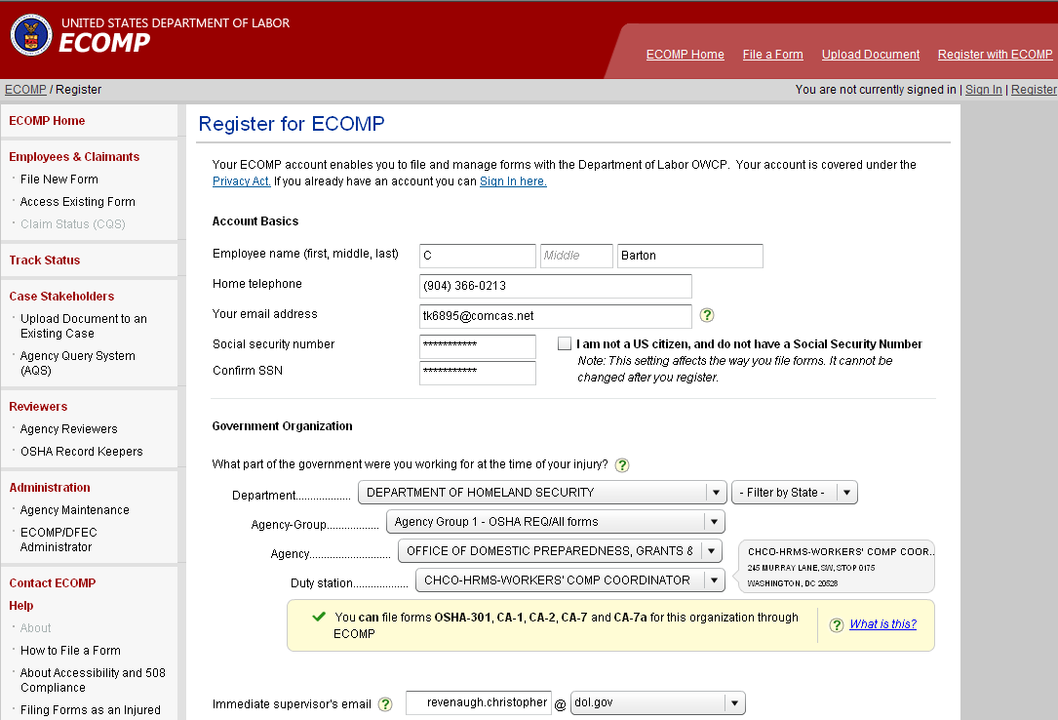
Employee Registration
Employee will have to register with ECOMP in order to file a claim. The employee will designate their supervisor during the registration process. As the supervisor you will not need an ECOMP account in order to review forms submitted to you.
Joe
Employee
(123) 456-7890
(123) 456-7890
Joe.Employee@gmail.com
Supervisor

Slide 9
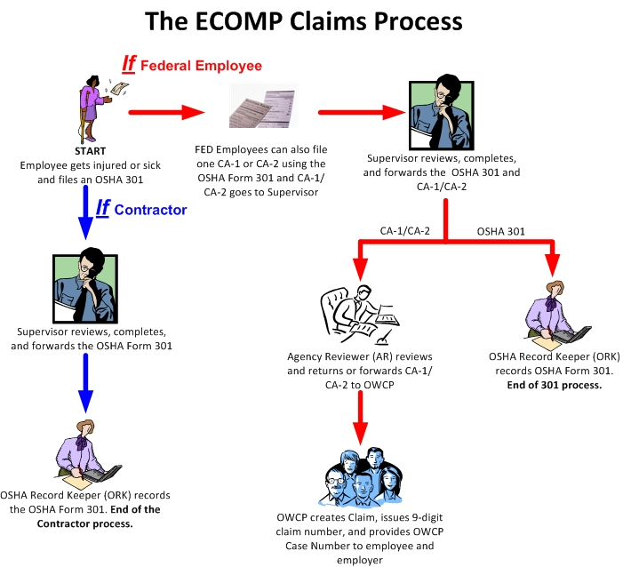
ECOMP’s Workflow
Agencies have the option to file OSHA-301 forms using ECOMP. Not all agencies will elect to use ECOMP to file OSHA-301 forms. The National Guard has elected this process flow.
HR
Safety

Slide 10
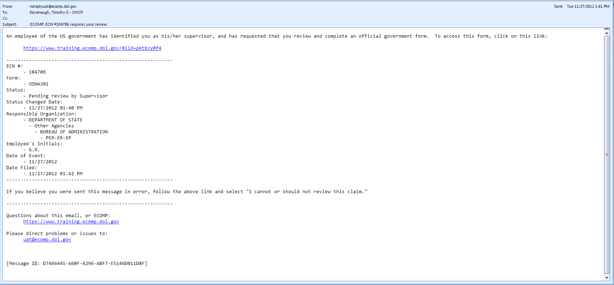
Filing an OSHA 301: Email to Supervisor
If an employee files an OSHA-301 form in ECOMP, the supervisor associated with the employee’s account will be sent an email alerting that supervisor to the fact that a form needs their review.
Reminder email notifications will be automatically sent to National Guard supervisors every two days.

Slide 11
Filing an OSHA 301: Email to Supervisor
The email will contain a link to access the form for review
The type of form to be reviewed
The initials of the employee
Pertinent dates

Slide 12
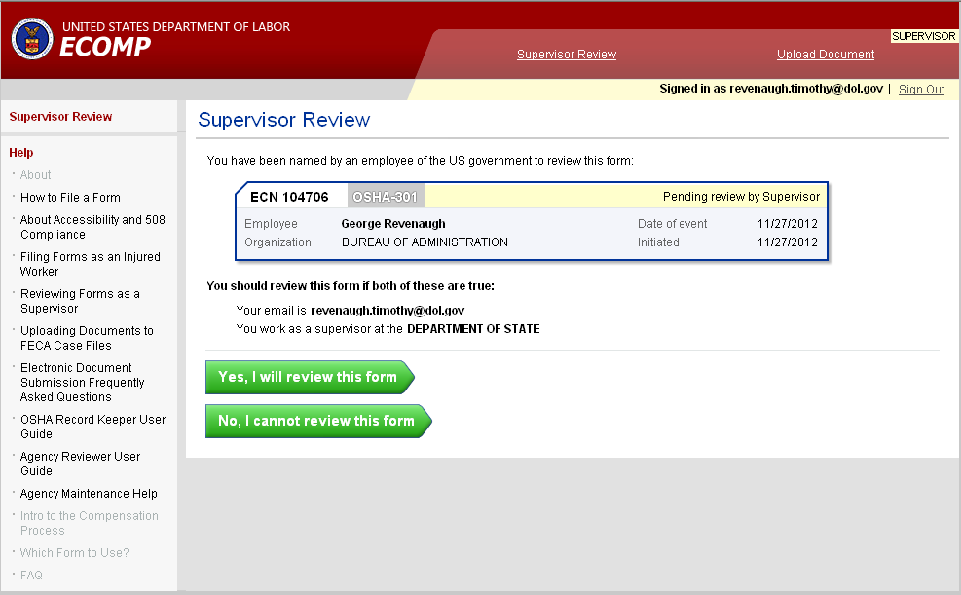
Filing an OSHA 301 : Supervisor Portion
Supervisor
Clicking on the link in the email will take the supervisor to ECOMP. If the employee sends the form to the incorrect supervisor or selects an incorrect agency when filing the form, the supervisor can return the form to the employee by selecting the
No, I cannot review this form button at the bottom of the screen.
Joe Employee
Joe Employee
Supervisor

Slide 13
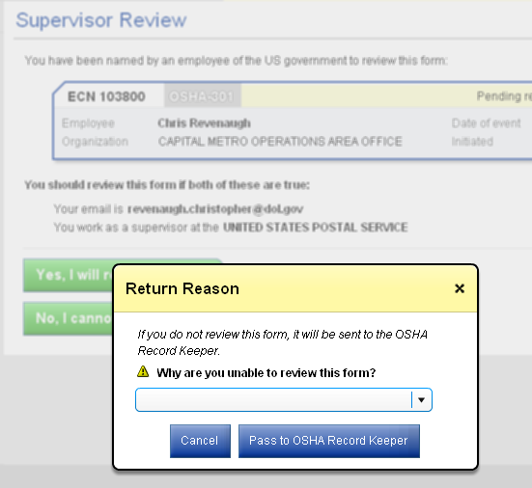
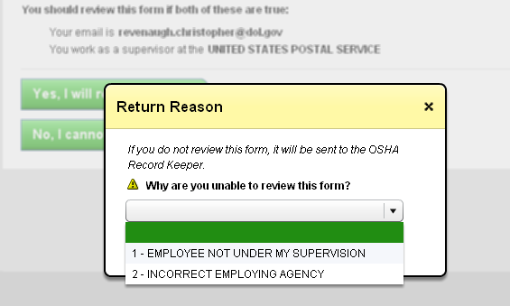
Filing an OSHA 301 : Supervisor Portion
The supervisor then selects a reason why the form cannot be reviewed. A notification will be sent to the employee and the Agency Comp Specialist informing them that the supervisor cannot review the form and the reason why.

Slide 14
Filing an OSHA 301 : Supervisor Portion
Supervisor
If the supervisor elects to review the form because they do indeed supervise the employee that submitted the form then the supervisor would select the
Yes, I will review this form
button at the bottom of the screen.
Joe Employee
Supervisor

Slide 15
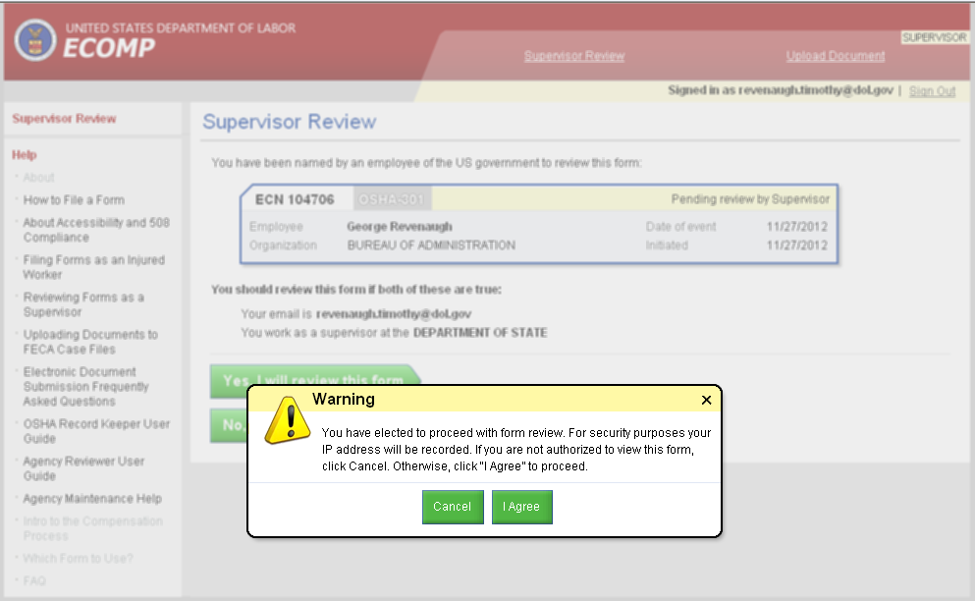
Filing an OSHA 301 : Supervisor Portion
supervisor
The system will capture the IP address of the computer used to review the claim as a security measure.
Joe Employee
supervisor
supervisor

Slide 16
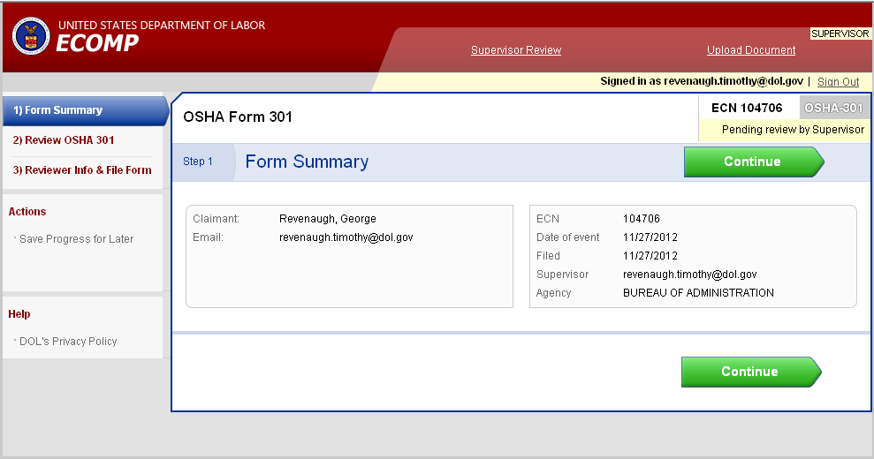
Filing an OSHA 301 : Supervisor Portion
To start the review, the supervisor will click on the Continue button.
Joe Employee
Joe.employee@gmail.com
Supervisor

Slide 17
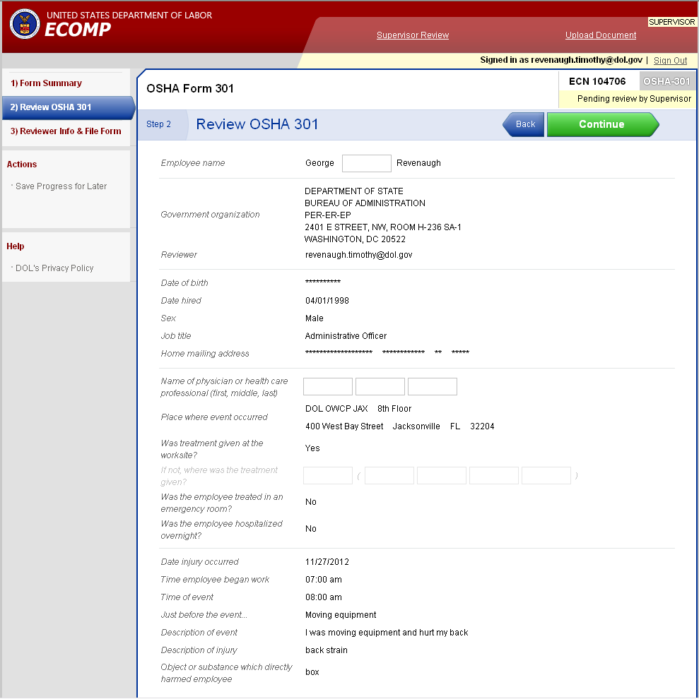
Filing an OSHA 301 : Supervisor Portion
The supervisor would then review the information on the form. Changes cannot be made to information submitted by the employee. If information submitted by the employee is incorrect or needs modification, the form will need to be sent back to the employee for correction and resubmission.
Joe Employee
supervisor

Slide 18
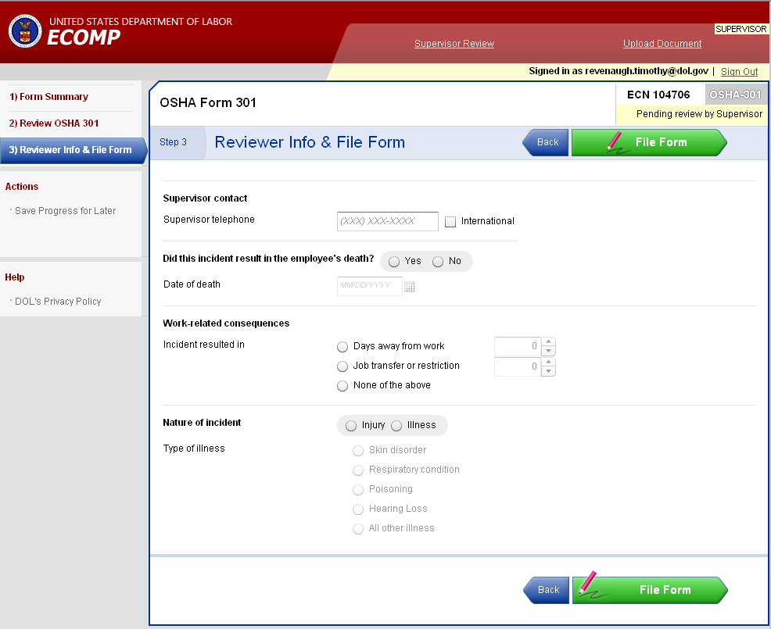
Filing an OSHA 301 : Supervisor Portion
The supervisor would also add any additional information into the form as well. Once the supervisor is done processing the form the File Form button at the bottom of the screen is selected.

Slide 19
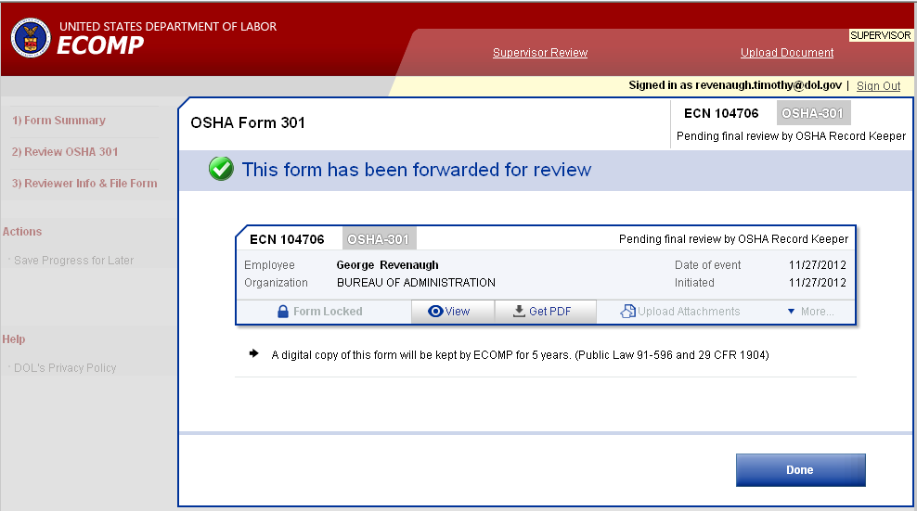
Filing an OSHA 301 : Supervisor Portion
Once the Supervisor completes the OSHA-301 form review they are finished with that form. The designated safety representative will complete processing of that form.
Joe Employee

Slide 20
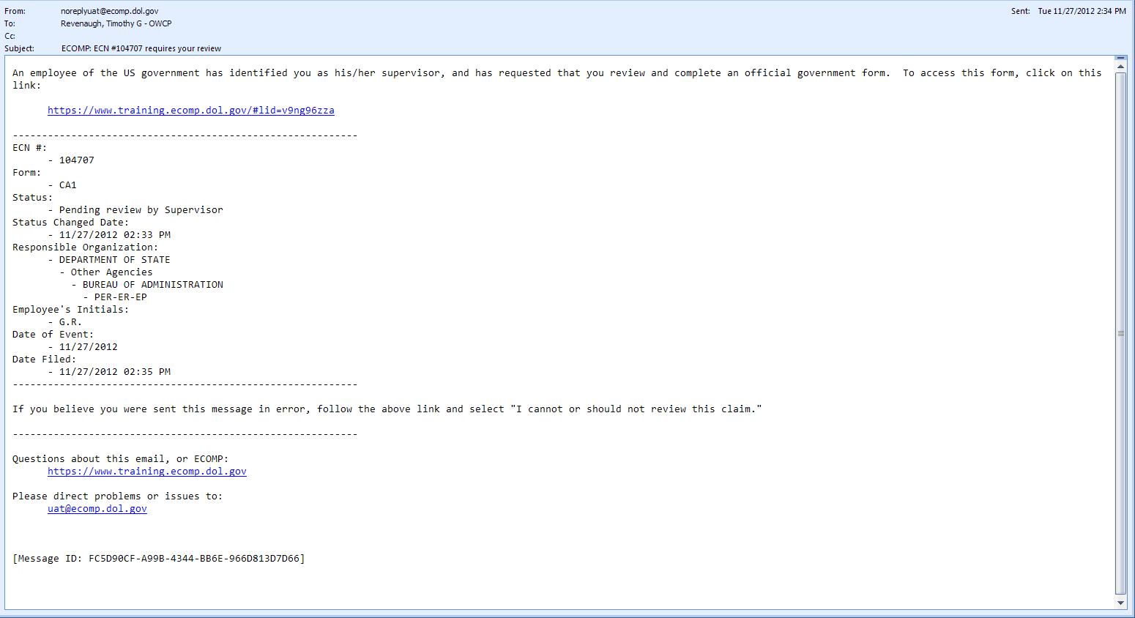
Filing a CA-1 or CA-2: Email to Supervisor
For National Guard technician employees, once the employee files the OSHA-301 form then they can file a CA-1 or CA-2 form. If they do this, the supervisor will receive a notification email alerting them that a form is awaiting their review.

Slide 21
Filing a CA-1 or CA-2: Email to Supervisor
The email will contain a link to access the form for review
The type of form to be reviewed
The initials of the employee
Pertinent dates

Slide 22
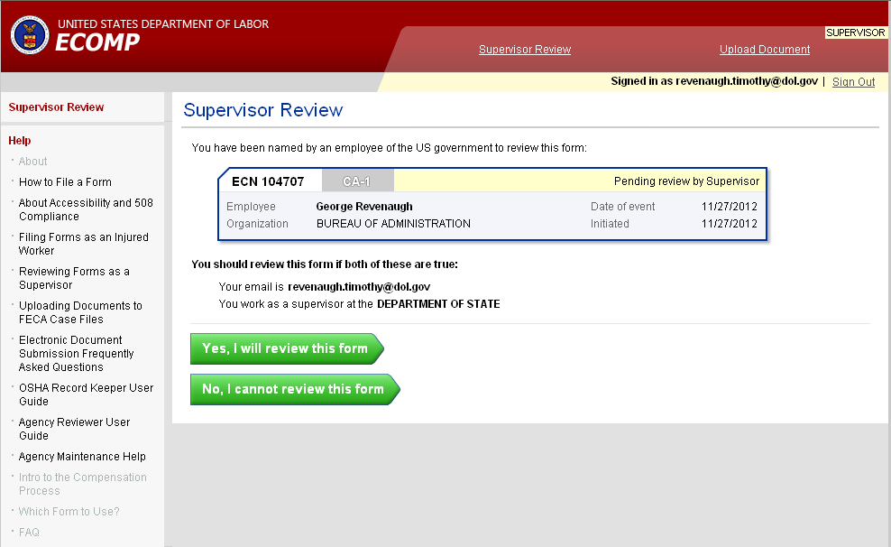
Filing a CA-1 or CA-2: Supervisor Portion
Clicking on the link in the email will take the supervisor to ECOMP. If the employee sends the form to the incorrect supervisor or selects an incorrect agency when filing the form, the supervisor can return the form to the employee by selecting the
No, I cannot review this form button at the bottom of the screen.
Joe Employee
supervisor

Slide 23
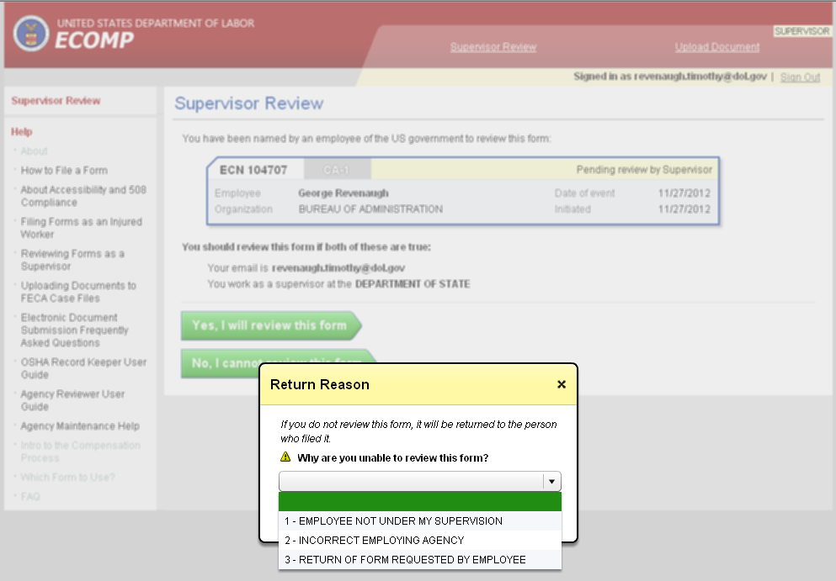
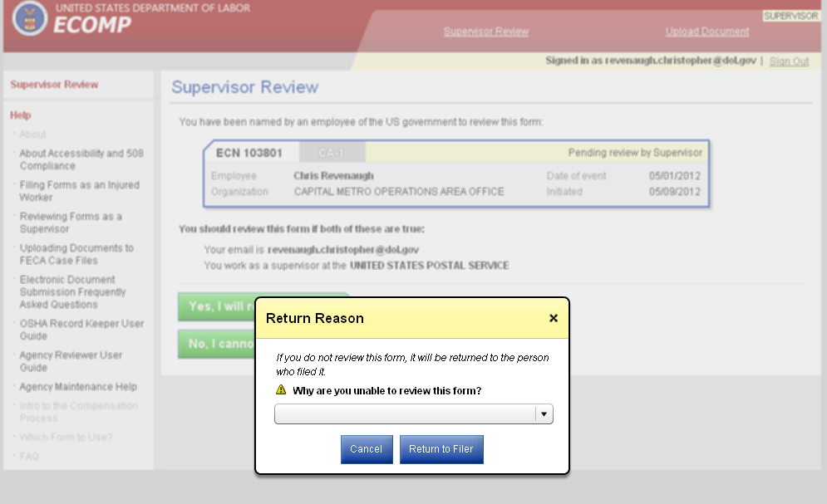
Filing a CA-1 or CA-2: Supervisor Portion
The supervisor then selects a reason why the form cannot be reviewed. A notification will be sent to the employee and the Agency Comp Specialist informing them that the supervisor cannot review the form and the reason why.
supervisor

Slide 24
Filing an OSHA 301 : Supervisor Portion
Supervisor
If the supervisor elects to review the form because they do indeed supervise the employee that submitted the form then the supervisor would select the
Yes, I will review this form
button at the bottom of the screen.
Joe Employee
Supervisor

Slide 25
Filing an OSHA 301 : Supervisor Portion
supervisor
The system will capture the IP address of the computer used to review the claim as a security measure.
Joe Employee
supervisor
supervisor

Slide 26
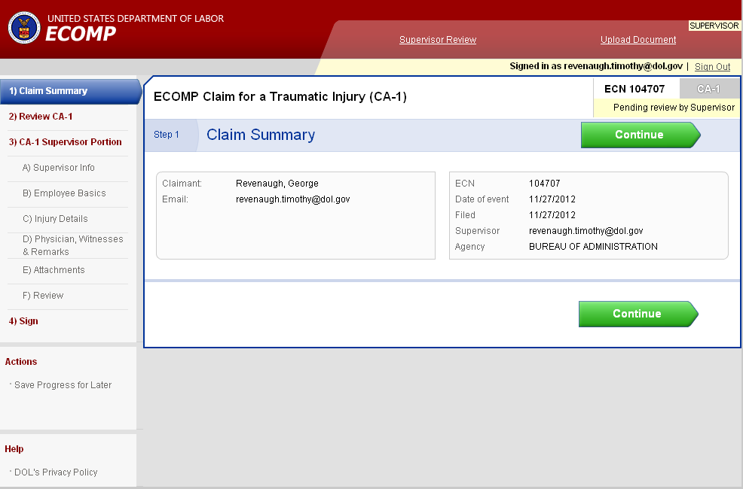
Filing a CA-1 or CA-2: Supervisor Portion
To start the review, the supervisor will click on the Continue button.
Joe Employee
Joe.employee@gmail.com
Supervisor

Slide 27
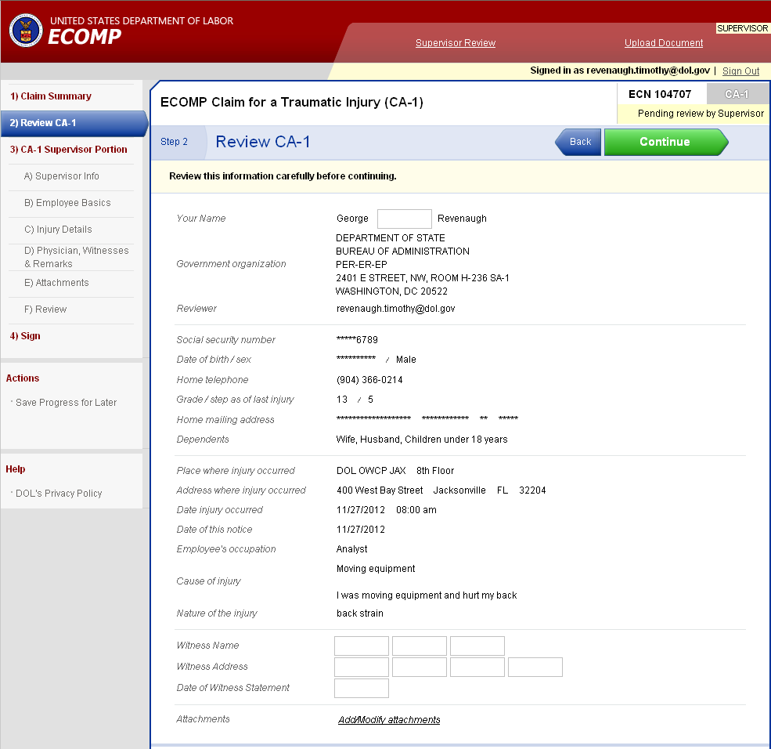
Filing a CA-1 or CA-2: Supervisor Portion
The information entered by the employee can be viewed by the supervisor but cannot be changed. If the supervisor notices information that he/she believes should be changed by the employee then there are two ways to handle the situation:
Talk to the employee and if they agree the information should be changed the form can be sent back to the employee for resubmission.
If the employee disagrees that the information should be changed then the supervisor can annotate areas where they do not agree with what the employee submitted.
Both processes will be discussed later in the presentation.

Slide 28
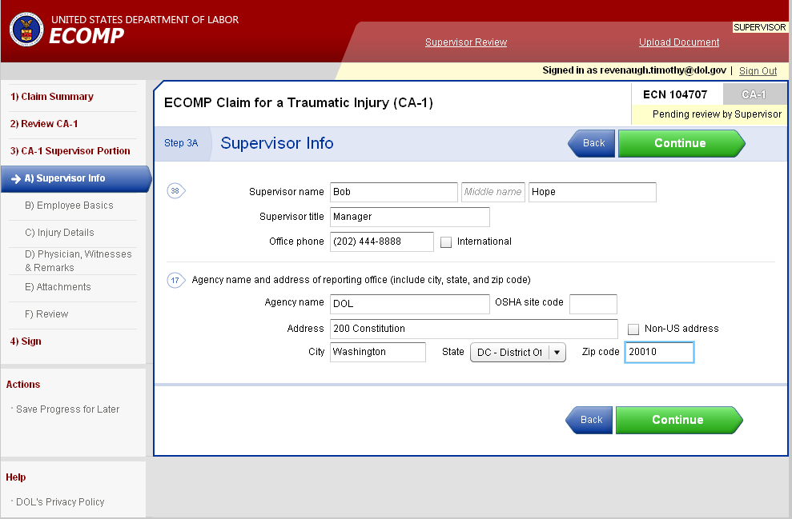
Filing a CA-1 or CA-2: Supervisor Portion
The supervisor will enter information into the claim form. Not all information is required so some information is optional and does not have to be entered by the supervisor.

Slide 29
Filing a CA-1 or CA-2: Supervisor Portion
Optional information for the CA-1 form:
  OSHA Site Code - Medical care first received date
  Date and Time employee stopped work - Pay Rate
  Date employee pay stopped - Remarks
  Date 45 day period began
  Date and hour returned to work
  Third party address
  Anatomical location
  Nature of Injury
  Cause of Injury
  Extent of Injury
  Physician name
  Physician address

Slide 30
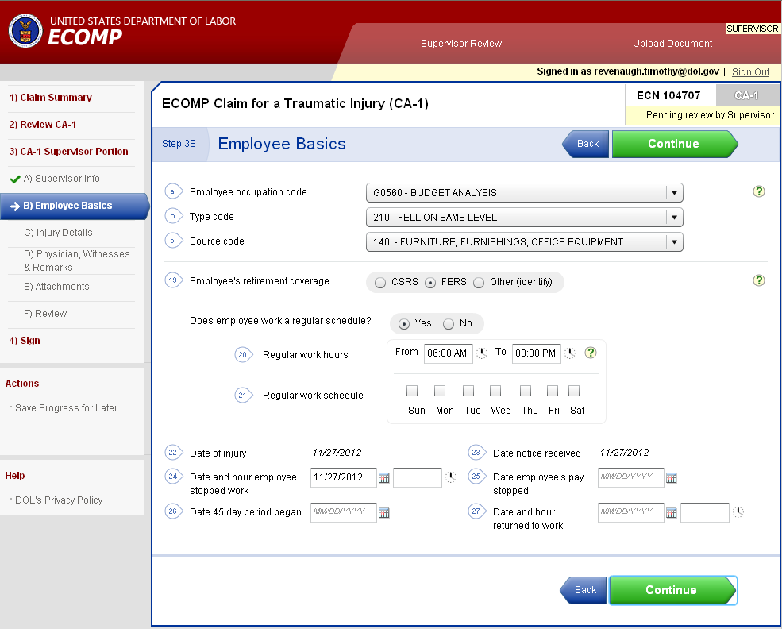
Filing a CA-1 or CA-2: Supervisor Portion
Continue to enter all required information into the claim form. When you are finished with one screen, select Continue to move to the next screen.

Slide 31
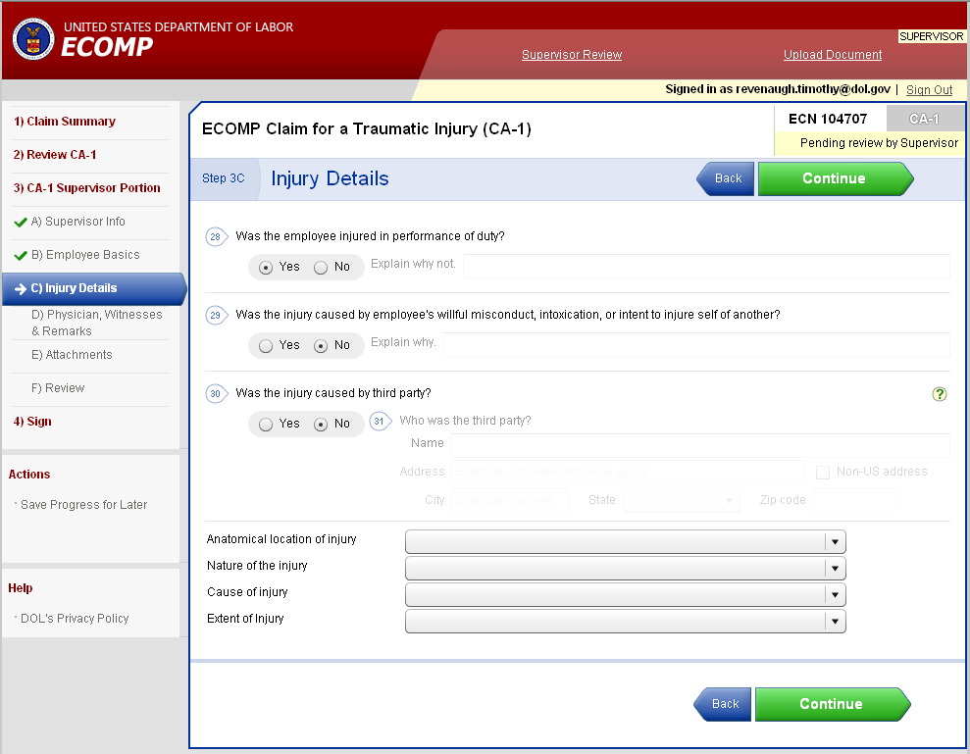
Filing a CA-1 or CA-2: Supervisor Portion
Continue to enter all required information into the claim form. When you are finished with one screen, select Continue to move to the next screen.

Slide 32
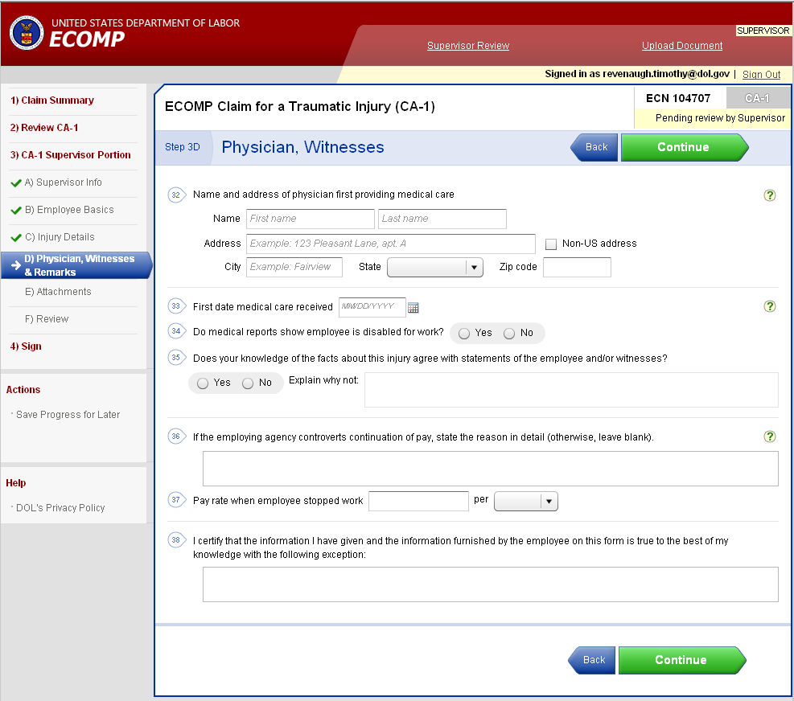
Filing a CA-1 or CA-2: Supervisor Portion
Continue to enter all required information into the claim form. If the supervisor disagrees with any information entered by the employee and the employee does not want to change what was entered on the form the he/she can annotate the disagreement in the area (outlined in red) at the bottom of the screen. For example if the DOI were entered erroneously by the employee and they did not want to change the DOI they entered the supervisor could provide what they believe to be the correct DOI in this field.

Slide 33
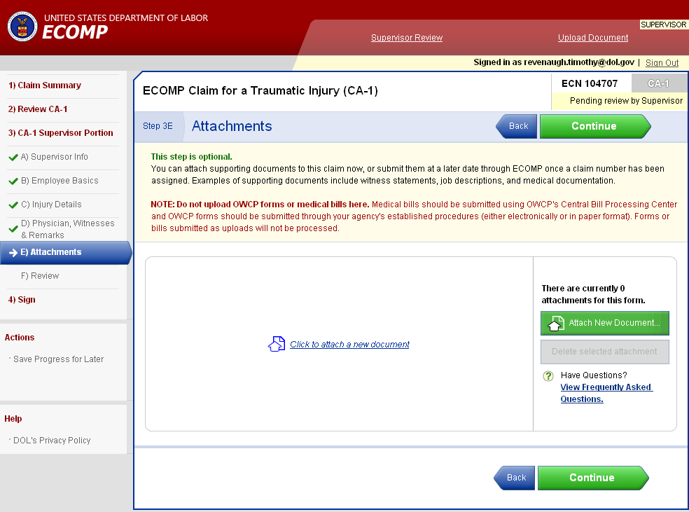
Filing a CA-1 or CA-2: Supervisor Portion
The supervisor can attach any additional document that is felt to be pertinent to the claim and should be considered by the Claims Examiner when adjudicating the claim.

Slide 34
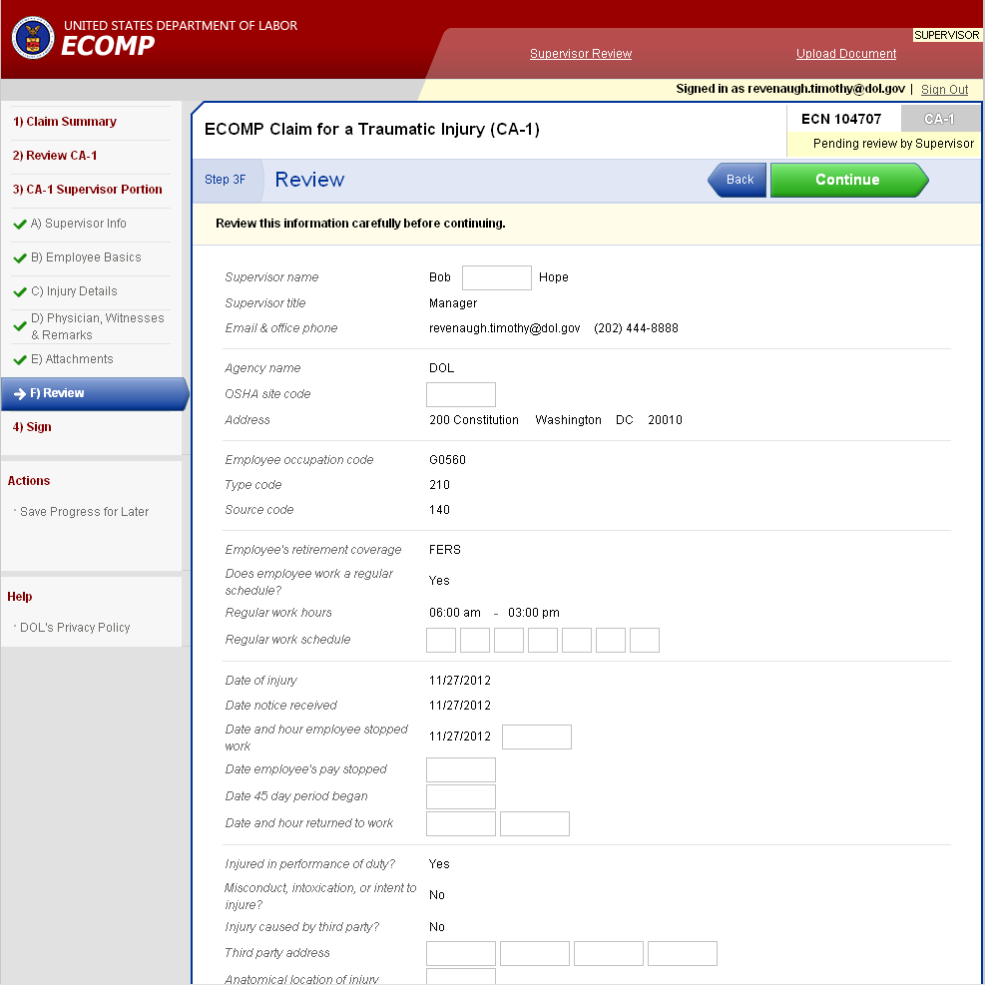
Filing a CA-1 or CA-2: Supervisor Portion
Finally, once all the information has been entered by the supervisor, one final review is done. Any changes can be made at this point by placing the cursor near the field and selecting the Go to field button that will appear.

Slide 35
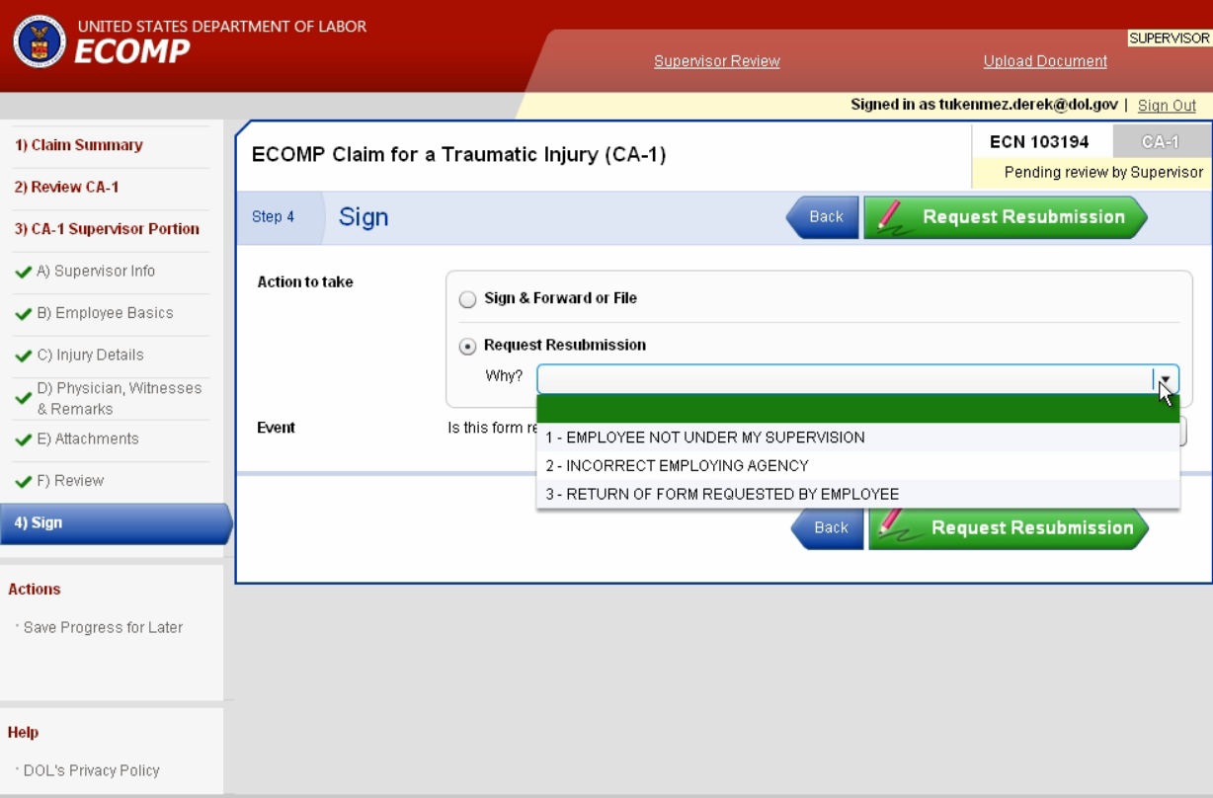
Filing a CA-1 or CA-2: Supervisor Portion
If the supervisor has discovered an entry by the employee is erroneous and the employee is willing to change the information entered into the form then the claim form can be sent back to the employee from this screen. The supervisor would select the Request Resubmission button and select RETURN OF FORM REQUESTED BY EMPLOYEE as the reason why. The form will be returned to the employee. They can then correct the erroneous information and resubmit the form to the supervisor.
The supervisor cannot refuse to process the form even if the employee does not change the erroneous information.

Slide 36
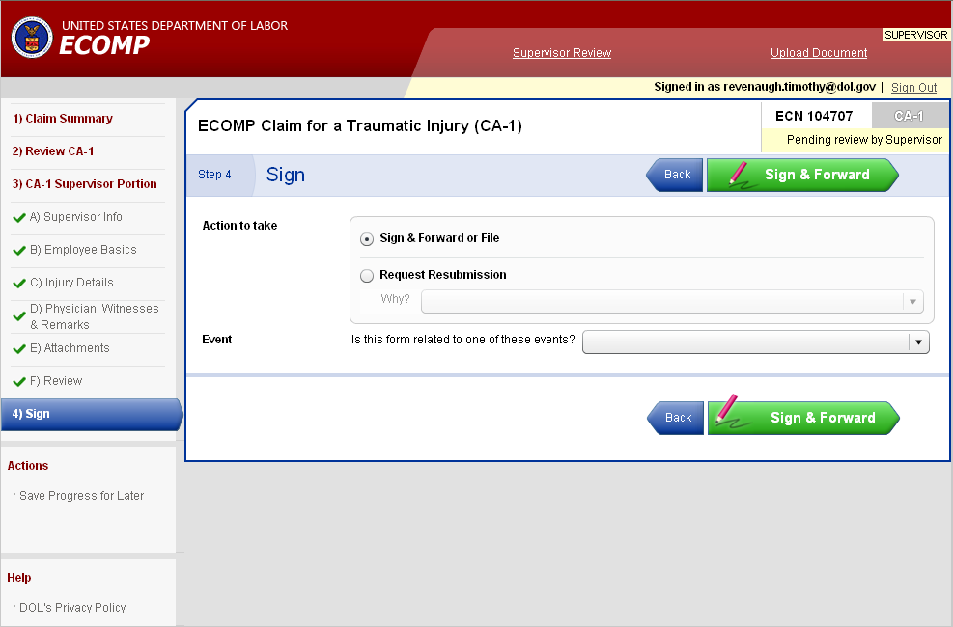
Filing a CA-1 or CA-2: Supervisor Portion
If the supervisor is completed reviewing the form then the Sign & Forward or File option will be selected and then the Sign & Forward button will be clicked.

Slide 37
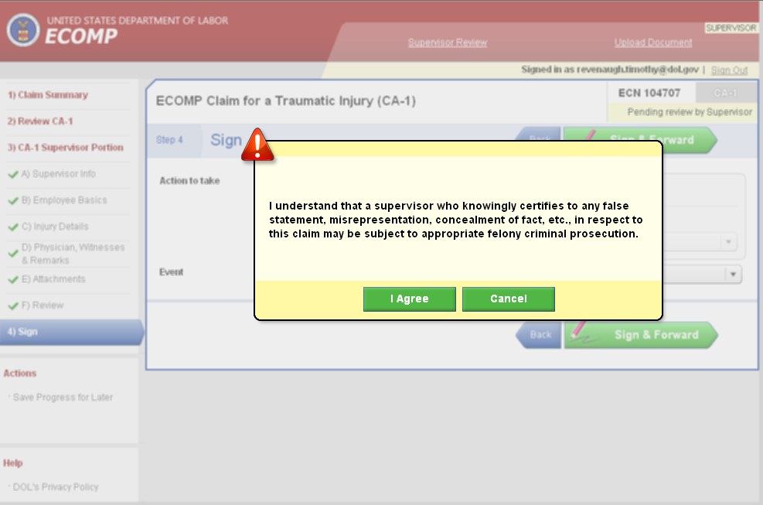
Filing a CA-1 or CA-2: Supervisor Portion
The supervisor will click I Agree to finish processing the form.

Slide 38
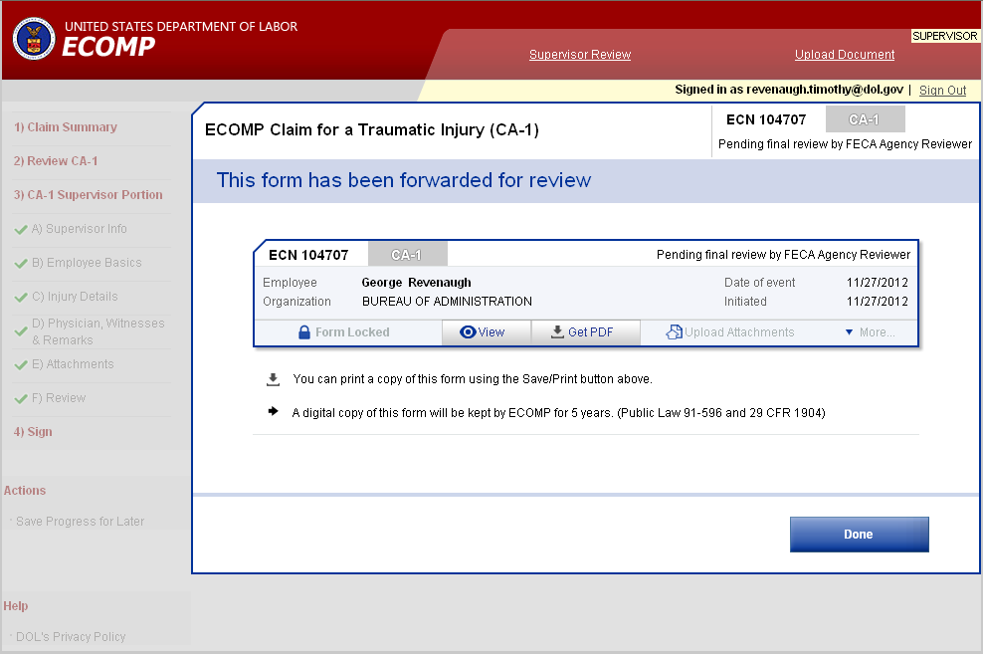
Filing a CA-1 or CA-2: Supervisor Portion
The form will now be submitted to the Injury Compensation Specialist for the agency to finish processing.
Joe Employee

Slide 39
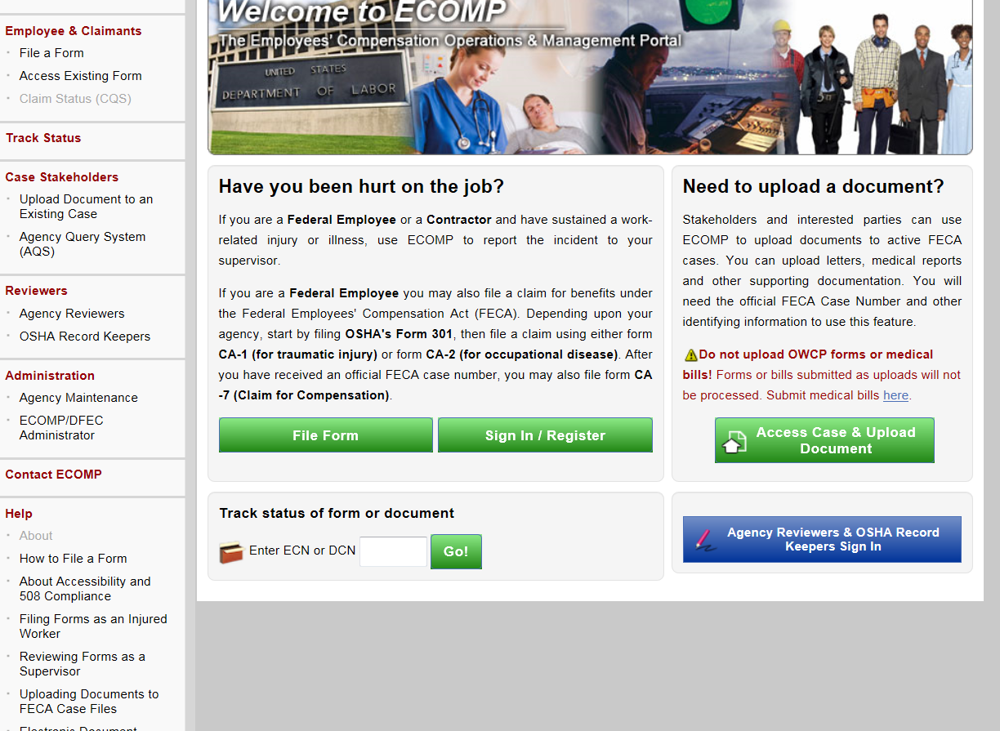
Additional Training
Additional training can be found on the ECOMP website at www.ecomp.dol.gov/ under the Help section.

Slide 40
Additional Training
Training is available for employees, supervisors, safety personnel and ICPAs. To view training for supervisors click on the Reviewing Forms as a Supervisor link

Slide 41
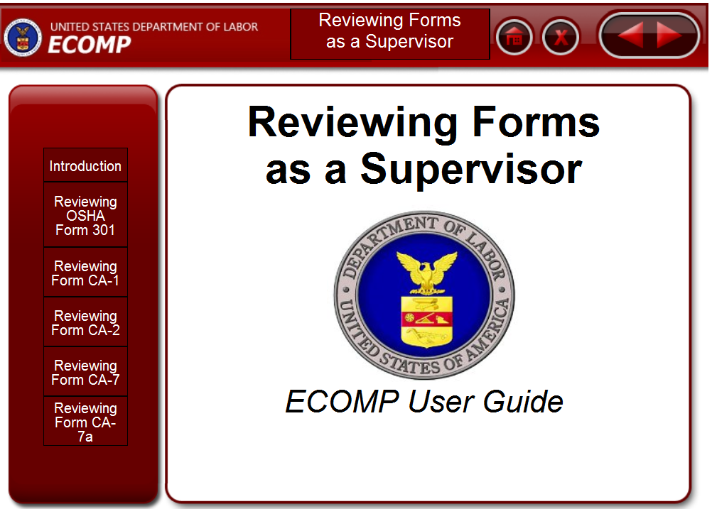
Additional Training
The available topics are shown on the left side of the screen. Select any topic listed to view the training on that topic.

Slide 42
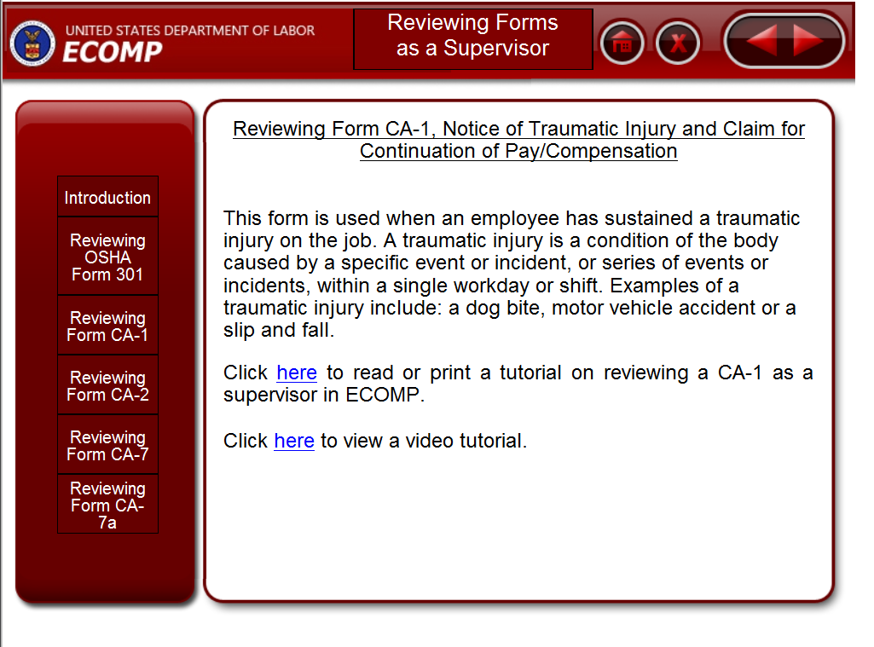
Additional Training
For each topic you can view either a written tutorial or view the actual steps via screen recording that will walk you through the necessary actions step by step.

