Slide 1
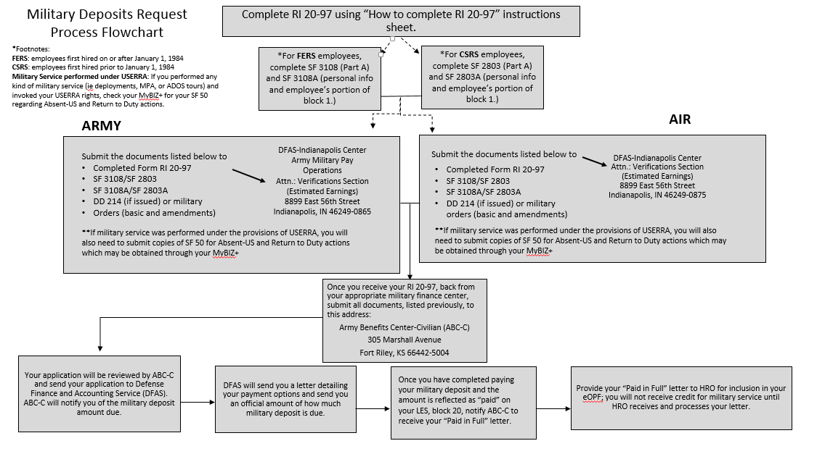
Military Service Deposit

Slide 2
Military service deposit process
Step 1: Wait for your SF-50 for your RTD to be processed, you can find this information on mybiz.
Step 2: Once processed for RTD go onto www.opm/gov/form/standard-forms: and file according to you retirement system either FERS or CSRS.
Complete your RI 20-97 and attached your DD-214 or complete orders, and you will also need to send a copy of your AUS and RTD actions.
You can find this information on the ABC-C website : ABC-C | FERS Deposit/Redeposit Service

Slide 3
VS 16 TECHNICIAN/agr dEPLOYERS
Per ABC-C, the technicians are allowed to buy back their military time without processing SF52 Absent US/RTD in DCPDS for deployments under 30 days. ABC-C would need the members:
1. Military LES (for actual earnings)
2. Pay cards (to verify KG status)
SF 3108 - Application to Make Service Credit Payment
AGR members:
Your orders will not be modified to reflect this deployment. Per ANGI 36-101,
para 7.9.3.1, member will use AF IMT 1299, Officer's Certificate of Statement
of Service to document the deployment period less than 30 days. Please ensure
I get a copy of the AGR members M4S to place in the members records including
modification to the M4S.

