Slide 1
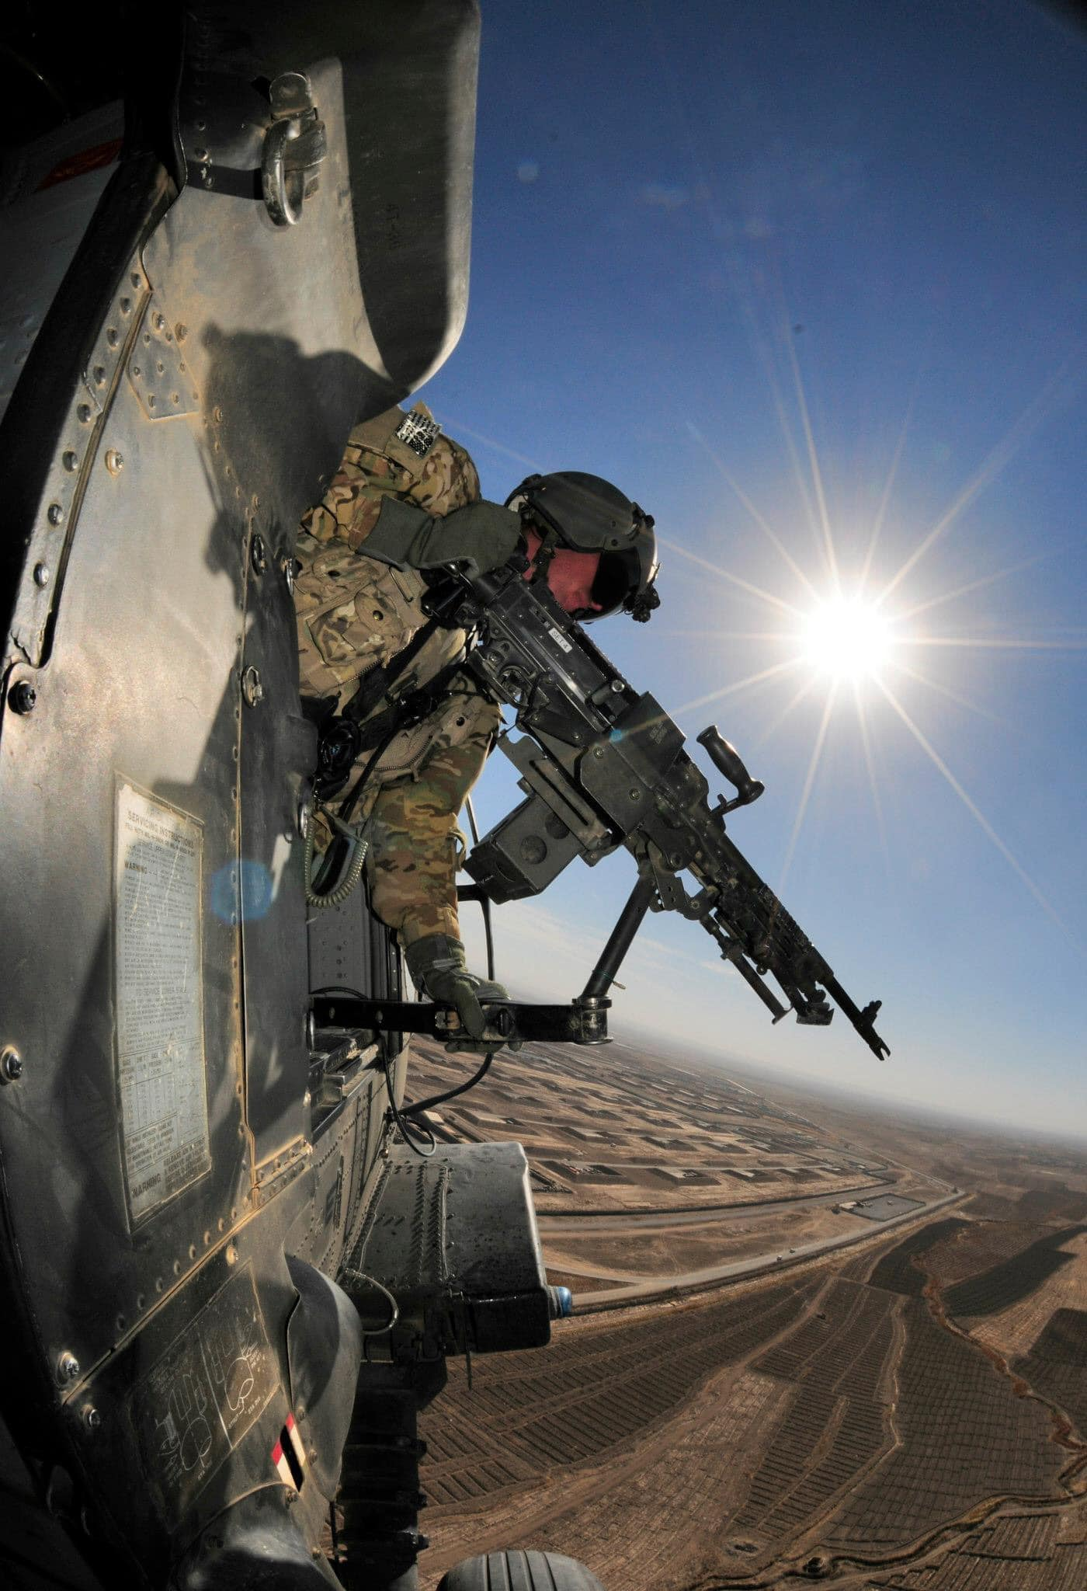


Hawaii National Guard
Basic UPAR Training

Slide 2
Agenda
In the Beginning…
Policy
UPAR Responsibilities
Public Affairs Planning
Public Affairs Liaison
Take Photos, Write Captions, & Get Published
Record Basic Video
Final Notes
Page 1
Introduction / Basic UPAR Training

Slide 3
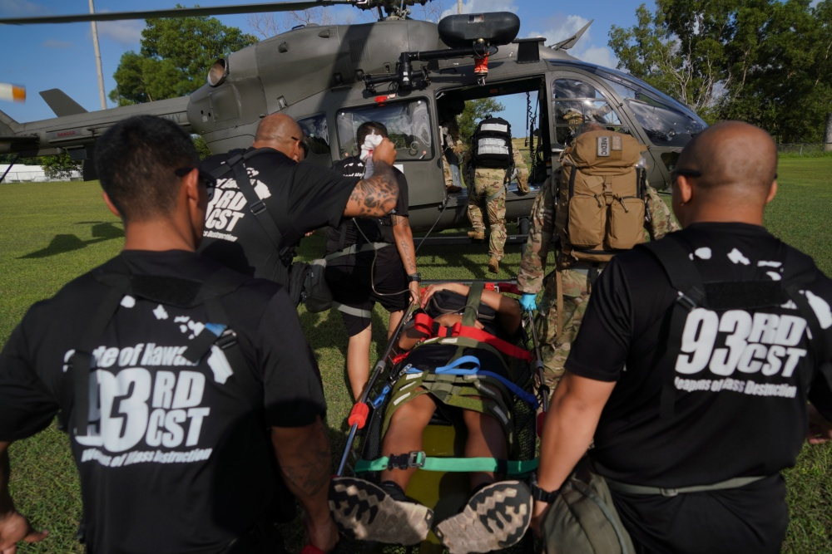
In the Beginning…
Introductions
  Rank, first and last name, unit, favorite snack
Mahalo!
Building a foundation (for you and your unit’s PA program)
The HING UPAR Handbook
Page 2
Introduction / Basic UPAR Training
Notes:
- tell all of us your rank, first and last name, unit, favorite snack.
Thank you all for being here
learn the basics of how to be a UPAR. advanced UPAR class offered. UPAR It nests with the slides
The highest PA element is the State Public Affairs Office, if they can get 3-5 pics from UPARs a quarter, help share the HIARNG story

Slide 4

Why UPAR?
Support HING Public Affairs program
We need your help in telling your units, and “Hawaii National Guard story”
  HIARNG 23 PAO positions
  HIANG 12 PAO positions
  Over 5,500 guardsman
History of HING
UPARS need two important things from the commander and the unit:
  Time
  Support
Page 3
Introduction / Basic UPAR Training
Notes:
There are over 5,500 stories to tell.
PA Specialists cannot cover everything.
Commanders will need to provide you UPARs two things….
Time: for a UPAR to plan and carry out tasks, to meet with the UPAR to plan and initiate the unit’s PA Plan.
Support: The unit’s staff need to know the UPAR and that command supports the UPAR's efforts. Involve the UPAR in unit meetings, access to info

Slide 5

Policy
In the beginning
Policy
UPAR Responsibilities
Public Affairs Planning
Public Affairs Liaison
Take Photos, Write Captions, & Get Published
Record Basic Video
Final Notes
Page 4
Policy / Basic UPAR Training

Slide 6
DOD Policy
Free-flow of general and military information, without censorship or propaganda
Information will not be classified or withheld to protect the Government from criticism or embarrassment
Information will be withheld only when:
  adversely affect national security
  threaten safety or privacy of the Armed Forces
  directed by law or regulation
DoD’s obligation to provide the public with information on major programs may require detailed public affairs planning
Propaganda has NO place in DOD public affairs
Page 5
Policy / Basic UPAR Training

Slide 7
DOD Policy
Standalone or portions of classified and unclassified information have the potential to compromise security
Information intended for public release is cleared via security and policy review (conducted by Public Affairs)
Effective communication is required at the core
Increase public awareness of the mission, goals, policies, and programs
Helps foster community relations and build good will
Release of accurate information must be done with speed, efficiency, and through a variety of mediums (different audiences)
We are accountable to taxpayers and rely on their support
Page 6
Policy / Basic UPAR Training

Slide 8

OPSEC
Operations Security
Exact # of troops, Exact times of departure, radio frequencies, which vehicles are mission ready, what route a unit will take…
Adhere to SAPP (Security, Accuracy, Propriety and Policy)
All DoD employees must practice security at the source
All personnel must be aware of OPSEC and be responsible for safeguarding sensitive information
OPSEC applies to:
  media interviews
  sharing information/imagery with family and friends, including email and social media platforms
Prevent unauthorized disclosure of information that could degrade operational effectiveness
Page 7
Policy / Basic UPAR Training

Slide 9
SAPP
Security, Accuracy, Propriety and Policy
Security
Is there an OPSEC concern? Protect your team
Accuracy
Is the information correct and true? Don’t spread misinformation
Propriety
Is it in good taste? Be professional and respect privacy rights
Policy
Do not violate DOD policy; if you don’t know, Ask
Goes hand-in-hand with operations and personnel security
Monitor the information environment and balance release to print media, television, social media, etc.
Page 8
Policy / Basic UPAR Training

Slide 10
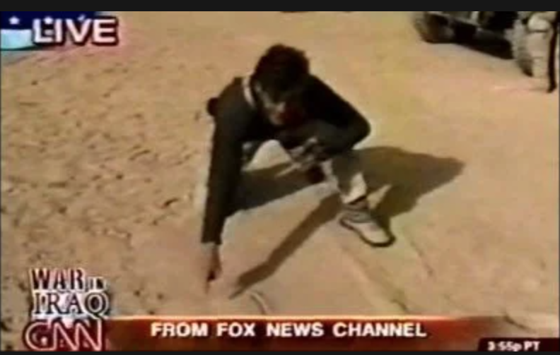
What Not To Do
For example:
2003, Geraldo Rivera was traveling with the 101st Airborne Division in Iraq as a war correspondent for Fox News and made a major tactical error
Rivera drew a map in the sand during a live broadcast, pinpointing his exact location and revealing the time and details of an upcoming operation
Page 9
Policy / Basic UPAR Training

Slide 11
Misc. & Things to Consider
Parental Permissions
Photos of children during family day or community day events must have parental permission prior to releasing
Photo/video release form at PAO office
Copyright and Fair Use of your products
If you are a service member, working with government equipment, and/or on government time, you cannot copyright your work - it belongs to the government
FOIA (Freedom of Information Act)
Allows members of the public who follow the rules (established by proper authority) to request a record without it being withheld unless the record is exempt
Every large unit has a FOIA Rep, UPARs may assist in gathering info, but never lead FOIA responses
Do not forward bad or inappropriate photos, please delete them
Page 10
Policy / Basic UPAR Training

Slide 12
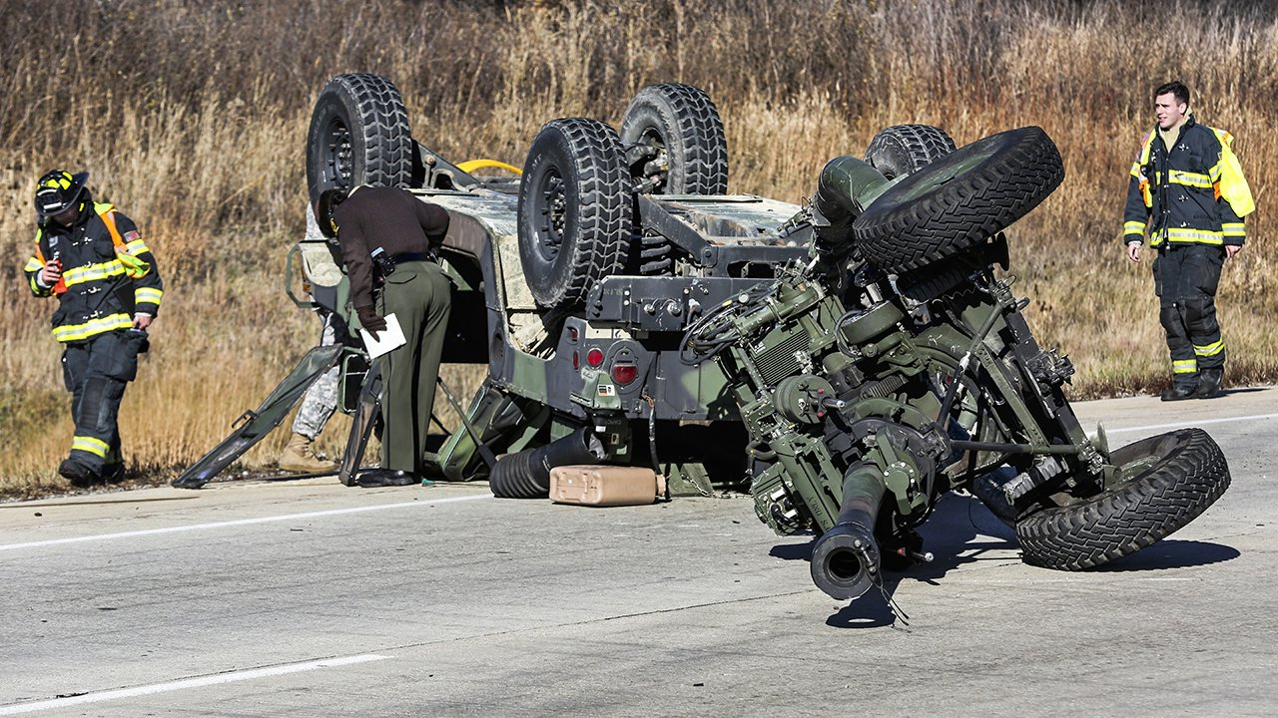
Where the PA steps in
Privacy Act and PII
HIPAA
Deaths, Incidents and Accidents
Criminal Matters and Investigations
Let PAO handle these matters
PAO has specific training
If unit or UPAR does speak to media after an incident: Notify Public Affairs immediately
Page 11
Policy / Basic UPAR Training

Slide 13
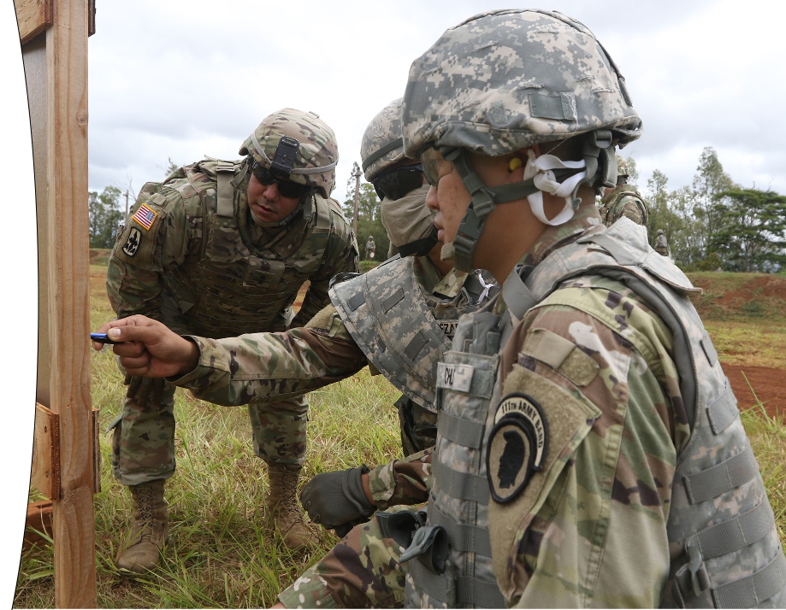
UPAR RESPONSIBILITIES
In the beginning
Policy
UPAR Responsibilities
Public Affairs Planning
Public Affairs Liaison
Take Photos, Write Captions, & Get Published
Record Basic Video
Final Notes
Page 12
UPAR Responsibilities / Basic UPAR Training

Slide 14
UPAR Responsibilities
Create a Public Affairs Plan – meet with Commander to set goals and create a plan
Public Affairs Liaison – being the POC for all things public affairs
Take Photos, Write Captions and Get Published - #1 job
Record Basic Video – film short clips
Media Escort and Preparation – prepare your unit and assist the media
Media Relations – understand the media and prepare for interviews
Command Information – communicating to members of the command
Writing the Story - news story vs feature story
Page 13
UPAR Responsibilities / Basic UPAR Training

Slide 15
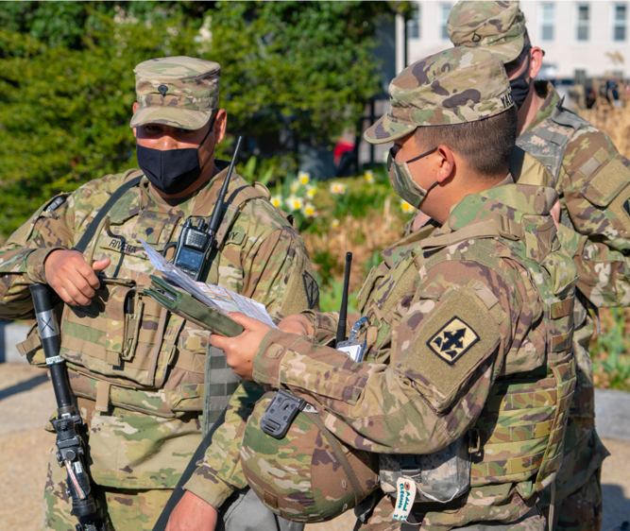
PA PLANNING
In the beginning
Policy
UPAR Responsibilities
Public Affairs Planning
Public Affairs Liaison
Take Photos, Write Captions, & Get Published
Record Basic Video
Final Notes
Page 14
Public Affairs Planning / Basic UPAR Training

Slide 16
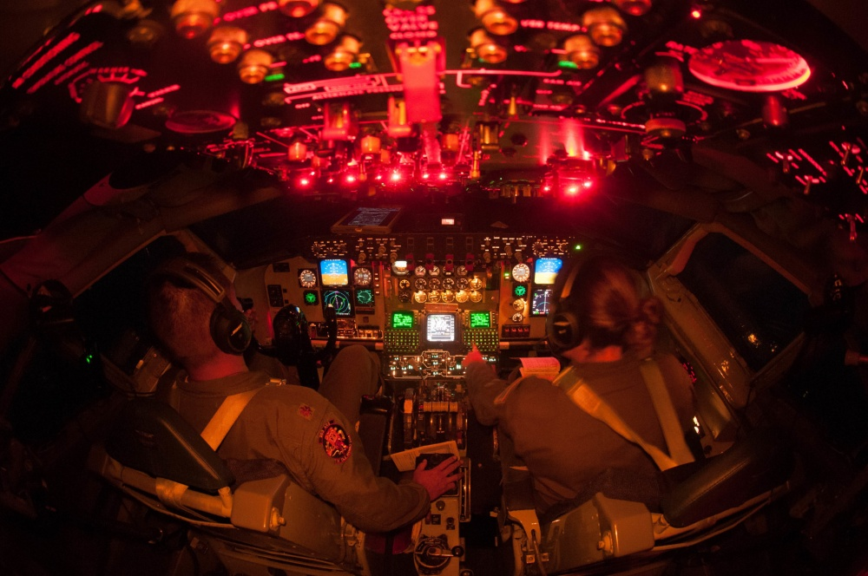
PA Planning
Talk to unit Commander
Get info from YTB and Tng Schedules
Make a plan together
Pitch ideas
Choose events, coordinate with POC
Prepare, have a schedule
Annual Training = Goldmine
Look at other units’ social media to get ideas
PA Plans are fluid, keep adding to it
Page 15
Public Affairs Planning / Basic UPAR Training

Slide 17
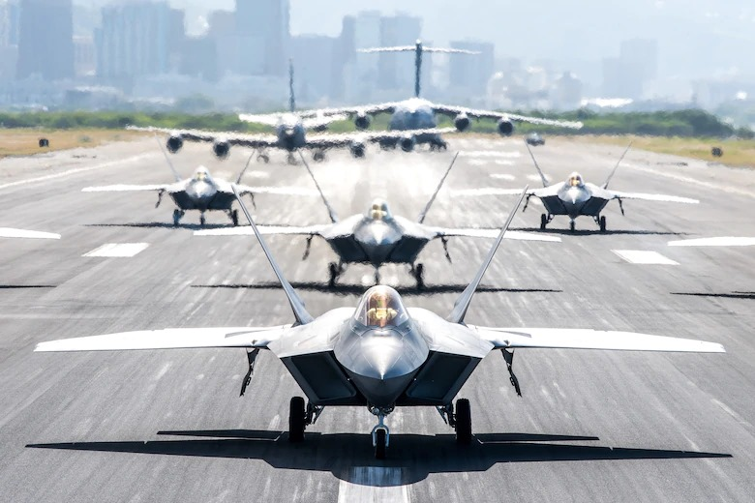
Release Authority
Approving of photos- Release Authority
  Unit level = Commander for unit newsletters
  This step protects you
Levels of Public Affairs
Level 1 | Unit level Example: unit newsletter
Level 2 | MSC’s Example: HIARNG, HIANG, Recruiting, 29th IBCT, 103rd TC, 298th MFTR, social media
Level 3 | Example: TAG, DAG, CSEL social media, HIDOD PowerPoints, Pupupukahi, DVIDS or media releases
Level 4 | Example: Any media outlet (TV, online, newspaper), DOD, NGB, INDOPACOM, Big Army or Big Air Force, USARPAC
Page 16
Public Affairs Planning / Basic UPAR Training

Slide 18
PA Plan Sample
OCT 2023
Social Media Post - Weapons qualifications Take photos, get best scores and new shooters. Write caption. Send to higher PA elements
Dec Newsletter - Start designing layout and looking at past socials for story ideas
DEC 2023
Social Media Post - Mandatory Classes Take photos. Write caption. Send to higher PA elements
Dec Newsletter - Do final draft. Get commander approval. Distribute newsletter
Holiday party - Take photo. Write a story. Send to higher PA elements
NOV 2023
Social Media Post – New PT test Take photos, interview, most improved. Write caption. Send to higher PA elements
Dec Newsletter - Draft content and pics. Get Commander to write a column
Coordinate with higher PA, about new equipment, Reach out to contact with story idea and details (5 W’s)
Holiday party contact committee to get event details
Annual Training
Social Media Post - New equipment Take photos. Write caption. Send to higher PA elements
Social Media Post - Soldier’s first AT Take photos. Write caption. Send to higher PA elements
Page 17
Public Affairs Planning / Basic UPAR Training

Slide 19
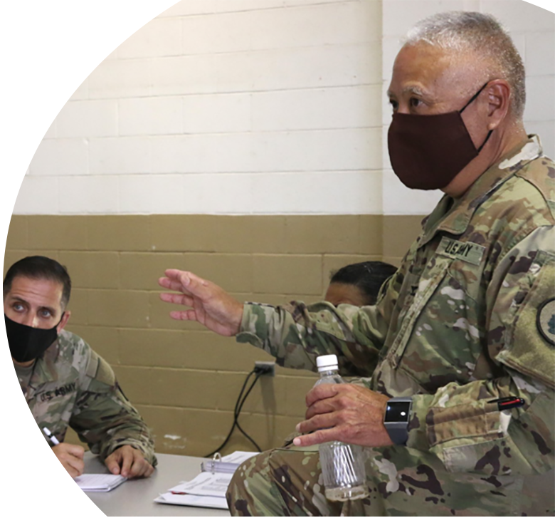
What Should Come Out of a PA Plan?
Commander’s intent / objectives
Commander’s priorities, command messages
What will be covered by UPAR during drills and Annual Training
Release authority given
When to request PAO
Expectations, content evaluation
Page 18
Public Affairs Planning / Basic UPAR Training

Slide 20
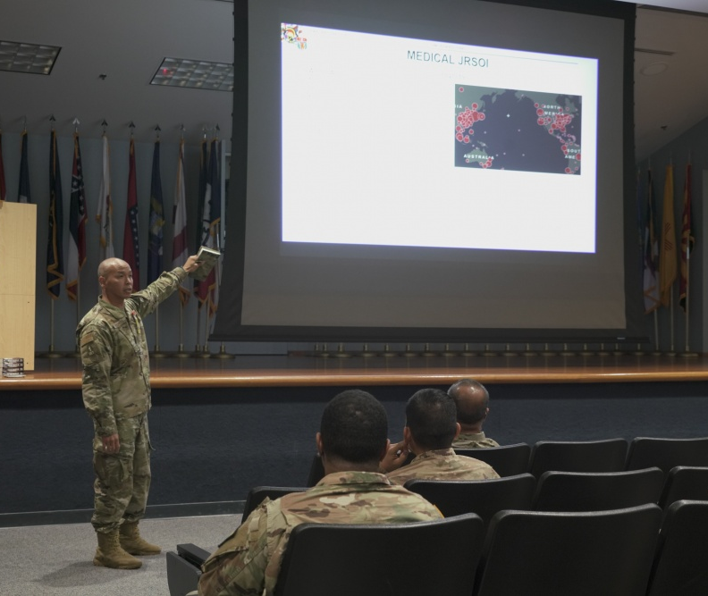
PA LIAISON
In the beginning
Policy
UPAR Responsibilities
Public Affairs Planning
Public Affairs Liaison
Take Photos, Write Captions, & Get Published
Record Basic Video
Final Notes
Page 19
Public Affairs Liaison / Basic UPAR Training

Slide 21
PA Liaison
A person that allows different organizations or groups to work together and provide information to each other.
Position of responsibility
To the Commander
To Higher PA elements
Can share the most current PA information from higher PA element- State PAO, 117th MPAD
Could be unit spokesperson for media engagements
Page 20
Public Affairs Liaison / Basic UPAR Training

Slide 22
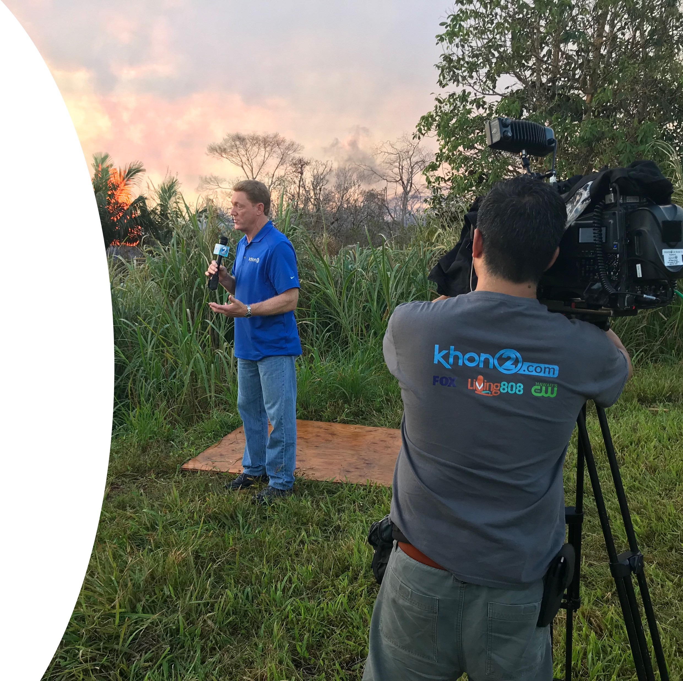
PA Liaison
Provide counsel to the Commander and Higher PA
This does not happen automatically
Be self-aware and respectful
Understand what higher PA element is
“Pulling and Pushing” of information
UPARs will immediately notify PAO of any issues that might gain national or international media attention (accidents/investigations)
Page 21
Public Affairs Liaison / Basic UPAR Training
Notes:
Establish communication with 117th MPAD, as they will approve all products and be the release authority during exercises or some training events.
The State PAO will be your full-time higher PA element.
The State PAO oversees and provides all UPAR training and serve as PA SMEs. During State Active Duty Missions there may be a Task Force PAO, but you can always contact the State PAO.

Slide 23
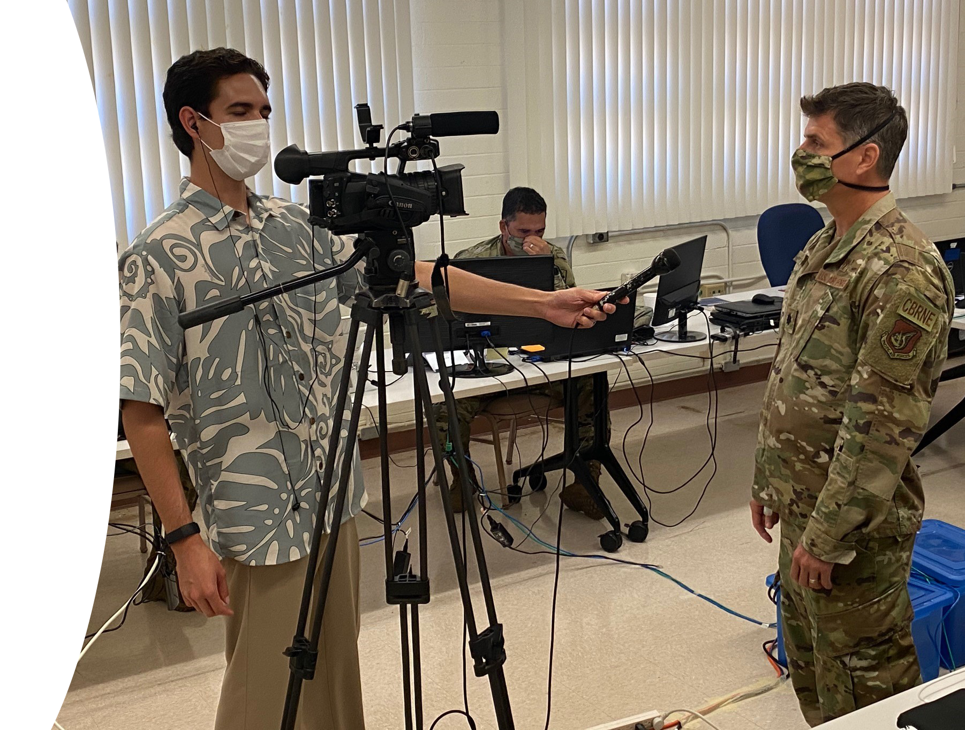
PA Liaison
Not PA trained, just helping commander
With approval from higher PA, Coordinate unit level media escort
First person who media meets when visiting
Page 22
Public Affairs Liaison / Basic UPAR Training

Slide 24
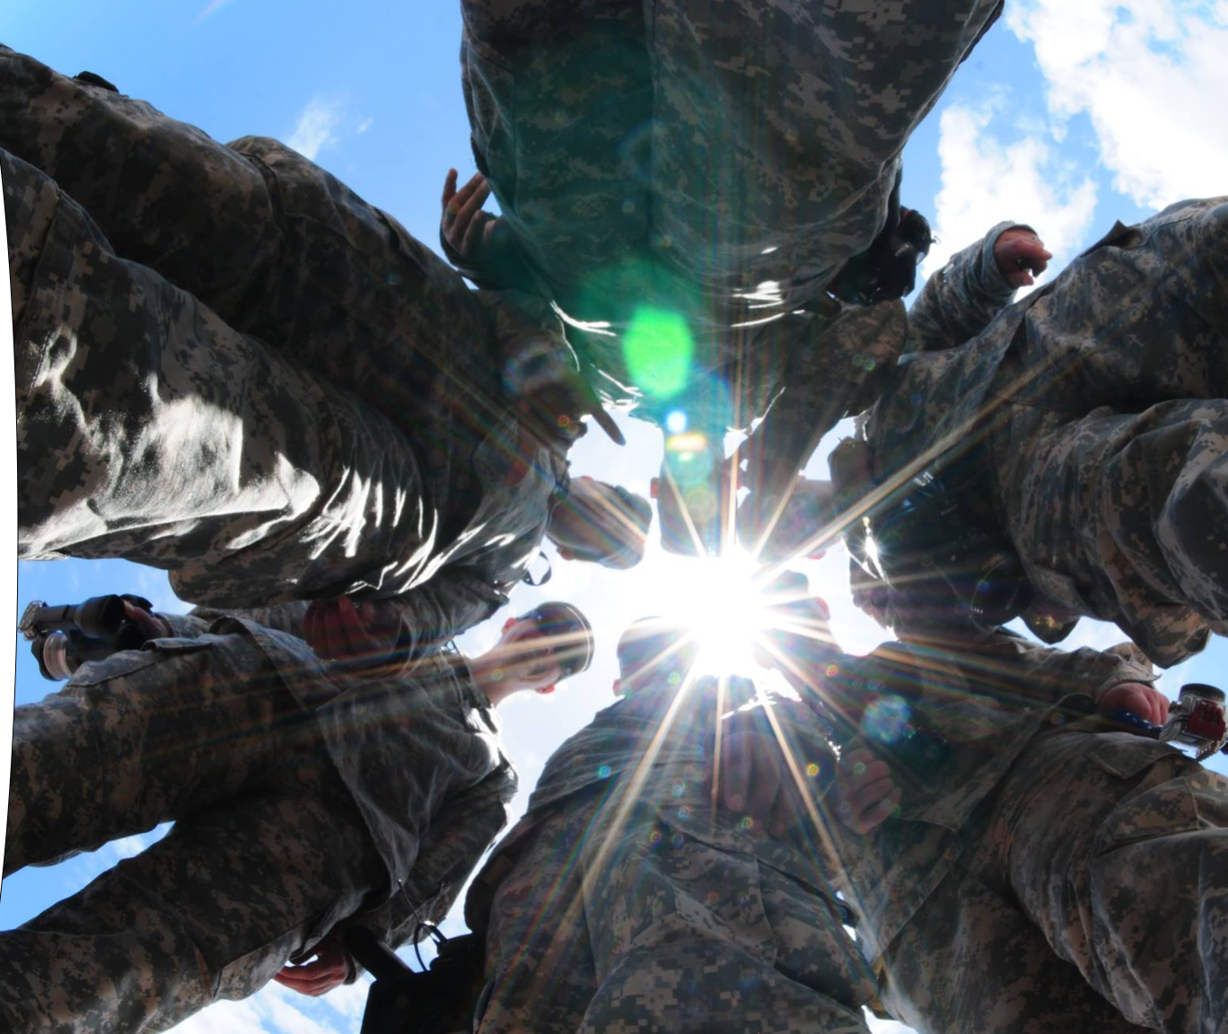
TAKE PHOTOS, WRITE CAPTIONS, & GET PUBLISHED
In the beginning
Policy
UPAR Responsibilities
Public Affairs Planning
Public Affairs Liaison
Take Photos, Write Captions, & Get Published
Record Basic Video
Final Notes
The primary function that the State PAO would like every UPAR to do is to take a good photo, write a caption for it and then get it to the next PA echelon.
Page 23
Take Photos, Write Captions, & Get Published / Basic UPAR Training

Slide 25
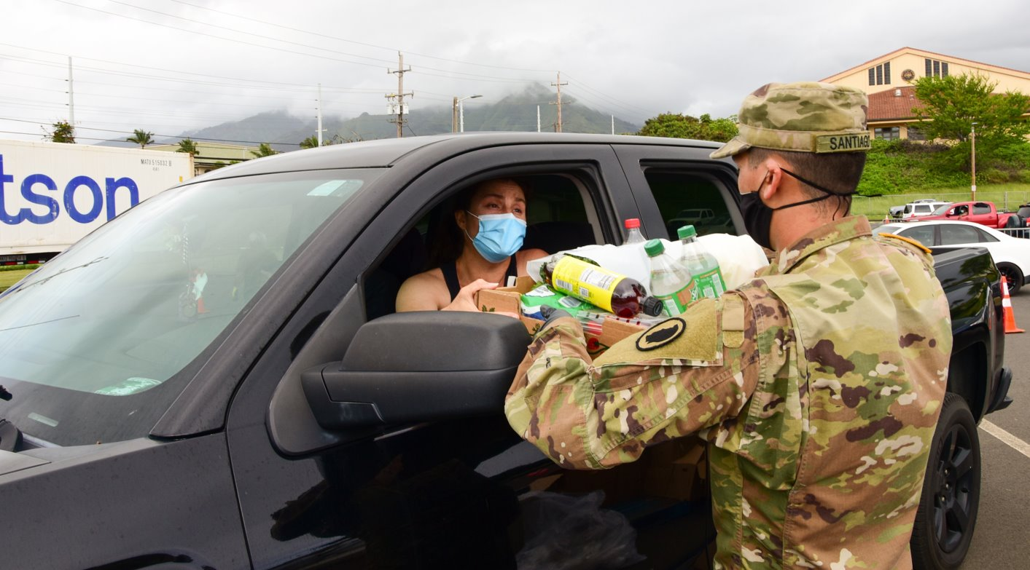
TAKE PHOTOS
Page 24
Take Photos, Write Captions, & Get Published / Basic UPAR Training

Slide 26
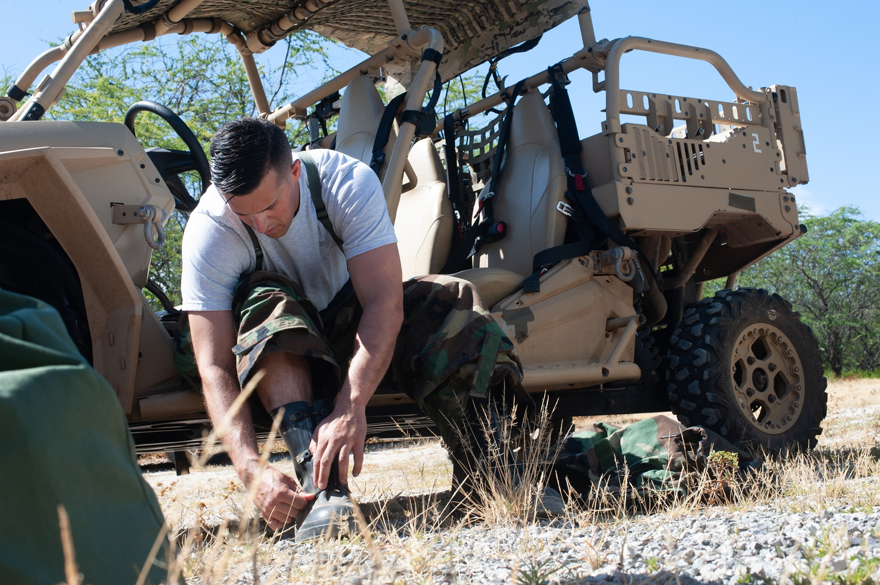
Photos
Action Begin shooting before the subject starts moving through the scene.
“Faces and Patches”
Less “Shaka” photos
Catch subject doing something, not looking at camera
Less pics at desks
Page 25
Take Photos, Write Captions, & Get Published / Basic UPAR Training

Slide 27
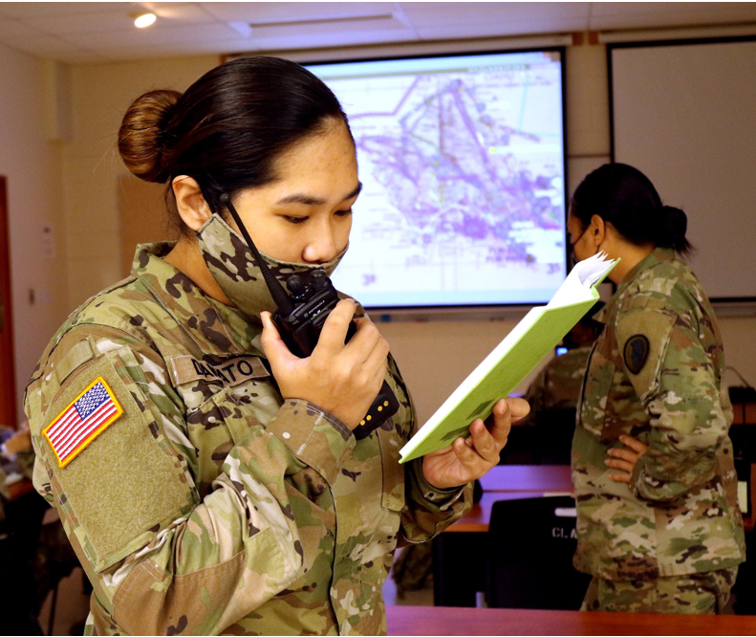
Photos – Things to Look For
What is in the background?
Is everyone in proper uniform? No Badges.
Proper PPE
Hands in pockets
Not to standard- injured, belly hanging out, non-reg hair, pens, tilted hat
Eyes closed; mouth open
Page 26
Take Photos, Write Captions, & Get Published / Basic UPAR Training

Slide 28
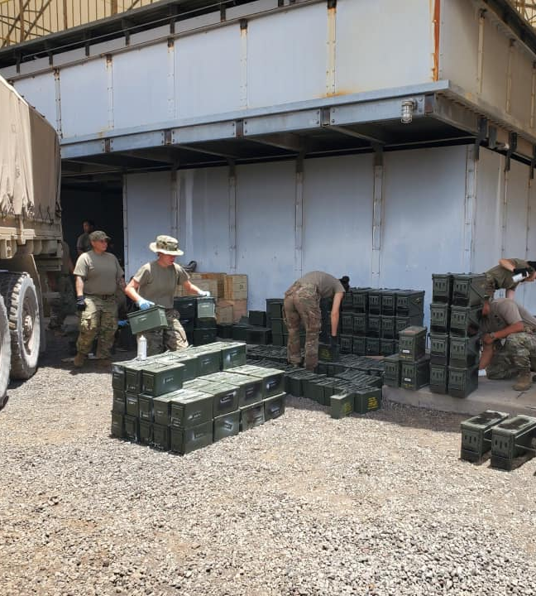
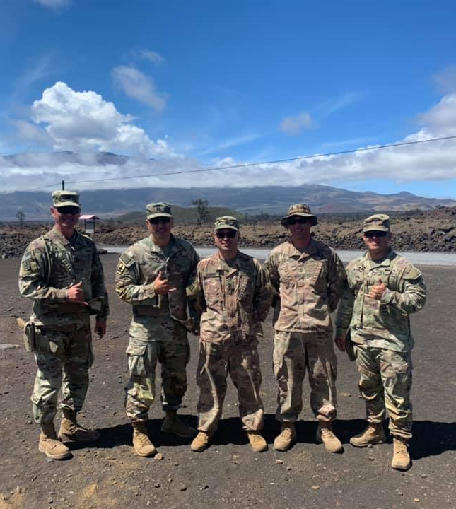
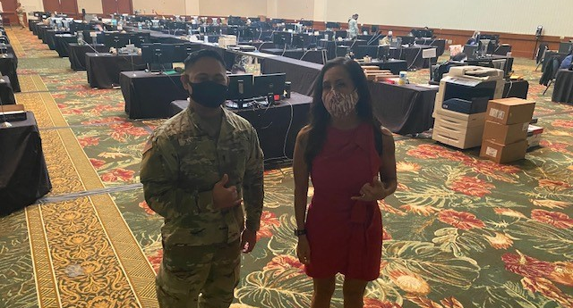
More to Look For
Backlit subjects
Shadows on face
“Photo bombers”
No faces, but butts and backs
Cigarettes/ vapes, phones in hands
Muzzle awareness
OSHA violations- safety
Product endorsement
Middle fingers (it happens!)
Page 27
Take Photos, Write Captions, & Get Published / Basic UPAR Training

Slide 29

Taking Pictures with Your Smart Phone
Get close to the action, but do not interfere, restrict movement, or compromise safety
  Do a practice run
Focus on your subject tap the screen
Don’t stop shooting
  Burst mode
  Review your photos after the event
Prepare ahead of time battery life & storage space (Be at rehearsals)
Page 28
Take Photos, Write Captions, & Get Published / Basic UPAR Training

Slide 30
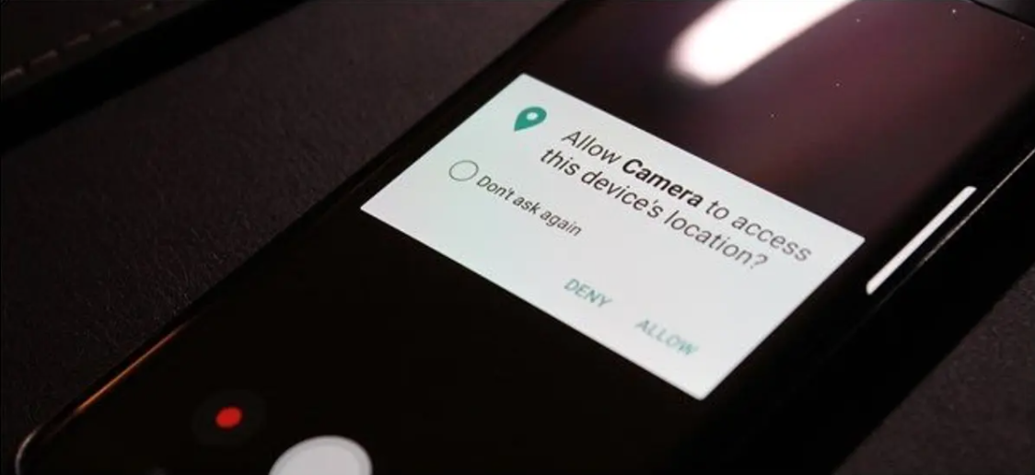
Smartphone Tips
Turn off GEO Tagging on your phone
High Dynamic Range- setting to help with low light
Turn off the camera sound
Helpful hint: airplane mode
Page 29
Take Photos, Write Captions, & Get Published / Basic UPAR Training
Notes:
HDR settings: (High Dynamic Range), HDR photo is created by balancing the shadows and highlights of an image so that neither is being favored or ignored

Slide 31


Rule of Thirds
Place your subject in the cross hairs for a more “balanced” photo
If your subject is moving, leave empty room to move in and out of the frame.
Page 30
Take Photos, Write Captions, & Get Published / Basic UPAR Training

Slide 32

Enable Gridline on Your Smart Phone
IOS
Setting
Camera
Under composition
  Switch on grid
Android
Camera
Setting
Switch on grid lines
Page 31
Take Photos, Write Captions, & Get Published / Basic UPAR Training

Slide 33

Photos – Using Angles
Eye level
Top view
High angle
Framed view / Hidden view
Low angle
Off-center
Action
Static shot
Focal Point
Candid
Posed
Page 32
Take Photos, Write Captions, & Get Published / Basic UPAR Training

Slide 34
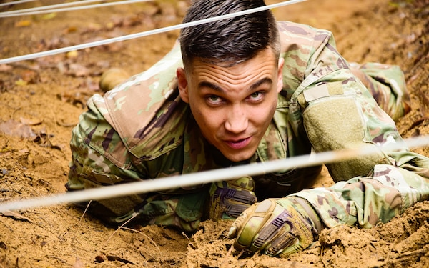
Eye Level
Page 33
Take Photos, Write Captions, & Get Published / Basic UPAR Training
Notes:
Eye Level: camera / smartphone is placed at the same height as the eyes of the subject in your frame

Slide 35
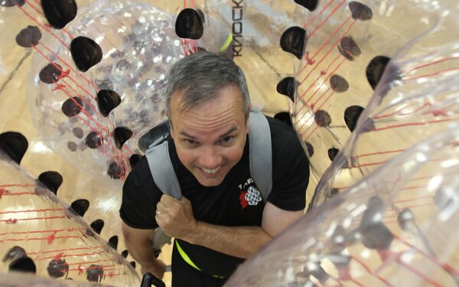
Top View
Page 34
Take Photos, Write Captions, & Get Published / Basic UPAR Training
Notes:
Top Angle: where the smartphone looks down on the subject

Slide 36
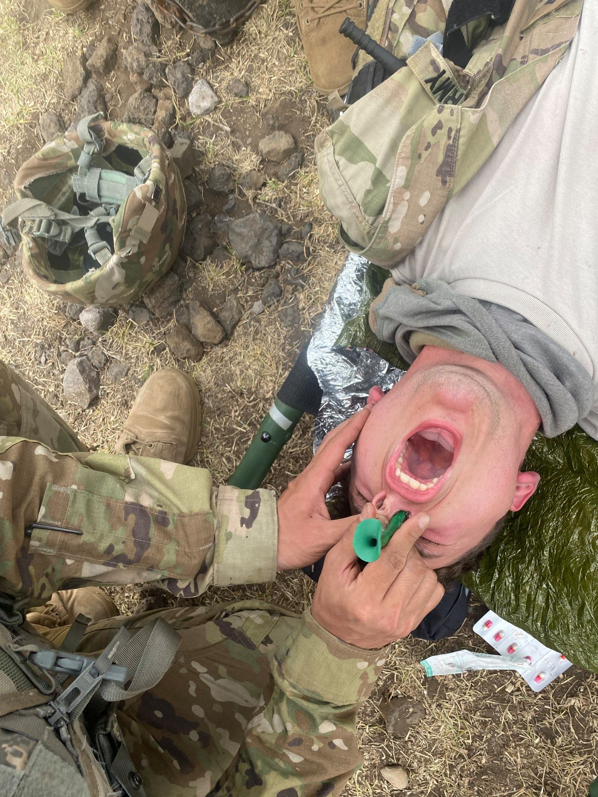
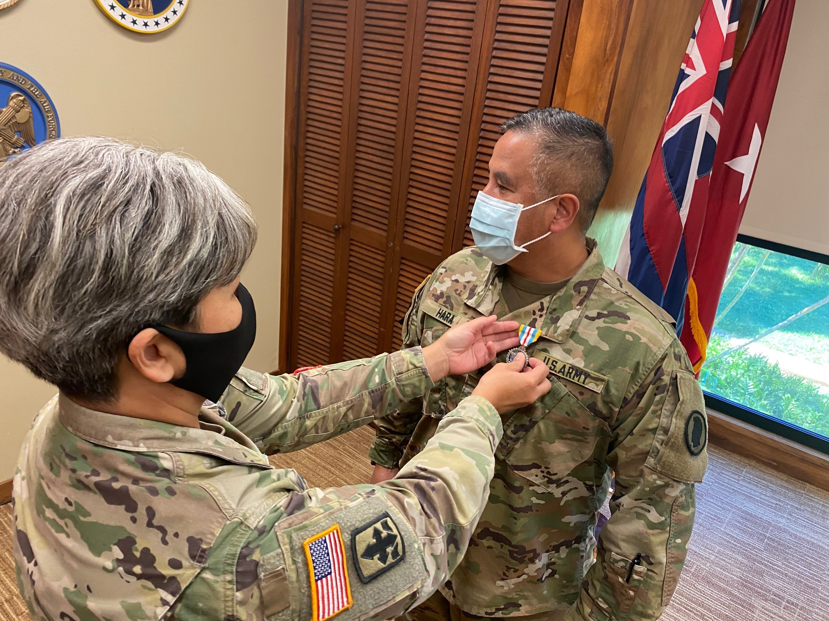
High Angle
Page 35
Take Photos, Write Captions, & Get Published / Basic UPAR Training
Notes:
A high-angle shot: placing the smartphone high about your head angled down on your subject. Similar to a top angle

Slide 37
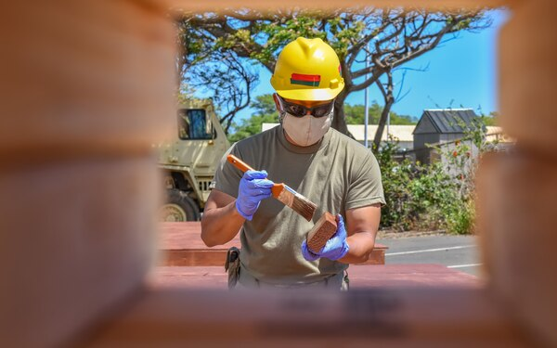
Framed/Hidden View
Page 36
Take Photos, Write Captions, & Get Published / Basic UPAR Training
Notes:
Framed / Hidden View: can be set and framed in any shot size you like, just as long as there is only one character featured within the frame

Slide 38
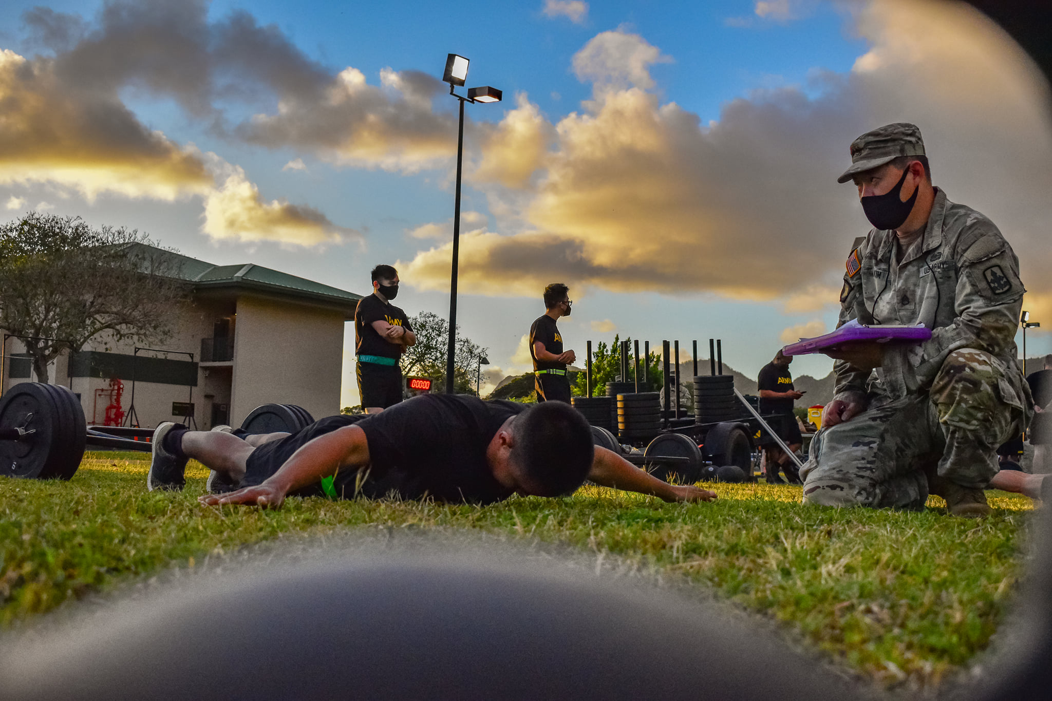
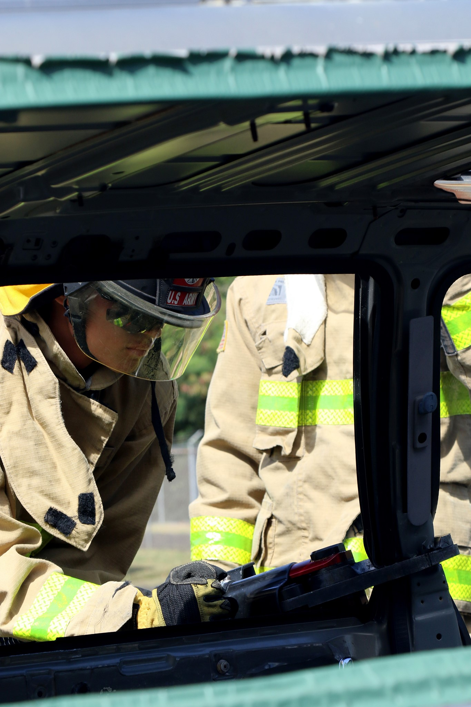
Framed/Hidden View
Page 37
Take Photos, Write Captions, & Get Published / Basic UPAR Training
Notes:
Framed / Hidden View: can be set and framed in any shot size you like, just as long as there is only one character featured within the frame

Slide 39
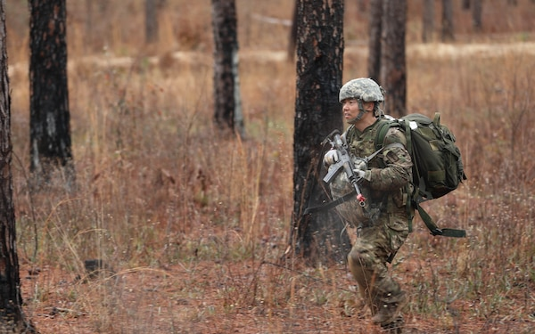
Off-Center
Page 38
Take Photos, Write Captions, & Get Published / Basic UPAR Training
Notes:
Space in front of the subject

Slide 40
Off-Center
Page 39
Take Photos, Write Captions, & Get Published / Basic UPAR Training
Notes:
Space in front of the subject

Slide 41
Off-Center Cropped
Page 40
Take Photos, Write Captions, & Get Published / Basic UPAR Training
Notes:
Do not crop an off-center picture. It takes away interest in picture and looks odd

Slide 42
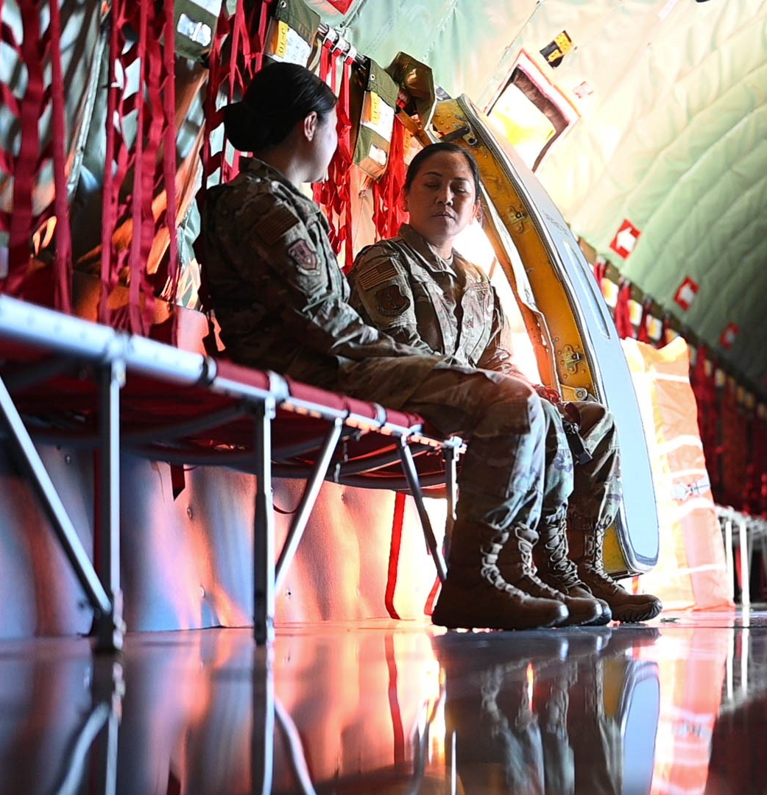
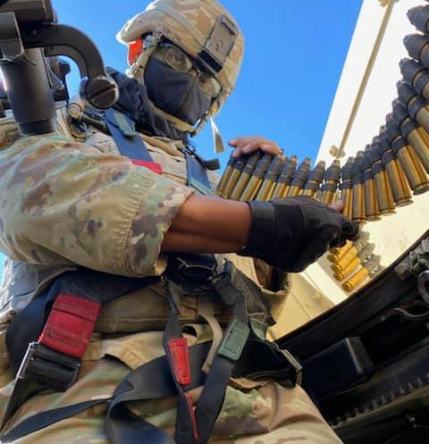

Low Angle
Page 41
Take Photos, Write Captions, & Get Published / Basic UPAR Training
Notes:
Low Angle: conveys a number of emotions or feelings about the subject in the frame, it gives them power
You can get low, or you can just hold the camera low

Slide 43
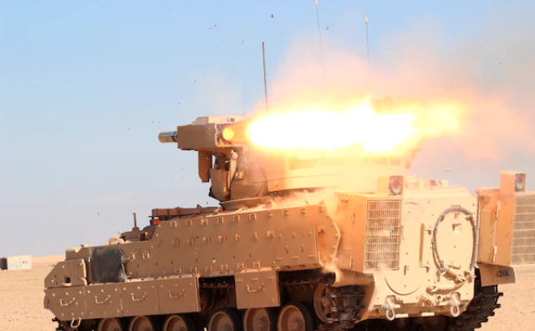
Action
Page 42
Take Photos, Write Captions, & Get Published / Basic UPAR Training

Slide 44
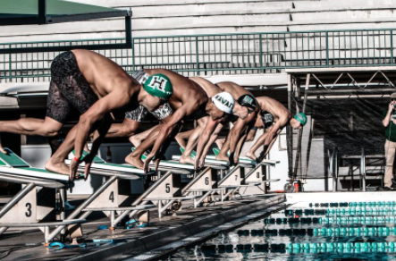
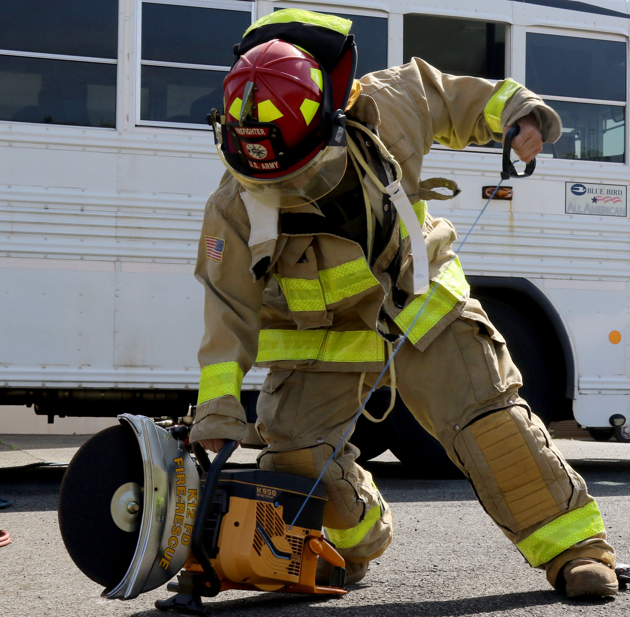
Action
Page 43
Take Photos, Write Captions, & Get Published / Basic UPAR Training

Slide 45
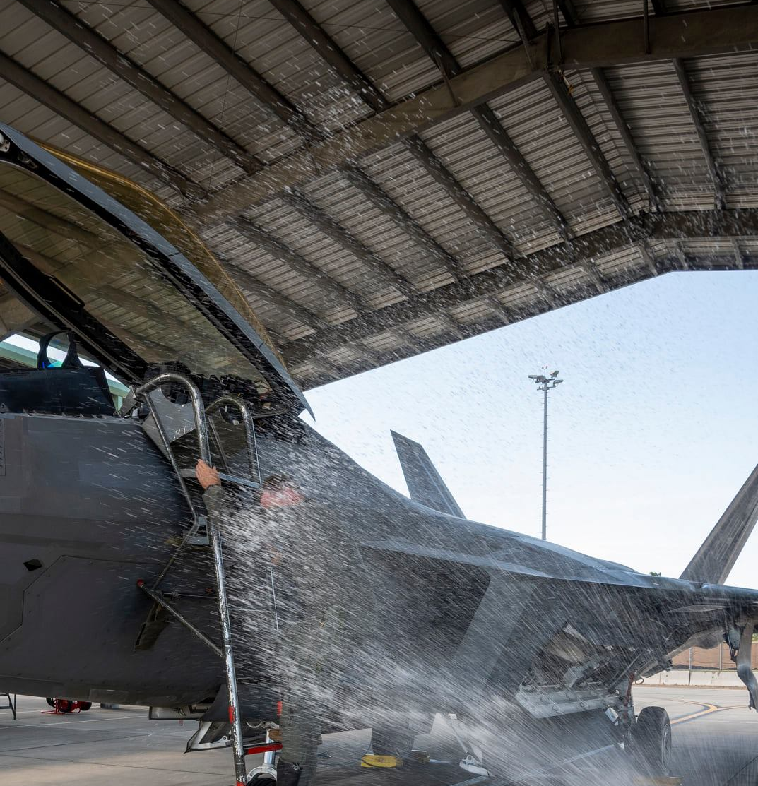
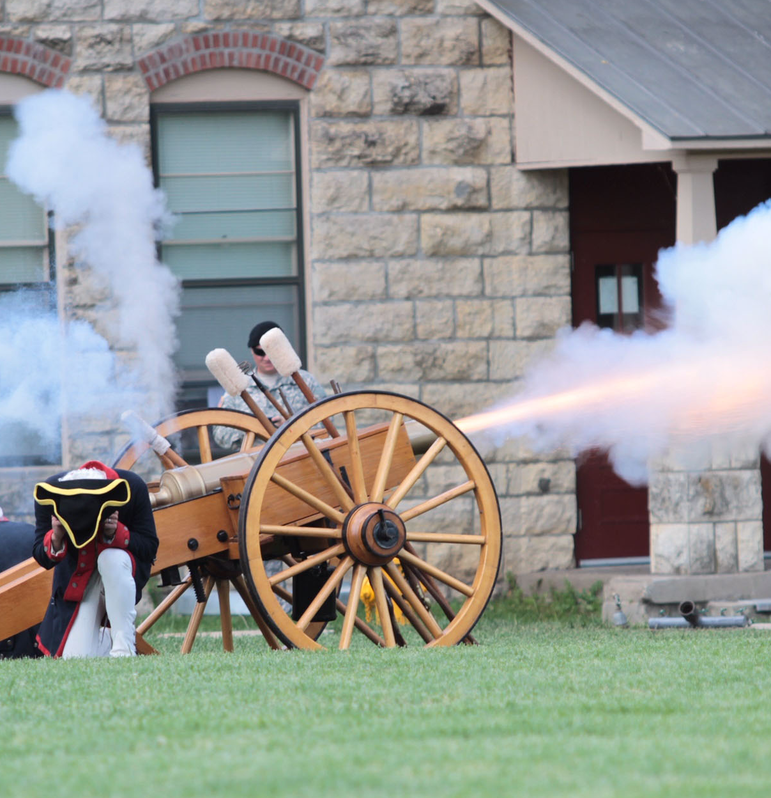
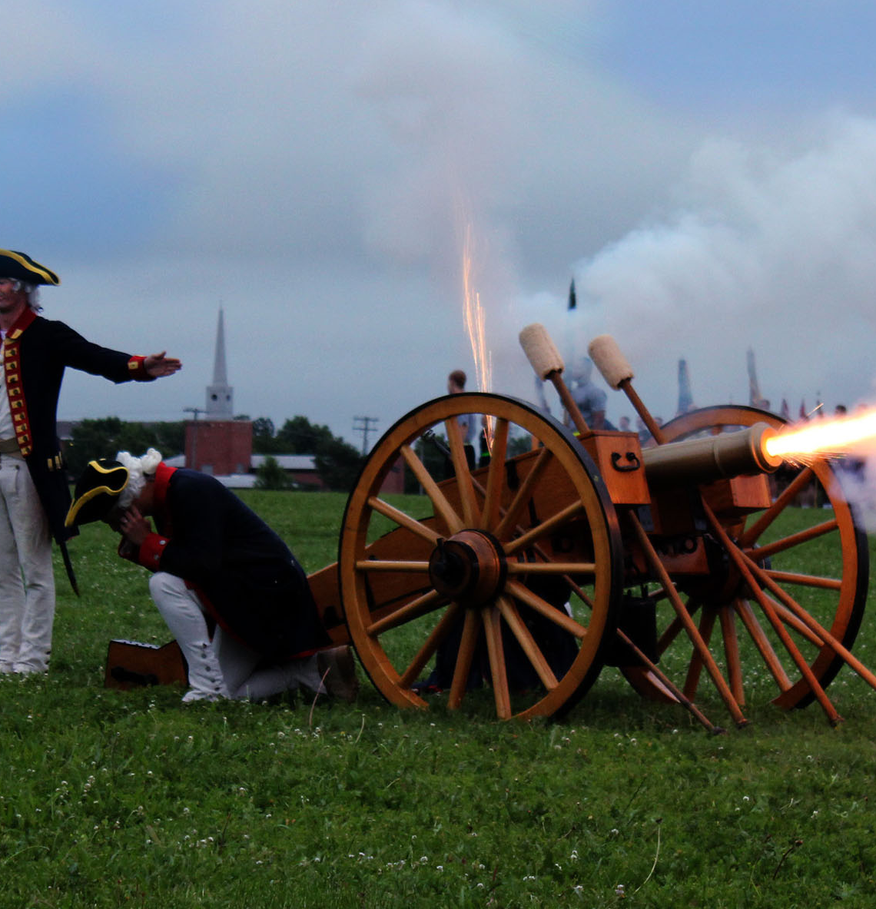
Action
Page 44
Take Photos, Write Captions, & Get Published / Basic UPAR Training

Slide 46
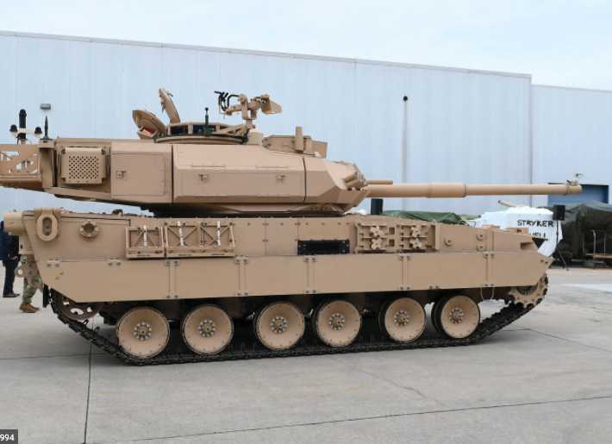
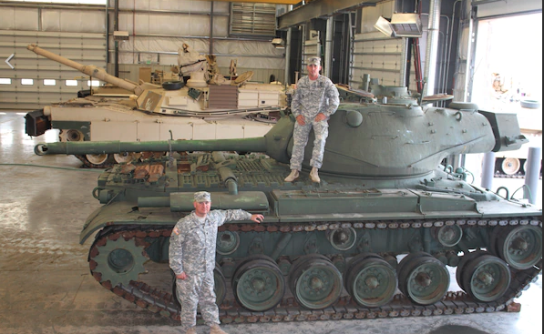
Static Shots
Page 45
Take Photos, Write Captions, & Get Published / Basic UPAR Training

Slide 47
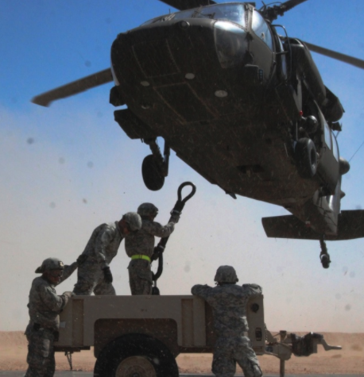
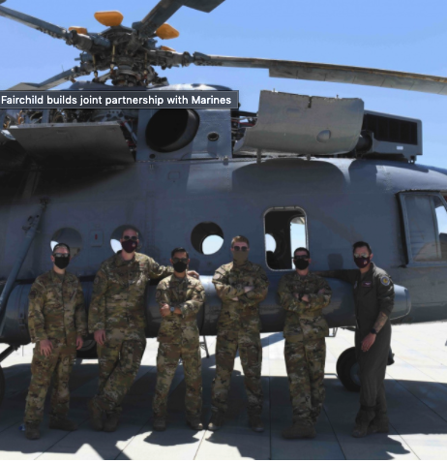
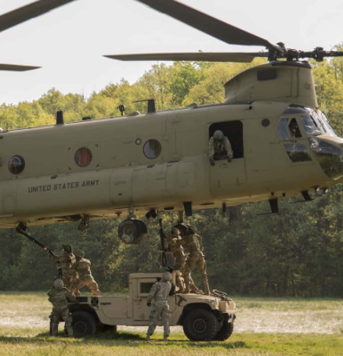
Helicopters and Other Cool Stuff
Page 46
Take Photos, Write Captions, & Get Published / Basic UPAR Training

Slide 48
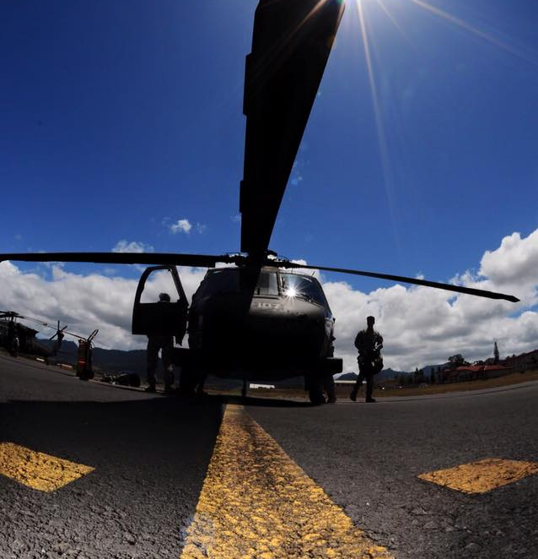
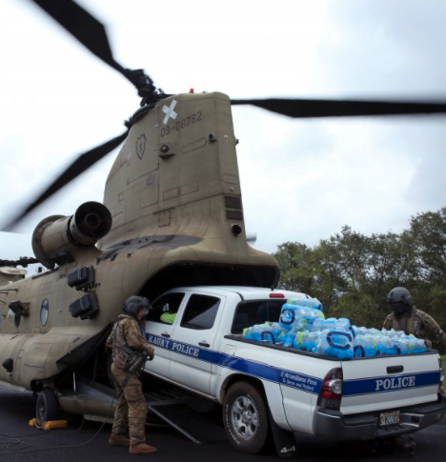
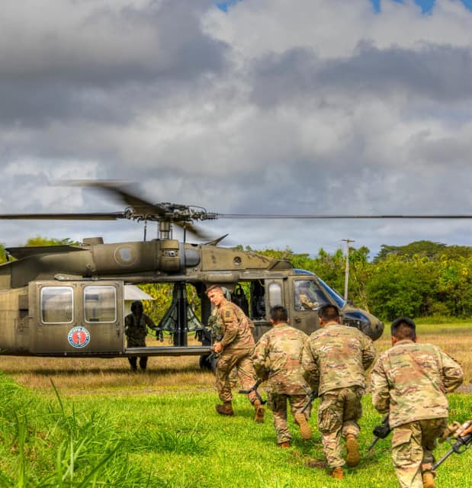
“Good” Helicopter Shots
Page 47
Take Photos, Write Captions, & Get Published / Basic UPAR Training

Slide 49
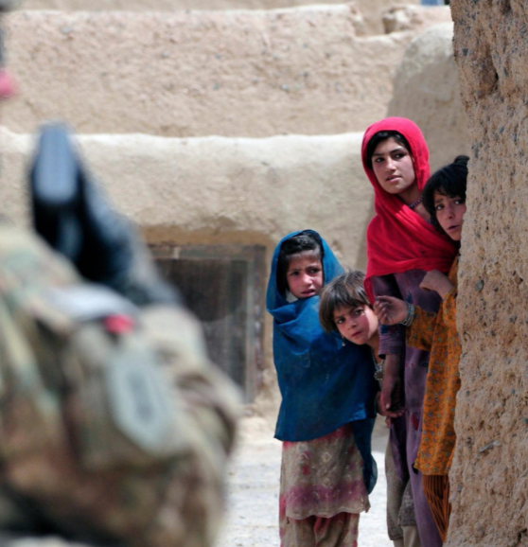
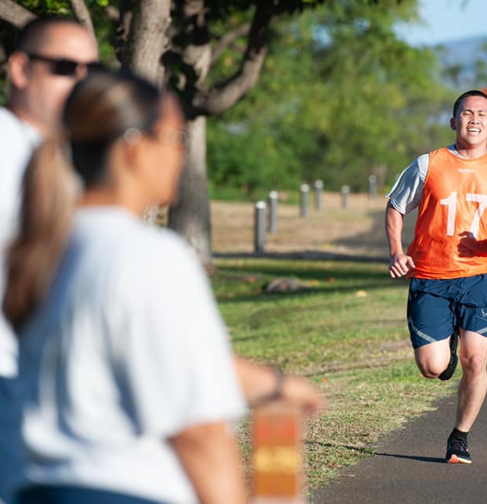
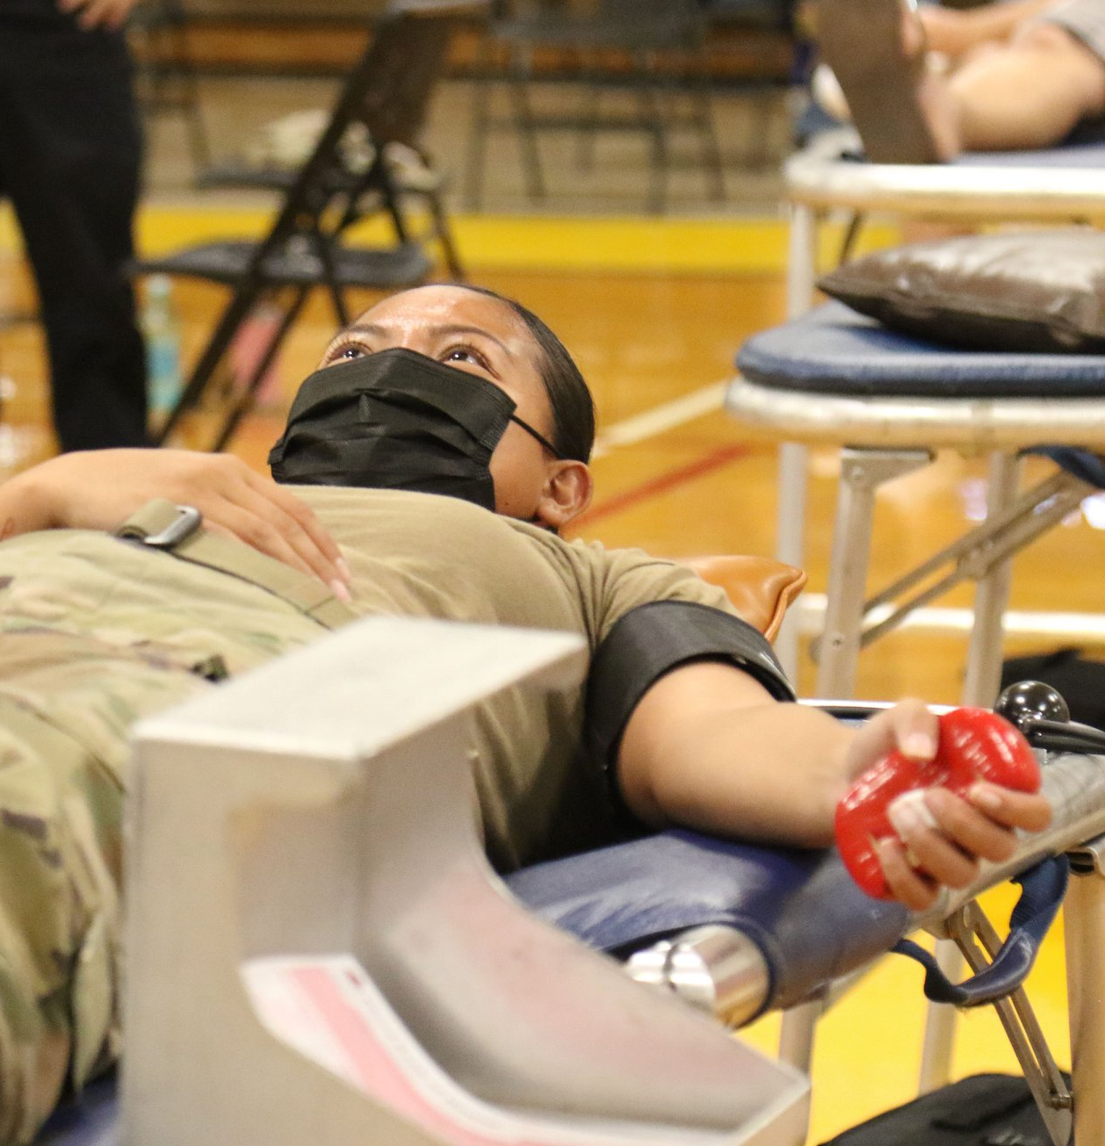
Focal Point
Page 48
Take Photos, Write Captions, & Get Published / Basic UPAR Training

Slide 50
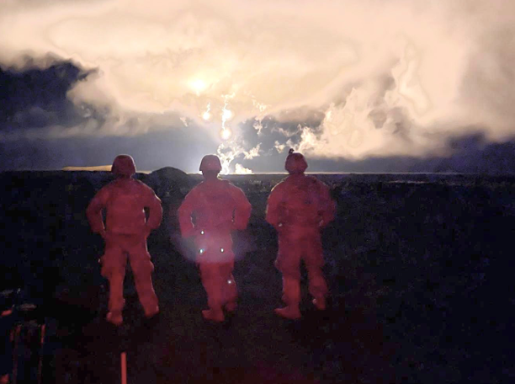
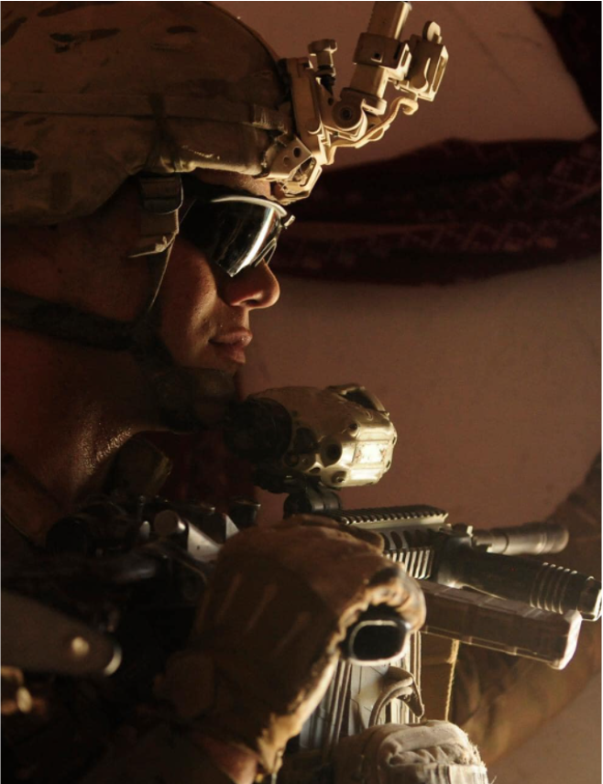

Lighting
Page 49
Take Photos, Write Captions, & Get Published / Basic UPAR Training

Slide 51
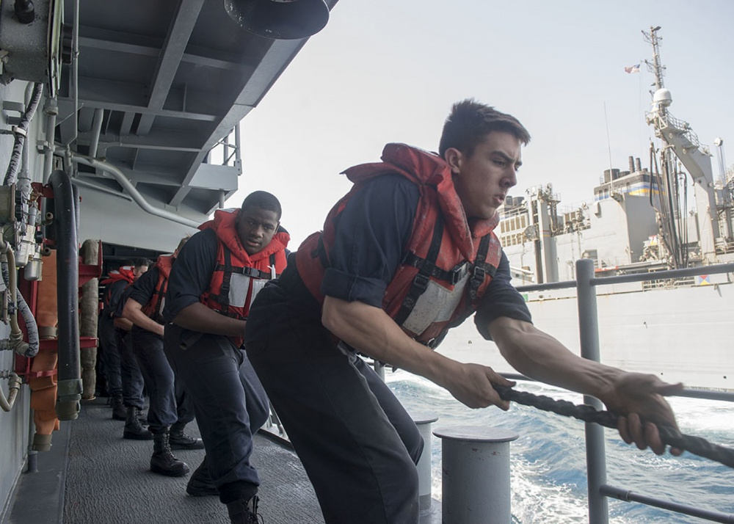

People in Motion
Page 50
Take Photos, Write Captions, & Get Published / Basic UPAR Training

Slide 52



Ceremonies
Page 51
Take Photos, Write Captions, & Get Published / Basic UPAR Training
Notes:
Rehearsals, you move around action, expected “money shots” that should be captured, easy to get up close, you know where action will be
Other- equipment, formations, PT, office, field….more challenging, shoot plenty, review later, find the good nuggets, action and posed shots will be

Slide 53

Key Moments to Capture
Reenlistment
Oath of office
Promotion
Pinning of rank
Change of Command
Incoming and outgoing
Page 52
Take Photos, Write Captions, & Get Published / Basic UPAR Training
Notes:
Remember that there are people behind you- ceremonies
Don’t photo-bomb other photogs or videographer- ceremonies

Slide 54


Candid
Page 53
Take Photos, Write Captions, & Get Published / Basic UPAR Training
Notes:
Hands in pockets, proper PPE, eyes open, body language is positive, don’t make subjects look bad
Candid vs posed
Focus on the face- without any context or background scenery, a face can express a lot.
It’s also constantly changing from emotion to emotion, giving you an endless source of interesting shots
A prime spot to look for candid photos is in a group or pair of people

Slide 55


Posed
Page 54
Take Photos, Write Captions, & Get Published / Basic UPAR Training
Notes:
Posed Award or promotion ceremony.
Get Close and Watch Your Subjects Without Being Noticed
Turn off the Flash to Stay Discreet
Move Around Your Subjects for Better Composition
Shoot in Burst Mode to Capture Every Moment

Slide 56


(Good) Posed
Page 55
Take Photos, Write Captions, & Get Published / Basic UPAR Training
Notes:
Even you need to take a posed shot, look for interesting backgrounds, use low or high angle to take the shot. Be creative.

Slide 57

(Good) Posed
Page 56
Take Photos, Write Captions, & Get Published / Basic UPAR Training
Notes:
Find something interesting in the background, it does not need to be in focus, but it should add context to the shot.

Slide 58


What NOT to Do
Page 57
Take Photos, Write Captions, & Get Published / Basic UPAR Training
Notes:
Promotion on left- she has a puppet on her hand while taking the oath of office. Big no go! And she was a PAO.
Dude on right is all kinds of wrong. I don’t know what status he is, I don’t know if he knew either.

Slide 59



What NOT to Do
Page 58
Take Photos, Write Captions, & Get Published / Basic UPAR Training
Notes:
PPE- masks not covering nose
Background- OPSEC, maps or lists or statuses of equipment
Tonguing a POW sign
Jumping out of airplane with a fish, then taking a pic of it. Dumb.
People like flipping the camera off at the end of a course. Please don’t do this.

Slide 60




A Series of Photos Can Tell a Story
Establishing Shot
Long Shot
Medium Shot
Close-up
Extreme Close-up
Vary the angle and the distance
Page 59
Take Photos, Write Captions, & Get Published / Basic UPAR Training
Notes:
Establishing Shot: lets the audience know the setting for the scene they're about to watch
Long Shot: a view of a scene
Medium Shot: is a shot that frames the subject from just above their head down to about midway on their torso.
Close-up: faces
Extreme Close-up: hands on an instrument or turning a wrench

Slide 61
Practical Exercise
Get up for a moment and stretch
Now l want everyone to take about five minutes take a few pictures of…
Page 60
Take Photos, Write Captions, & Get Published / Basic UPAR Training

Slide 62
Break!
Page 61

Slide 63

WRITE CAPTIONS
Page 62
Take Photos, Write Captions, & Get Published / Basic UPAR Training

Slide 64
Captions
Tell the story behind the photograph
Be short and clear
1-3 Sentences
Influence picture meaning
Complements the pic by relating to non-visual senses
Explain technical information
Page 63
Take Photos, Write Captions, & Get Published / Basic UPAR Training
Notes:
An explanation of what is going on in a photograph and why it is important to the audience.
If possible include command messages

Slide 65
Element of a Basic Caption
Who?
  Full ID (Rank, Name, Unit and MOS) If less than three people in photo
What?
When?
Where?
Why?
Photo credit (byline)
Page 64
Take Photos, Write Captions, & Get Published / Basic UPAR Training

Slide 66

The Five W’s
WHO is in the photo? WHO is the subject of the photo?
WHAT is in the photo? WHAT is the action taking place?
WHEN is the action taking place? (date, training event)
WHERE is the action taking place? (geographic location)
WHY is the action taking place? WHY does it matter?
If possible, explain the HOW?
Page 65
Take Photos, Write Captions, & Get Published / Basic UPAR Training

Slide 67

Caption
U.S. Army Sgt. 1st Class Bryan T. Hinkle, a flight paramedic, and Sgt. Curtis Wright, a HH-60 Black Hawk helicopter repairer and crew chief assigned to Detachment 1, Golf Company, 3rd Battalion, 126th Aviation Regiment, Hawaii Army National Guard, prepare a simulated patient for litter transport from a HH-60 Black Hawk helicopter by medical technicians from the 908th and 911th Aeromedical Staging Squadrons during Exercise NEXUS FORGE at Schofield Barracks, Hawaii, Feb. 6, 2025. NEXUS FORGE allows participants to experience the full depth of tactical combat casualty care and deployment process, ensuring wartime combat readiness. (U.S. Army National Guard photo by Staff Sgt. Lianne M. Hirano)
Page 66
Take Photos, Write Captions, & Get Published / Basic UPAR Training

Slide 68

Caption
U.S. Air Force Senior Master Sgt. Wilda Morita, 154th Maintenance Operations Squadron senior enlisted leader, waves from the backseat of a 173rd Fighter Wing F-15 Eagle April 15, 2025, at Joint Base Pearl Harbor-Hickam, Hawaii. During Exercise Sentry Aloha, Morita experienced an incentive flight, accommodated by visiting F-15 personnel, to gain firsthand insight into the challenges fighter pilots face, whose missions are supported by her critical work in the Maintenance Operations Flight. (U.S. Air National Guard photo by Senior Master Sgt. Mysti Bicoy)
Page 67
Take Photos, Write Captions, & Get Published / Basic UPAR Training

Slide 69

Caption
Rotary Wing aviators from the Hawai‘i Army National Guard (HIARNG) and the Armed Forces of the Philippines (AFP) held a key leader engagement on ‘Oahu during the first week of March 2025. The engagement included 103rd Troop Command Commander Col. Phoebe Inigo, State Army Aviation Officer Lt. Col. Deanna Manriquez, Philippine Air Force 205th Tactical Helicopter Wing Commander Brig. Gen. Alvin Hate and select members of their respective staffs. (U.S. Army National Guard photo by Master Sgt. Andrew Jackson)
Page 68
Take Photos, Write Captions, & Get Published / Basic UPAR Training

Slide 70

Practical Exercise
Write a caption for this picture:
breaching exercise - demolitions and different explosive charge assembly and breaching methods
Spc. Sean McKee, a combat engineer
A Co., 227th BEB, 29th IBCT
unravels detonation cord
Schofield Barracks
March 2, 2025
trained alongside Reserve Soldiers
Page 69
Take Photos, Write Captions, & Get Published / Basic UPAR Training

Slide 71
Practical Exercise - Caption
U.S. Army Spc. Sean McKee, a combat engineer assigned to Alpha Company, 227th Brigade Engineer Battalion, 29th Infantry Brigade Combat Team, Hawaii Army National Guard (HIARNG), unravels detonation cord during a breaching exercise on Schofield Barracks, Hawaii, March 2, 2025. HIARNG’s engineers trained alongside U.S. Army Reserve Soldiers on demolitions and different explosive charge assembly and breaching methods to enhance the unit’s readiness and warfighting capabilities while showcasing their lethality to distinguished leaders observing the training. (U.S. Army National Guard photo by Staff Sgt. John Schoebel)
Page 70
Take Photos, Write Captions, & Get Published / Basic UPAR Training

Slide 72
Convention of Writing English
Proper Nouns
Word usage: their/they’re/there, your/you’re, its/it’s
Proper punctuation
Numbers: spell out 1-9, use numerals for the rest
Avoid passive voice (describing action)
  Active: U.S. Soldiers destroy confiscated ordnance.
  Passive: Confiscated ordnance is destroyed by U.S. Soldiers
Does not need to be perfect if sending to PAO. If it is for unit-level release, keep it simple and as perfect as possible.
Page 71
Take Photos, Write Captions, & Get Published / Basic UPAR Training

Slide 73

Practical Exercise
Write a caption for this picture
  (make up names, during the the HIARNG Best Warrior Competition)
Write a caption for this picture:
Page 72
Take Photos, Write Captions, & Get Published / Basic UPAR Training

Slide 74

Practical Exercise - caption
U.S. Army Spc. Joshua Mendiola, a healthcare specialist assigned to Bravo Company, 1109th Theater Aviation Sustainment Maintenance Group 103d Troop Command, Hawaii Army National Guard (HIARNG), takes a tactical halt during the HIARNG Best Warrior Competition (BWC) 2025 in Waimanalo, Hawaii, April 4, 2025. The state-level BWC is an annual event held throughout the country by Army National Guard organizations to identify the most skilled and proficient Soldiers, noncommissioned officers and officers within their organization. Hawaii’s winners in the Soldier and noncommissioned officer categories will advance to the Region 7 competition against Arizona, California, Colorado, Guam, Nevada, New Mexico and Utah National Guards. (U.S. Army National Guard photo by Staff Sgt. John Schoebel)
Page 73
Take Photos, Write Captions, & Get Published / Basic UPAR Training

Slide 75

DOD Key Themes
Page 74
Take Photos, Write Captions, & Get Published / Basic UPAR Training

Slide 76

Constructing an Extended Caption
1st: Who, What, Where, When
Present Tense
Describe image in moment captured
2nd: Why
Past Tense
Significant background info
Quote
Command message
  The Hawaii Army National Guard is a community-based organization.
Why does the audience care?
Page 75
Take Photos, Write Captions, & Get Published / Basic UPAR Training

Slide 77

Extended Captions
SAMPLE EXTENDED CAPTIONS
4W’s Sergeant First Class David Earle, an Officer Candidate with the Charlie company 29th Infantry Brigade Combat Team, Hawaii Army National Guard, participates in the stress shoot portion of the 2021 State Best Warrior Competition at Puuloa Rile Range, Ewa Beach, Hawaii April 1, 2021.
Why “The stress shoot pushes Soldiers to zero and qualify with their assigned weapon while placed under physical and mental stress,” said Earle. More than 30 Soldiers of the Hawaii Army National Guard participated in the 2021 Best Warrior Competition March 31-April 3, 2021.
Byline Photo by Spc. Ronald Bankole, 117th Mobile Public Affairs Detachment, Hawaii Army National Guard
Page 76
Take Photos, Write Captions, & Get Published / Basic UPAR Training

Slide 78

Extended Captions
SAMPLE EXTENDED CAPTIONS
4W’s As part of Sexual Assault Awareness & Prevention Month, “Chalk Dah Walk” was held for the first time at Hawai‘i Army National Guard’s (HIARNG) Diamond Head Armory, Bldg. 300 on April 22. The event featured participants drawing and writing messages of hope and encouragement in chalk for sexual assault survivors on the sidewalk.
Why “Events like this are a way for us to let our survivors know that during times when it can feel very lonely, we have people that are here to support them and care about them,” says Edgar Campbell, HIARNG Sexual Assault Response Coordinator. “It’s our way of communicating to people that we don’t always get a chance to talk to.”
Byline Photo by SPC Ruben Duldulao, 117th Mobile Public Affairs Detachment, Hawaii Army National Guard
Page 77
Take Photos, Write Captions, & Get Published / Basic UPAR Training

Slide 79

Practical Exercise
Write an extended caption for this picture:
First time a HIANG Airman Received the Space Force Association Award
Capt. My-Randa Quinata, commander of 109th Electromagnetic Warfare Squadron’s Intelligence Flight
Award for Intelligence operations officers from Guard and Reserve supporting space missions
Award Ceremony December 2024
Photo by Tech. Sgt. John Linzmeier, Hawaii Air National Guard
Page 78
Take Photos, Write Captions, & Get Published / Basic UPAR Training

Slide 80
Practical Exercise – Extended Caption
For the first time, a Hawai‘i Air National Guard (HIANG) Airman, Capt. My-Randa Quinata, commander of the 109th Electromagnetic Warfare Squadron’s Intelligence Flight, has been selected to receive the prestigious Space Force Association Award. Capt. Quinata earned this distinction among intelligence operations officers from Guard and Reserve units supporting space missions nationwide. She was formally recognized for her exceptional contributions during a ceremony in December 2024, where she received the award in front of peers and leaders, marking a historic moment for both the HIANG and the Space Force community. Photo by Tech. Sgt. John Linzmeier, Hawaii Air National Guard
Page 79
Take Photos, Write Captions, & Get Published / Basic UPAR Training

Slide 81

Captions and AI
AI has improved over the years, still not perfect (not replacing humans)
Feed it key details
Ask for multiple versions, adjust tone, edit
  It can be obvious when AI is used
Double check the facts
Good way to get ideas
Page 80
Take Photos, Write Captions, & Get Published / Basic UPAR Training

Slide 82
Captions – Review
Tell the story behind the photograph
Allows the photo to be used by higher PA Element
Could be used to support a story or stand alone
IDs group shots
With a caption, a photo can be used on social media or newsletter.
Remember that for every shot you think is good, a caption is needed.
Captioned photos help (Cdr, Unit, PA)
Don’t forget your byline (“Who are you?”)
Page 81
Take Photos, Write Captions, & Get Published / Basic UPAR Training

Slide 83
Break!
Page 82

Slide 84

Get Published
Page 83
Take Photos, Write Captions, & Get Published / Basic UPAR Training

Slide 85
Approved & Published
The job is not done until your photos and captions are sent to higher PA elements
Consider who has the Release Authority
AT or exercise: higher PA element
Deployment: Bde PAO, then DIV or higher
Page 84
Take Photos, Write Captions, & Get Published / Basic UPAR Training

Slide 86
Approved & Published
What is Level 2 vs Level 3?
Submit 3-5 of your best photos with captions (at least two sentences) to State PAO at least once a quarter (HIRANG Website)
PAO can help get your photos to L4
Levels of Public Affairs
Level 1 | Unit level Example: unit newsletter
Level 2 | MSC’s Example: HIARNG, HIANG, Recruiting, 29th IBCT, 103rd TC, 298th MFTR, social media
Level 3 | Example: TAG, DAG, CSEL social media, HIDOD PowerPoints, Pupupukahi, DVIDS or media releases
Level 4 | Example: Any media outlet (TV, online, newspaper), DOD, NGB, INDOPACOM, Big Army or Big Air Force, USARPAC
Page 85
Take Photos, Write Captions, & Get Published / Basic UPAR Training

Slide 87





L3: Your Photo Can Go Anywhere
HIDOD Newsletter
HIDOD Social Media
DVIDS
Page 86
Take Photos, Write Captions, & Get Published / Basic UPAR Training

Slide 88


L3: HIDOD Pupukahi Newsletter
Page 87
Take Photos, Write Captions, & Get Published / Basic UPAR Training

Slide 89
L3: Social Media – Approved Accounts
Hawaii Army National Guard
  www.facebook.com/HIARNG
  www.instagram.com/hawaiiarmynationalguard
  www.linkedin.com/company/hiarng
Recruiting and Retention Battalion
  www.facebook.com/HawaiiNationalGuard
  www.instagram.com/hi_armynationalguard
29th Infantry Brigade Combat Team:
  www.facebook.com/LavaBrigade/
  www.instagram.com/29thinfantrybrigade/
103d Troop Command:
  www.facebook.com/103DTC/
117th Mobile Public Affairs Detachment
  www.facebook.com/117MPAD/
  www.instagram.com/117mpad/
298th Multi-Functional Training Regiment
  www.facebook.com/298thFRG
Hawaii National Guard Leadership
  www.facebook.com/taghawaii
  www.instagram.com/tagofhawaii
  https://twitter.com/HawaiiTAG
  www.linkedin.com/company/hidod
  www.facebook.com/daghawaii/
  www.facebook.com/cselhawaii
Hawaii Air National Guard
  www.facebook.com/hawaiiairguard
  www.instagram.com/hawaiiairnationalguard/
  www.linkedin.com/company/hiang
Recruiting and Retention
  www.facebook.com/HIANGRecruitingandRetention
  www.instagram.com/hawaiiairguardrecruiting/
Page 88
Take Photos, Write Captions, & Get Published / Basic UPAR Training

Slide 90

L3: Posted on DVIDS, Potential L3 & 4
Page 89
Take Photos, Write Captions, & Get Published / Basic UPAR Training

Slide 91
L4: Your Photo Can Go Anywhere
National Social Media
  Big Army, Big Air, Big NG
Newspaper
TV
Page 90
Take Photos, Write Captions, & Get Published / Basic UPAR Training

Slide 92
Who are the higher PA elements?
State PAO
117th MPAD
154th Wing PAO
Joint Staff PAO
JTF PAO…
  The goal is to get to Level 3
  It can take minutes to days for approval
  Did it get used? You can follow up with State PAO
Page 91
Take Photos, Write Captions, & Get Published / Basic UPAR Training

Slide 93

SHOOTING VIDEO & “B-ROLL”
In the beginning
Policy
UPAR Responsibilities
Public Affairs Planning
Public Affairs Liaison
Take Photos, Write Captions, & Get Publishing
Record Basic Video
Final Notes
Page 92
Record Basic Video / Basic UPAR Training

Slide 94
What is "B-roll"
B-roll is what other organizations can use to make a video news story, the raw footage
If media cannot attend, they rely on HING shooting B-roll of an event
It is advantageous to HING for use to shoot B-roll and then submit to media for possible usage.
Page 93
Record Basic Video / Basic UPAR Training

Slide 95
What is "B-roll"
U.S. Soldiers from Alpha Company, 227th Brigade Engineer Battalion, 29th Infantry Brigade Combat Team, Hawaii Army National Guard (HIARNG) and the Headquarters and Headquarters Company, 411th Engineer Battalion, 303rd Maneuver Enhancement Brigade, 9th Mission Support Command, U.S. Army Reserve conduct intercomponent demolition training on Schofield Barracks, Hawaii, March 2, 2025. HIARNG’s engineers trained alongside U.S. Army Reserve Soldiers on demolitions and different explosive charge assembly methods to enhance the unit’s readiness and warfighting capabilities while showcasing their lethality to distinguished leaders observing the training. (U.S. Army National Guard video by Sgt. Sean Walker)
https://www.dvidshub.net/video/954069/b-roll-hawaii-army-national-guards-combat-engineers-showcase-warfighting-capabilities-with-demolition-training
Page 94
Record Basic Video / Basic UPAR Training

Slide 96
Shooting Video and "B-roll"
Video
can be used as a stand-alone
is ready for publishing
B-roll
a series of videos used by specialist or media
is raw footage that can be edited for a News story
Both: 15 seconds or less
Shoot video using landscape mode
Try to keep it as still as possible
Watch your lighting, (backlit video is the enemy of good video)
Try not to zoom, move your feet
Page 95
Record Basic Video / Basic UPAR Training

Slide 97

Shooting Video and “B-roll”
Vary angles and depth for B-roll
Watch out for “video bombing”
Is the subject worth shooting with video?
When shooting, don’t talk
Review it before sending
Page 96
Record Basic Video / Basic UPAR Training

Slide 98
Practical Exercise
Get up for a moment and stretch
Now l want everyone to take about five minutes take a few Videos of…
Page 97
Record Basic Video / Basic UPAR Training

Slide 99
B-roll “package” should include:
Multiple clips
Establishing shot, medium shots, close-ups
Cut-aways (the interruption of a continuously filmed action by inserting a view of something else)
Establishing Shot
Long Shot
Medium Shot
Close-up
Page 98
Record Basic Video / Basic UPAR Training

Slide 100
ALL PAU!
Wait!
Final Notes
In the beginning
Policy
UPAR Responsibilities
Public Affairs Planning
Public Affairs Liaison
Take Photos, Write Captions, & Get Publishing
Record Basic Video
Final Notes
Page 99
Final Notes/ Basic UPAR Training
Notes:
Have hand out ready and printed
Be sure to have pens for the class to use.

Slide 101
You Are Almost a UPAR
Create a Public Affairs Plan – meet with commander to set goals and create a plan
Public Affairs Liaison – being the POC for all things public affairs
Take Photos, Write Captions and Get Published - #1 job
Record Basic Video – film short clips
Intermediate UPAR Class
5. Media escort and preparation - prepare your unit and assist the media
6. Media relations – understand the media and prepare for interviews
7. Command information – communicating to members of the command
8. Writing the story - news story vs feature story
Page 100
Final Notes/ Basic UPAR Training

Slide 102
Final Word
Remember, if we don’t tell our story, someone else will!
The Army Public Affairs Program (AR 360-1)
  https://armypubs.army.mil/epubs/DR_pubs/DR_a/ARN30105-AR_360-1-000-WEB-1.pdf
Communication Strategy and Public affairs Operations
  https://armypubs.army.mil/epubs/DR_pubs/DR_a/ARN34864-FM_3-61-000-WEB-1.pdf
Army Social Media Handbook
  https://www.army.mil/socialmedia/
Page 101
Final Notes/ Basic UPAR Training

Slide 103

UPAR Resources
Handbook
Slideshow
Submit photos & captions,
Helpful links
DVIDS
Social Media links
Examples
Additional Duty Appointment Sample
https://dod.hawaii.gov/hawaii-national-guard-unit-public-affairs-representative-program/
Page 102
Final Notes/ Basic UPAR Training

Slide 104

Contact
State PAO: (808) 441-7000
Email: Rachel.s.blaire.civ@army.mil, Rachel.s.blaire@hawaii.gov or
dod.pao.all@hawaii.gov
Page 103
Final Notes/ Basic UPAR Training

Slide 105
HIDOD Social Media Class
If you are an admin on your unit's social media page, please contact PAO Information Specialist Ruben Duldulao:
ruben.duldulao@hawaii.gov
(808) 441-7000
30 minute virtual class on social media
Page 104
Final Notes/ Basic UPAR Training

Slide 106

AAR
Page 105
Final Notes/ Basic UPAR Training

